Slide 1
Planning your Technical Services Retreat
Have fun & get stuff done!

Slide 2
Land Acknowledgement
Miami University is located within the traditional homelands of the Myaamia and Shawnee people, who along with other indigenous groups ceded these lands to the United States in the first Treaty of Greenville in 1795. The Miami people, whose name our university carries, were forcibly removed from these homelands in 1846.
In 1972, a relationship between Miami University and the Miami Tribe of Oklahoma began and evolved into a reciprocal partnership, including the creation of the Myaamia Center at Miami University in 2001. The work of the Myaamia Center serves the Miami Tribe community and is dedicated to the revitalization of Miami language and culture and to restoring that knowledge to the Myaamia people.
Miami University and the Miami Tribe are proud of this work and of the more than 140 Myaamia students who have attended Miami since 1991 through the Myaamia Heritage Award Program.

Slide 3

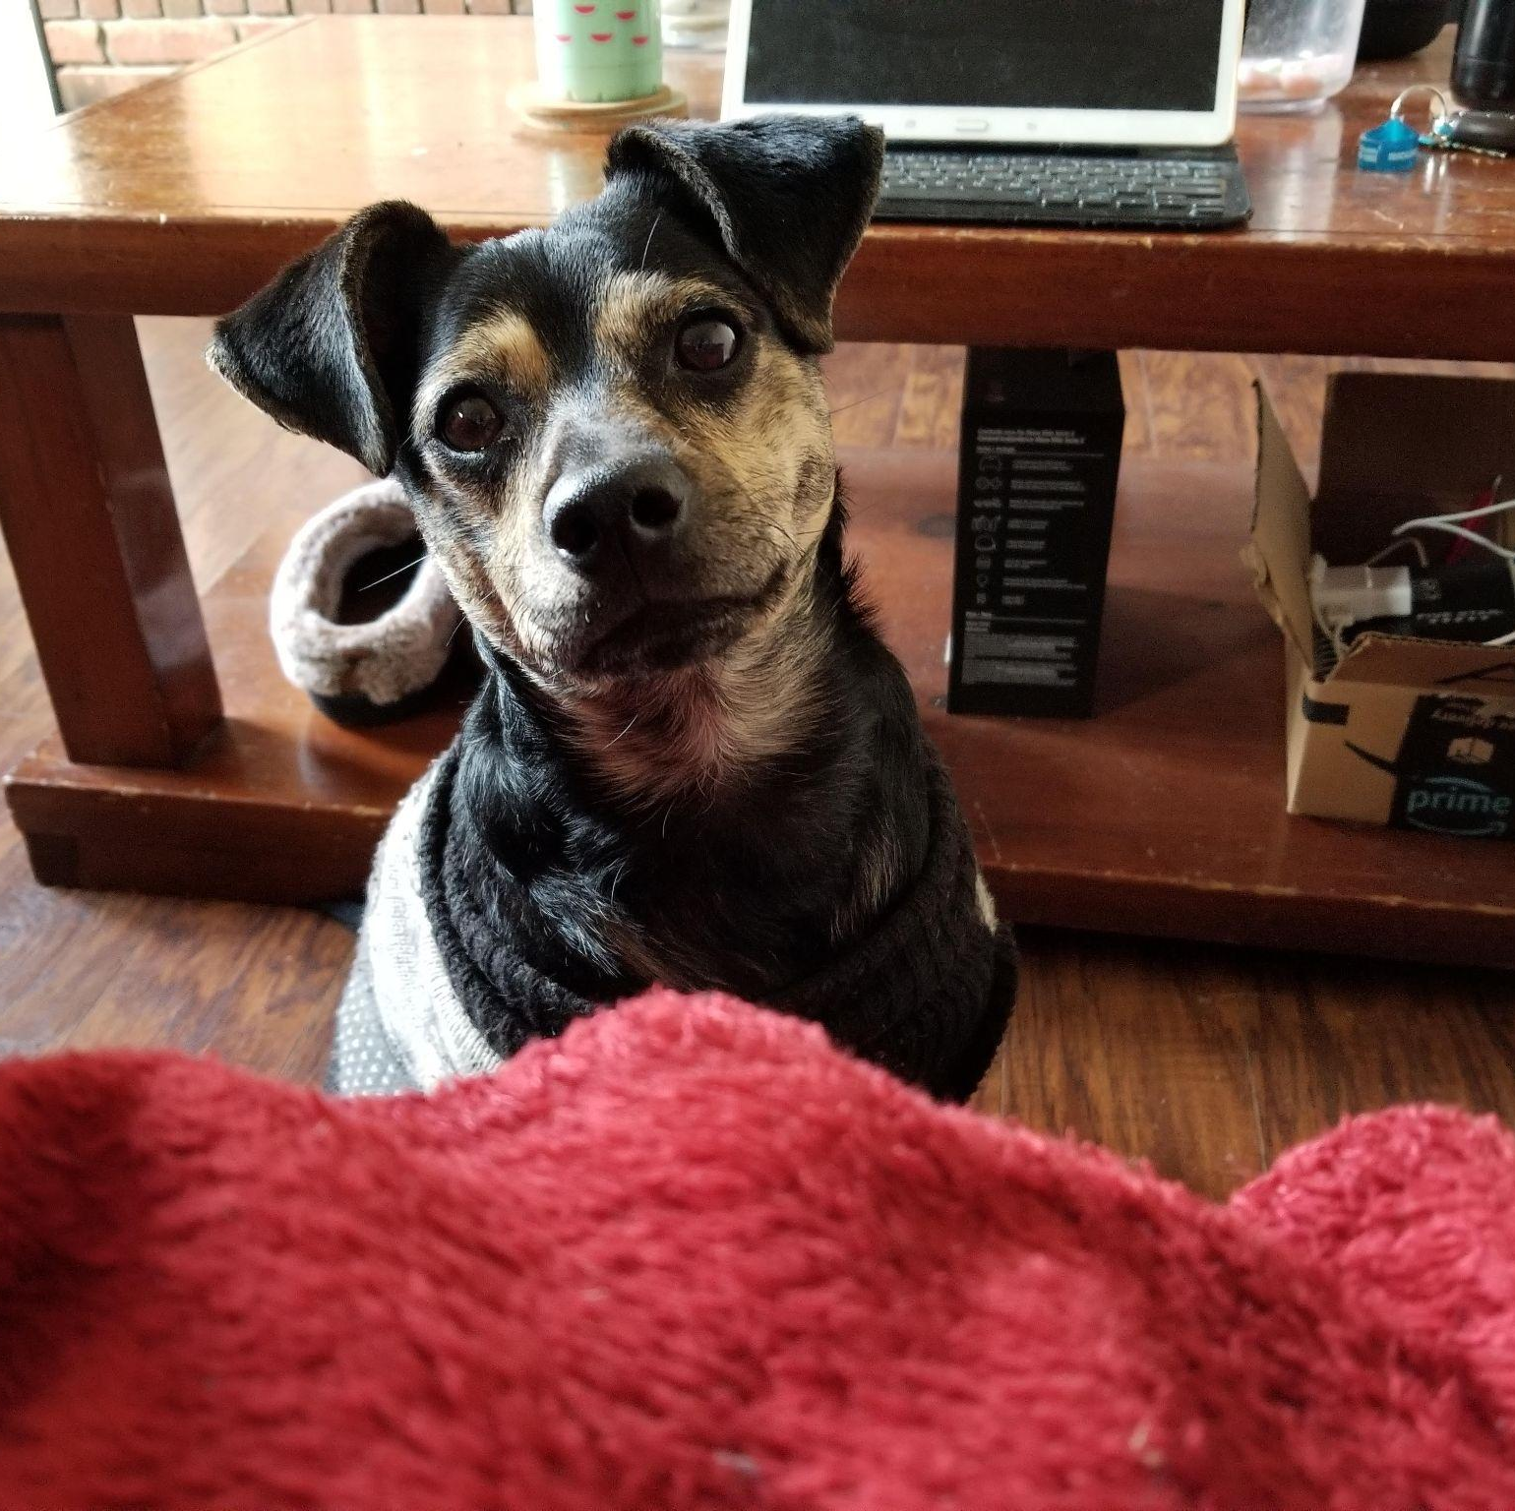

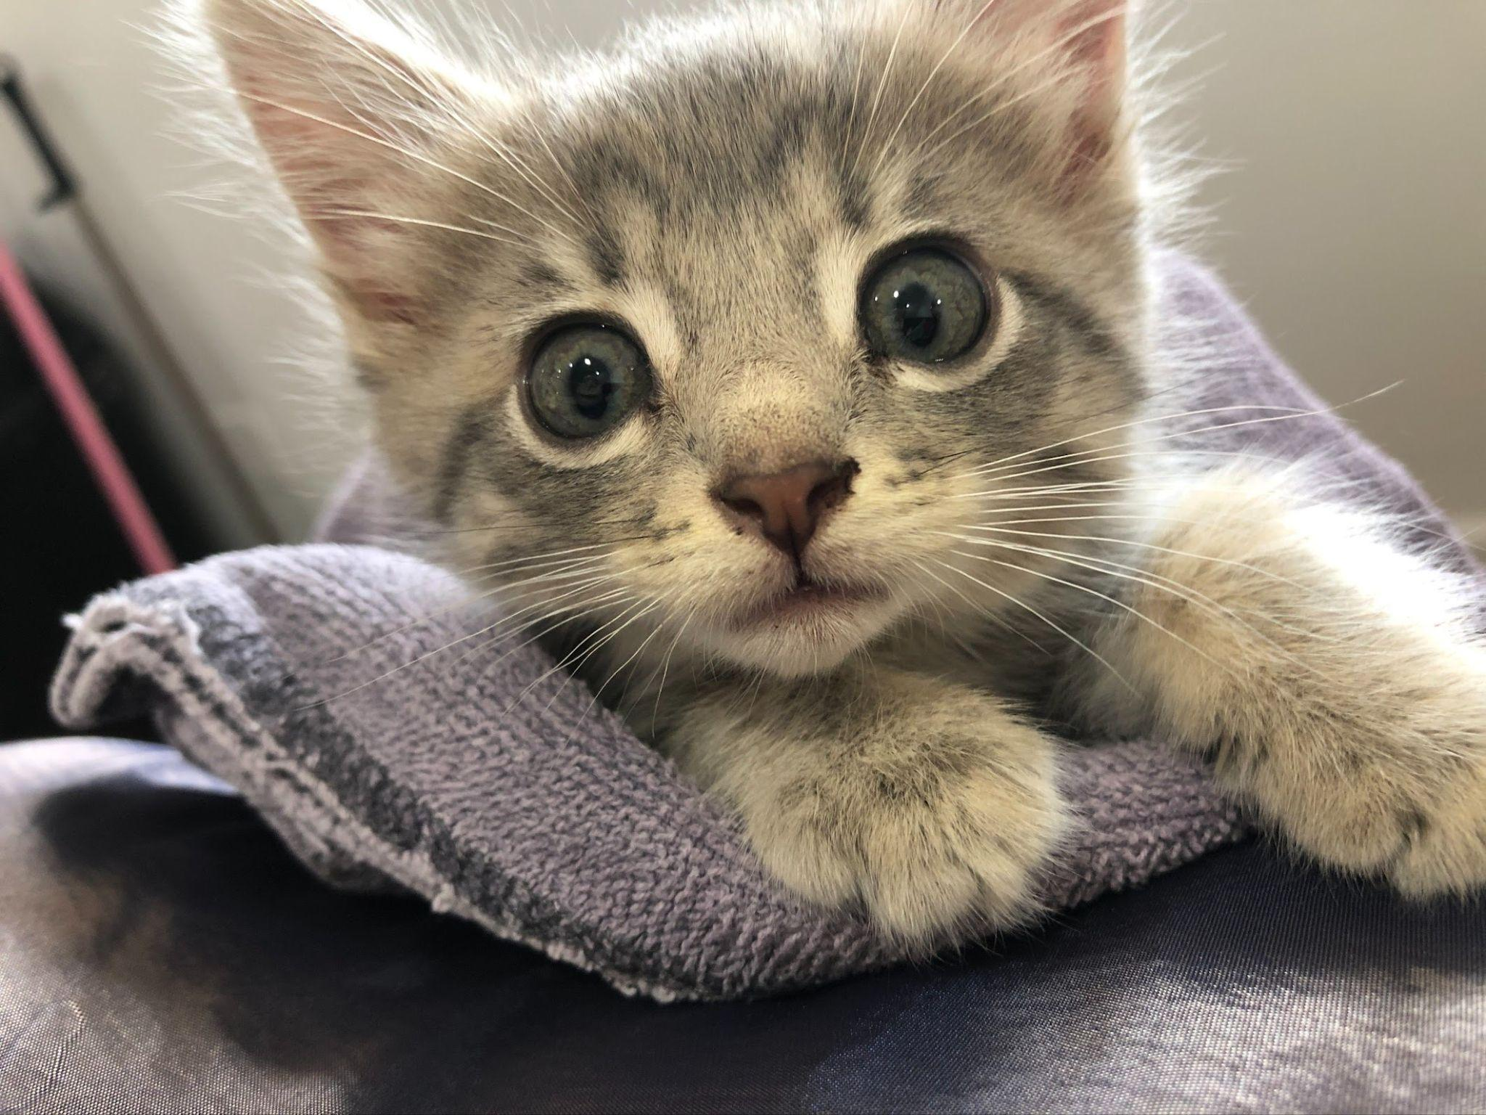
Your Presenters
Cara Calabrese
Sarah Nagle
Acquisitions & Access Librarian
Supervisor in TS
Calarcm@miamioh.edu
Creation & Innovation Services Librarian
Pricesb@miamioh.edu
Twitter:
@SarahNagle10

Slide 4
Table of Contents
01
02
03
04
Background
The What & The Why
Who are the players
Why did we want to do this & what were the goals
Makerspace
Conclusion
Session info & Planning
How did it all turn out
Notes:
Show of hands How many of you are from TS? How many students? How many are Public facing? liaisons? CD? Instructors? Specialized departments?
Have you participated in a retreat before?

Slide 5
Background
A&B
Access Services
Technical Services
Acquisitions Librarian
Coordinator of Cataloging
ER Librarian
Staff
Staff
TS org chart
Staff
Staff
Staff
Staff

Slide 6
Bolstering morale through useful, interesting, and fun activities
Coming back together after a long time apart
Celebrating accomplishments
Skill building
Interest in learning more about what colleagues do
Empowering staff to interact with library spaces
Organizing & Prepping for a new team member
Goals & Why we needed it

Slide 7
2019-2020
TS Retreat timeline
Summer 22
Initial idea, Research, & Planning
April 21
TS Virtual Learn N Grows, Art Museum Trip, &
Lunch in the park
Planning
With Makerspace
Fall 21
Brainstorming activities
& find a date
Feb 22
Plan for next events
Jan 22
ER Librarian starts
July 21
March 22
TS Picnic
December 21
TS wellness: Kittens & Carla
Organization check in
May 22
1st event: Wiki Organization & learning about the Makerspace
Makerspace Logo workshop

Slide 8
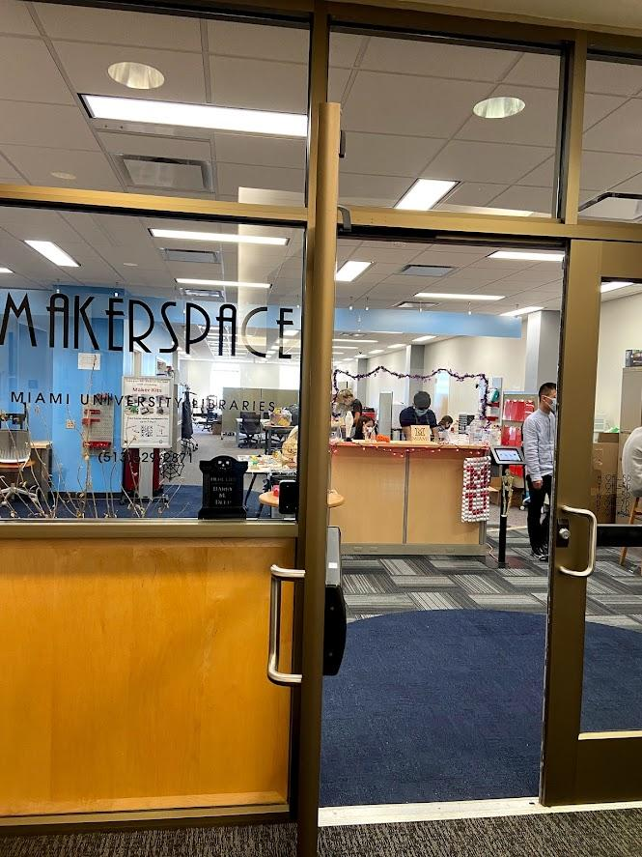
The Makerspace
Hands-on, experiential learning space
3D printing, laser cutting, vinyl cutting, sewing, embroidery, VR, AV recording, and more
Open to all Miami students, faculty and staff

Slide 9
Makerspace Session w/ TS
Initial Session
New Goals
Overview
What’s available
Make staff feel welcome
Create department logo
Engage staff w/ creative thinking
Ideation Workshop
Engagement
Brainstorm mission/values
Create logo mockups
Some staff use the space for projects.
Realize we may need to provide more support

Slide 10
Ideation Workshop
Design Thinking Overview
Creative
Warmup
Ideate:
Mission
Ideate: Values
Ideate: Logo
Stickers!
Jupiter is a gas giant and the biggest planet
Saturn is a gas giant, composed of hydrogen
Neptune is the fourth-largest planet

Slide 11
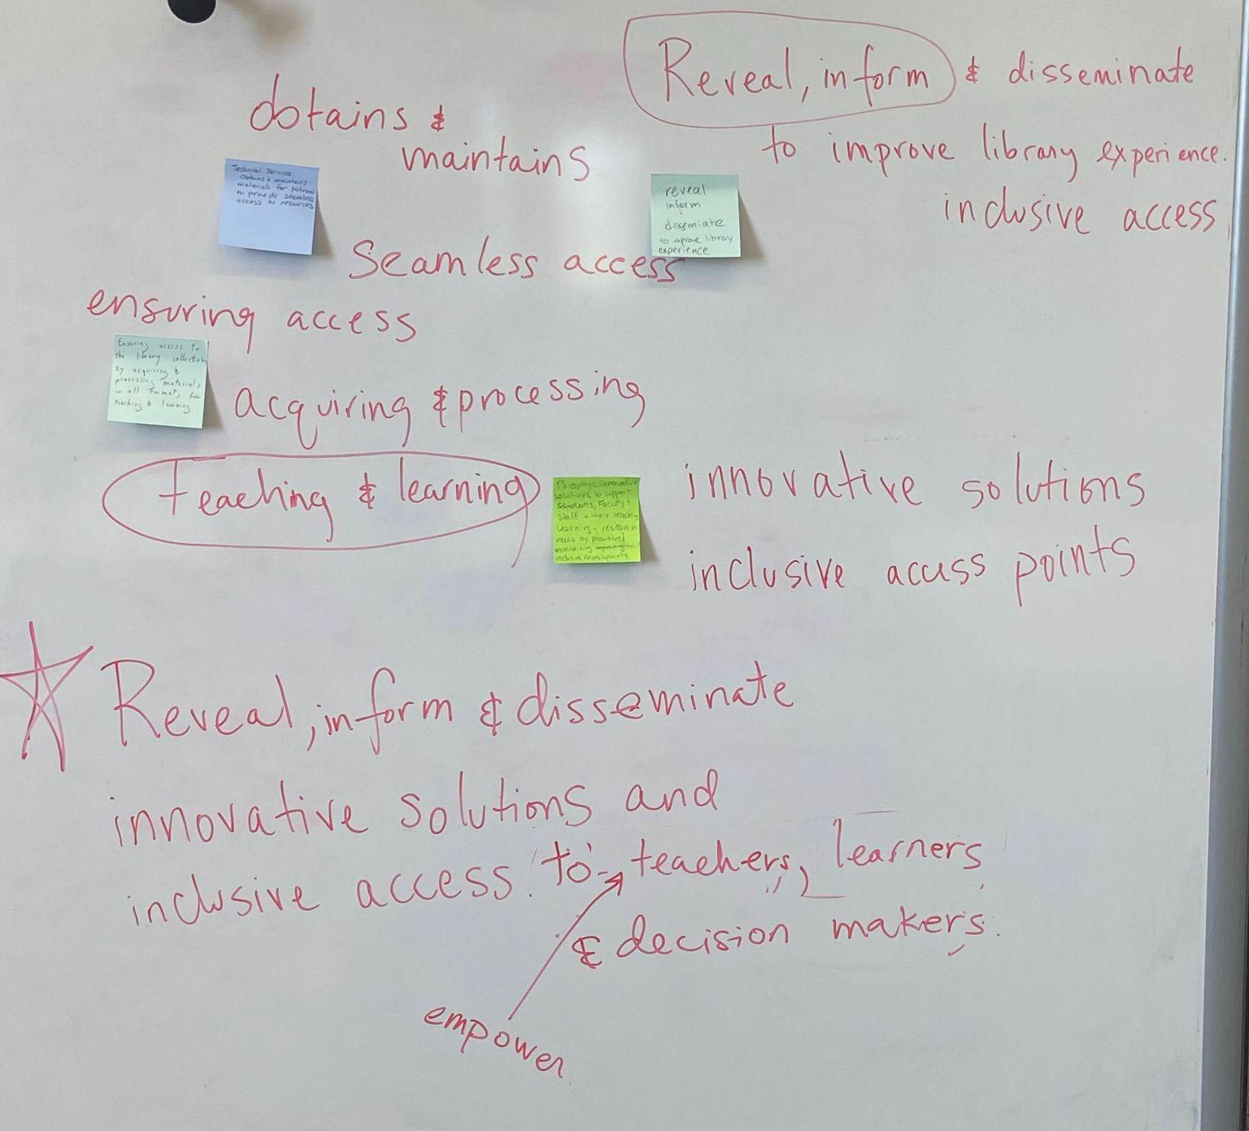
Mission
What you want to achieve and why
Why does Tech Services exist?
What problems does TS solve for the libraries?
What are the most important activities for TS on a daily basis?
What core functions bring all of your work together?
What do you see/hope for TS's future?
What should TS strive to achieve (work or interpersonally)

Slide 12
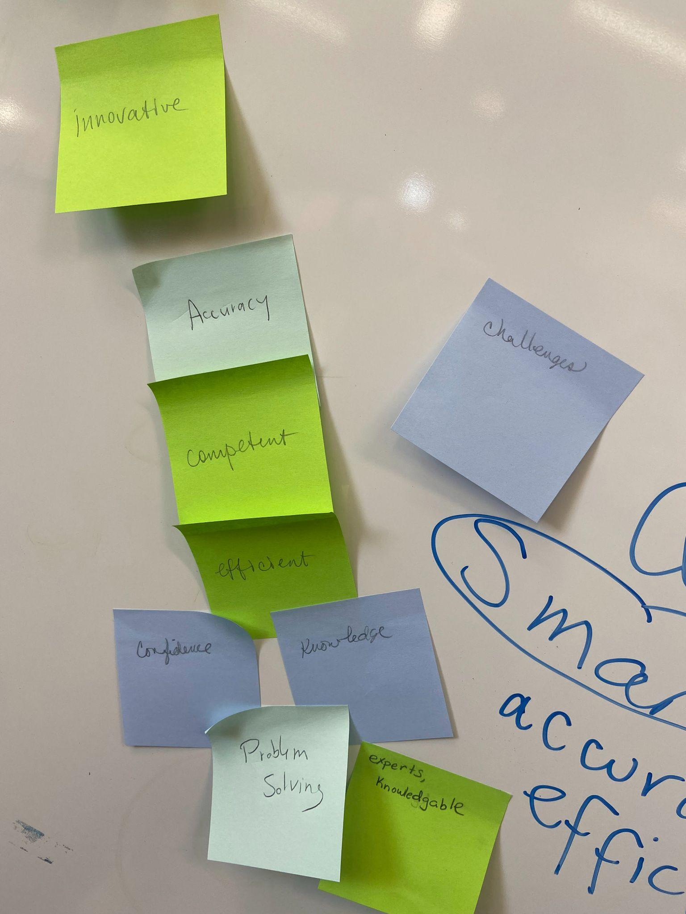
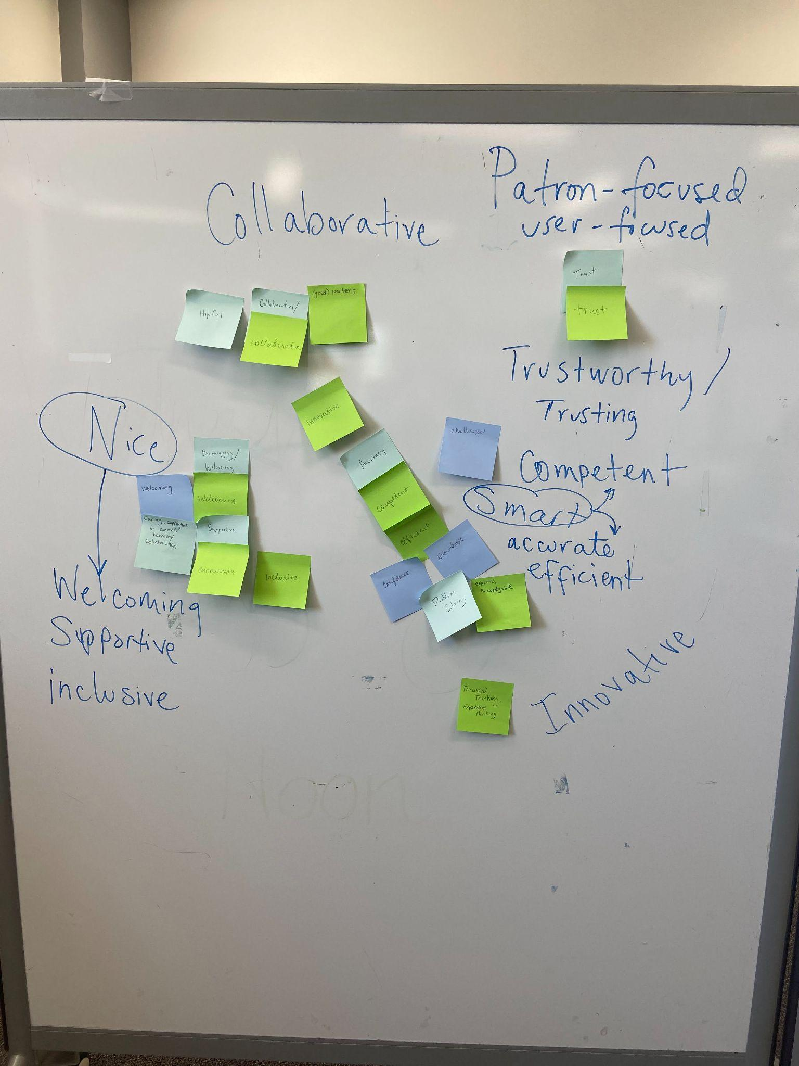
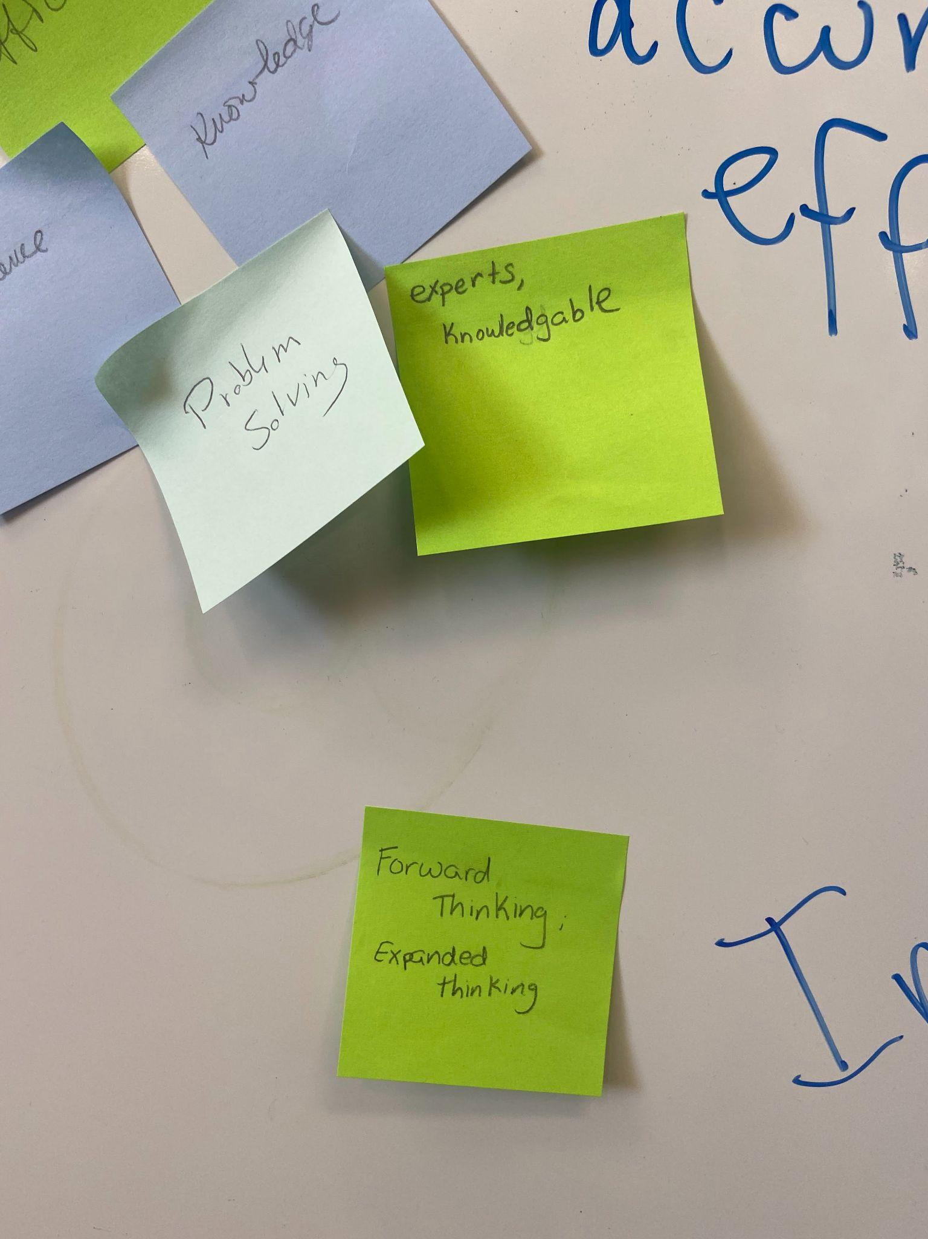
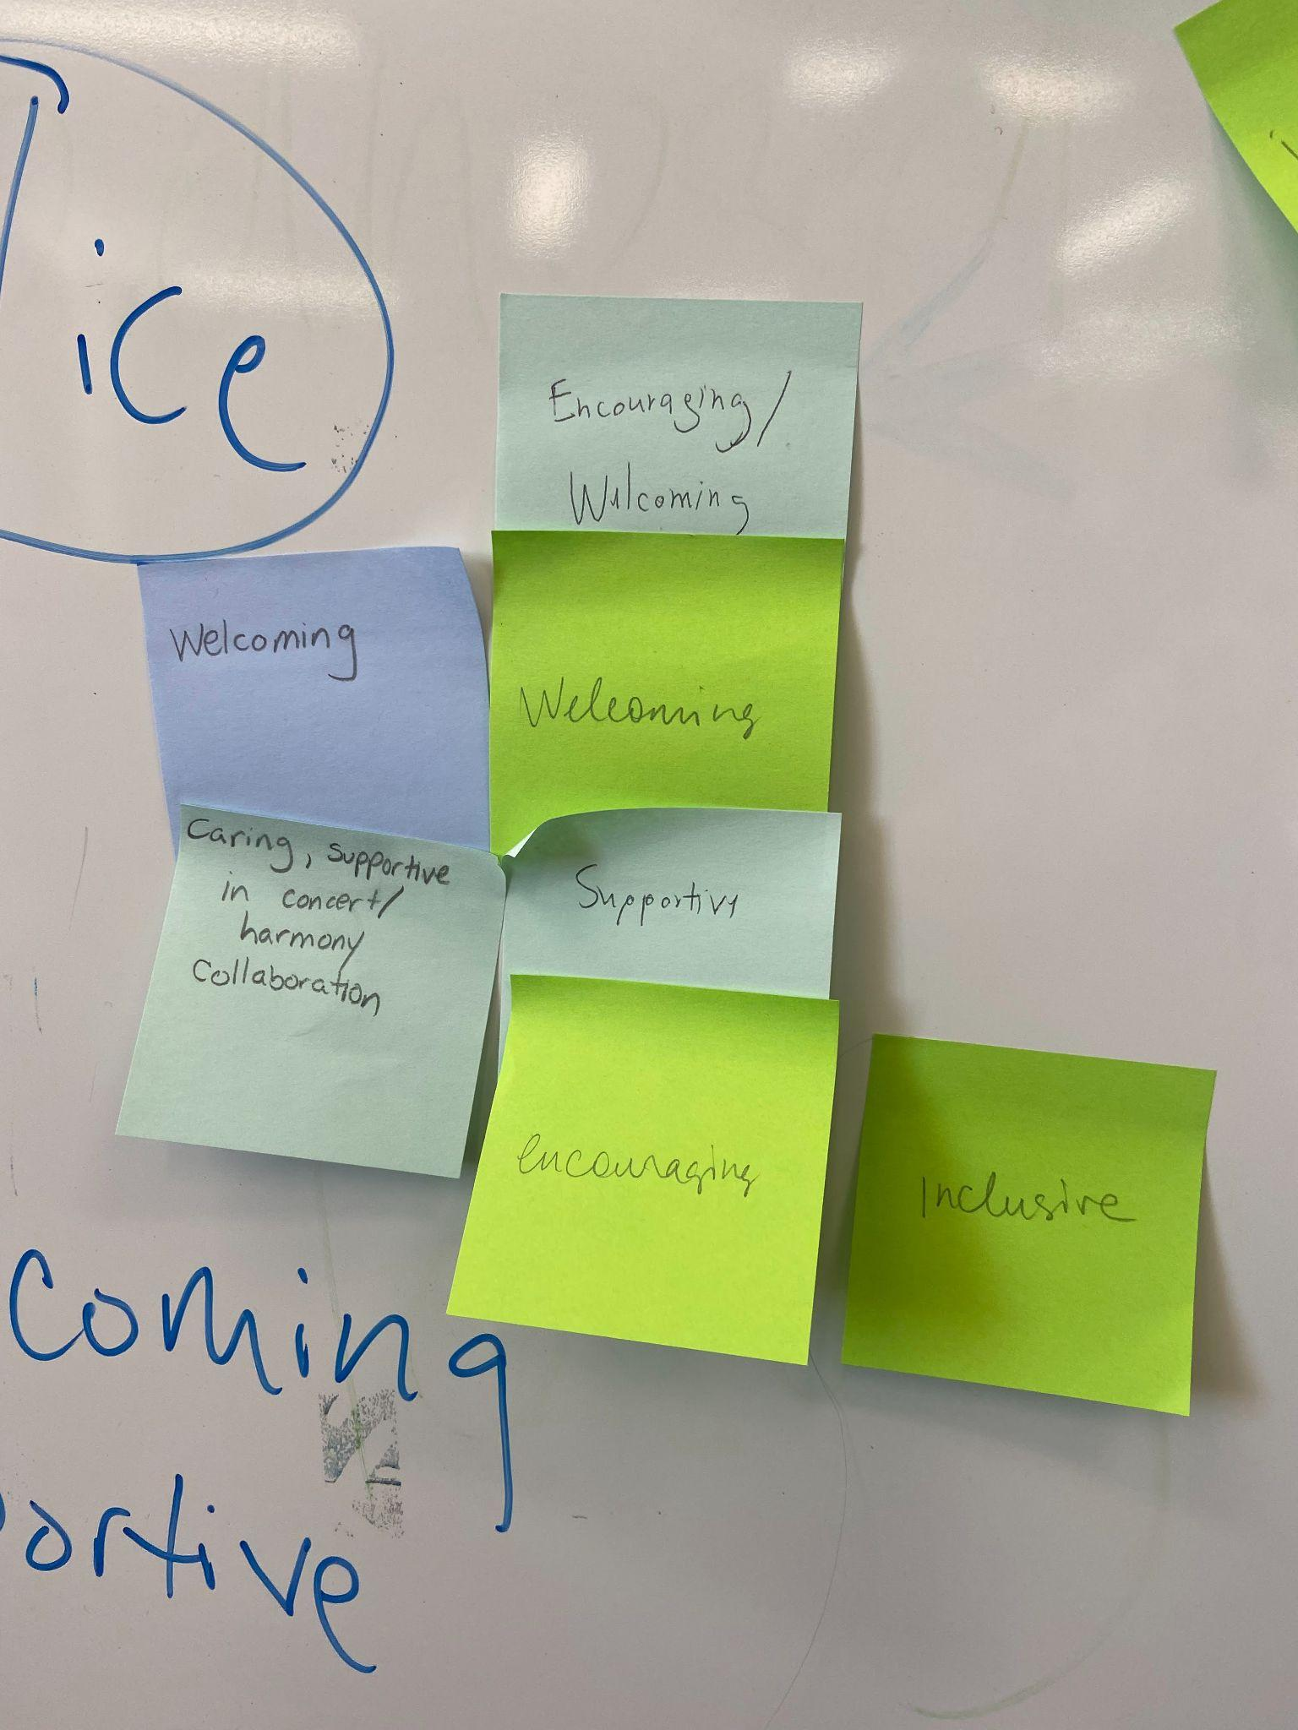
Values
Beliefs, philosophies, and principles that drive your work.
What motivates you best to do your work?
What is the atmosphere of TS?
What do you love about working in TS?
What behaviors of your coworkers inspire you?
What do you want others in the libraries to think about TS?
What are your duties to patrons?

Slide 13
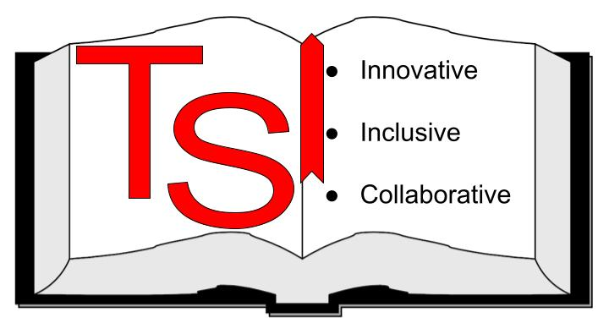
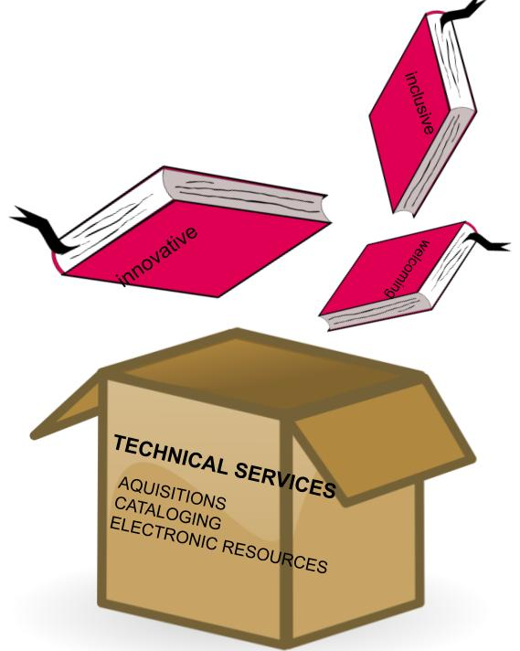

Logos
1-3 Words
Symbol
Color

Slide 14
Activity Time!
Get in Groups
Brainstorm Values: How you want others to perceive your Library? What is your most important work?
Write 1-3 single words or concepts that sum up your discussion (1 word per sticky note)

Slide 15
Outcomes!
Skill Gains
Knowledge sharing
Team building & Orientation
Staff using the Makerspace on their own or with other library committees
Procedure Updates
New documentation site
Celebrate staff & Encourage fun!

Slide 16
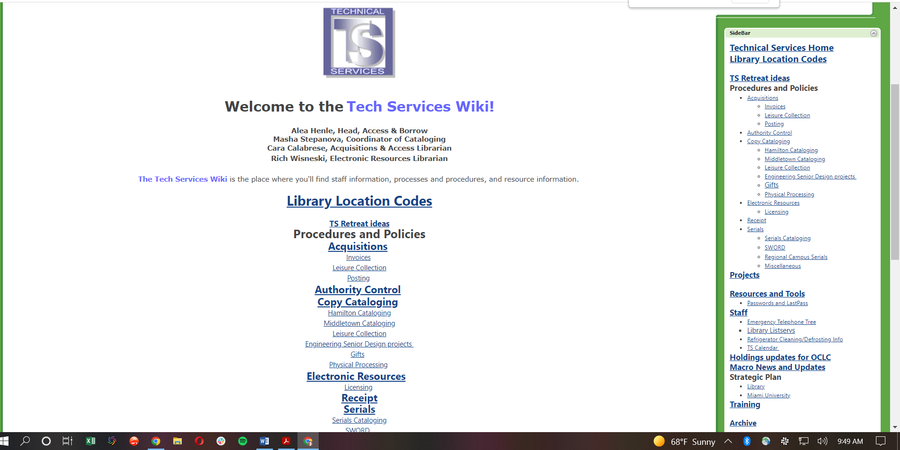
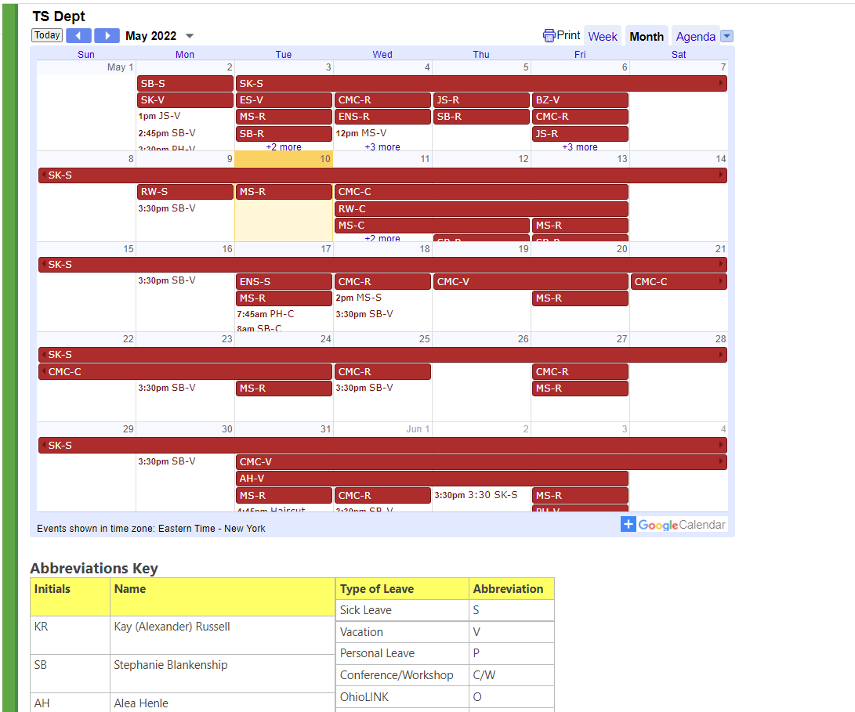
Updates

Slide 17
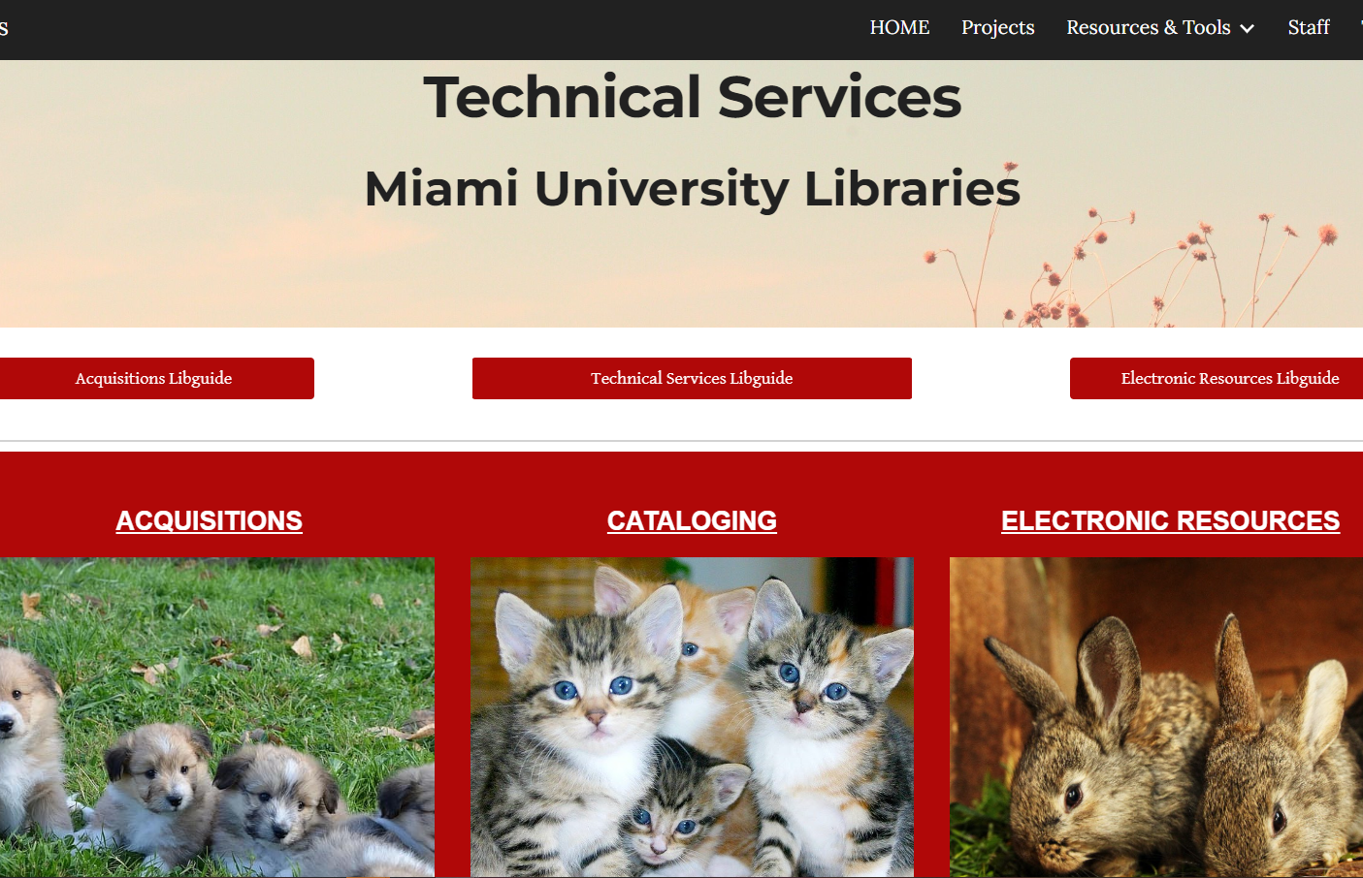

Slide 18

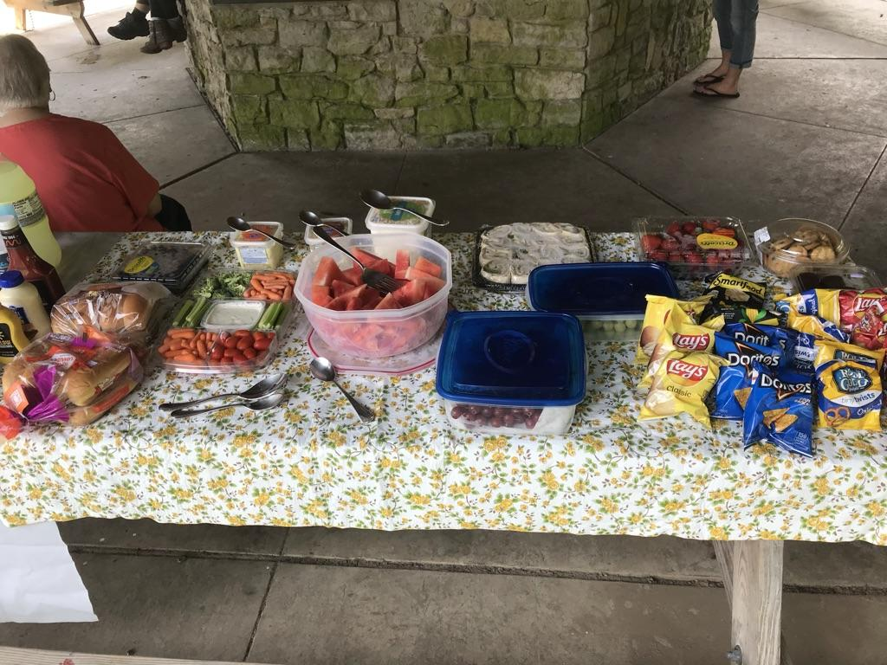
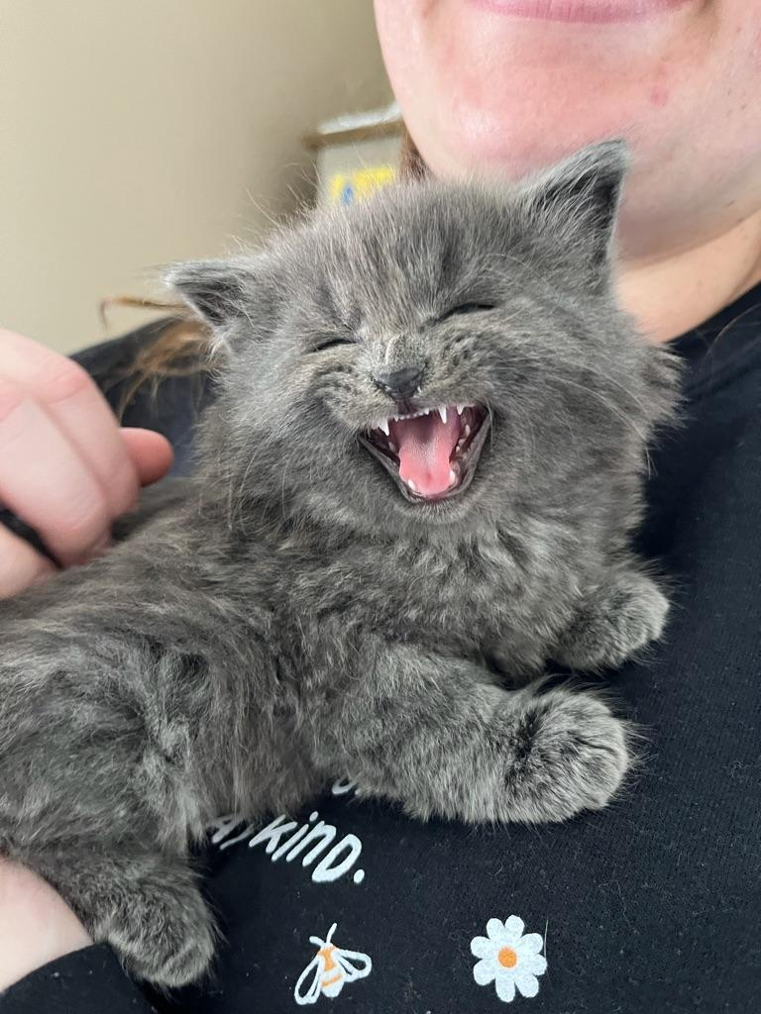

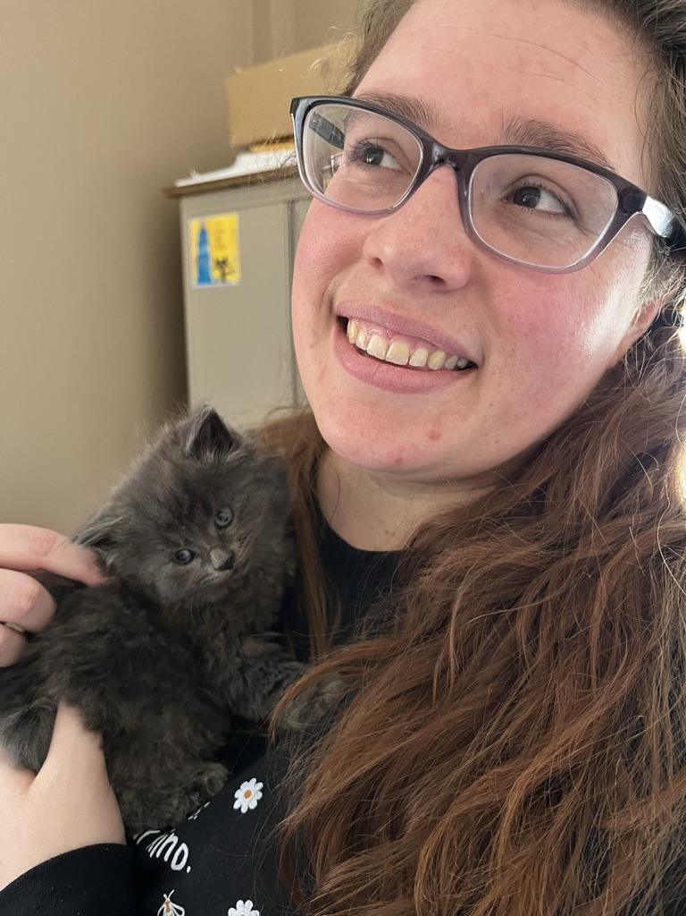
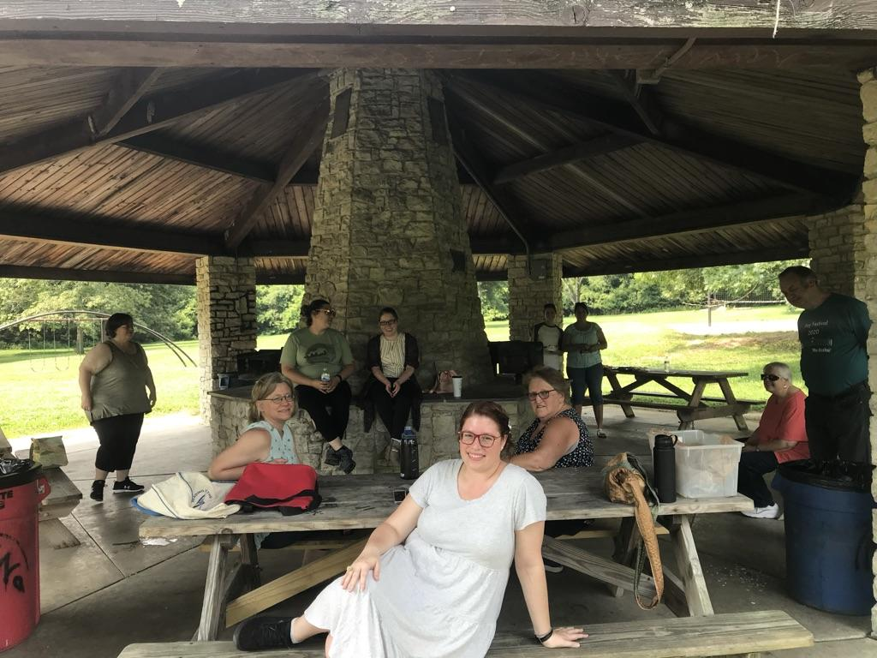
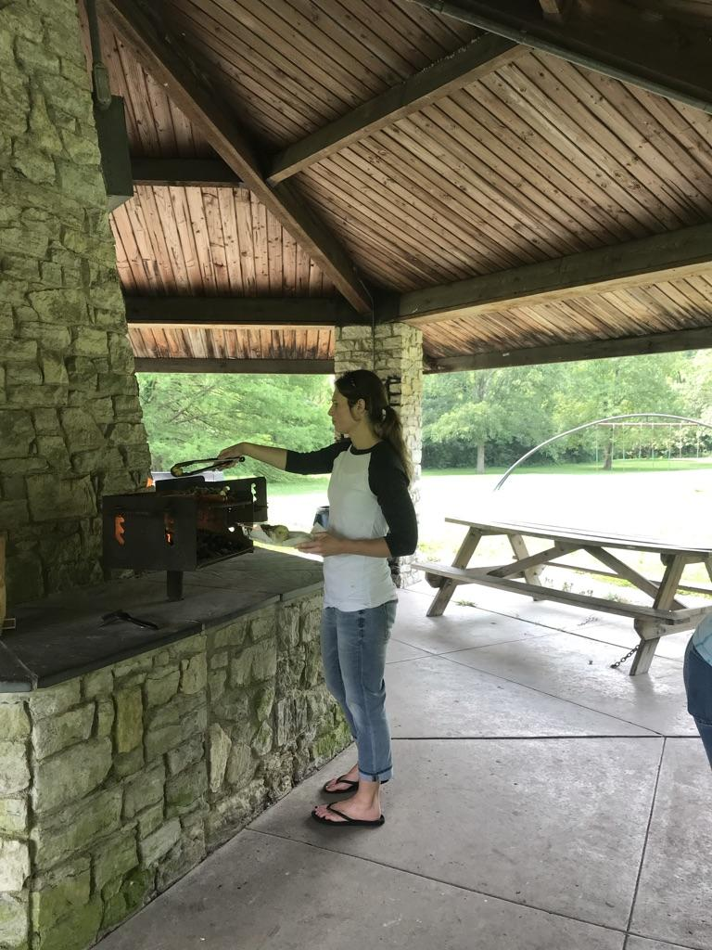
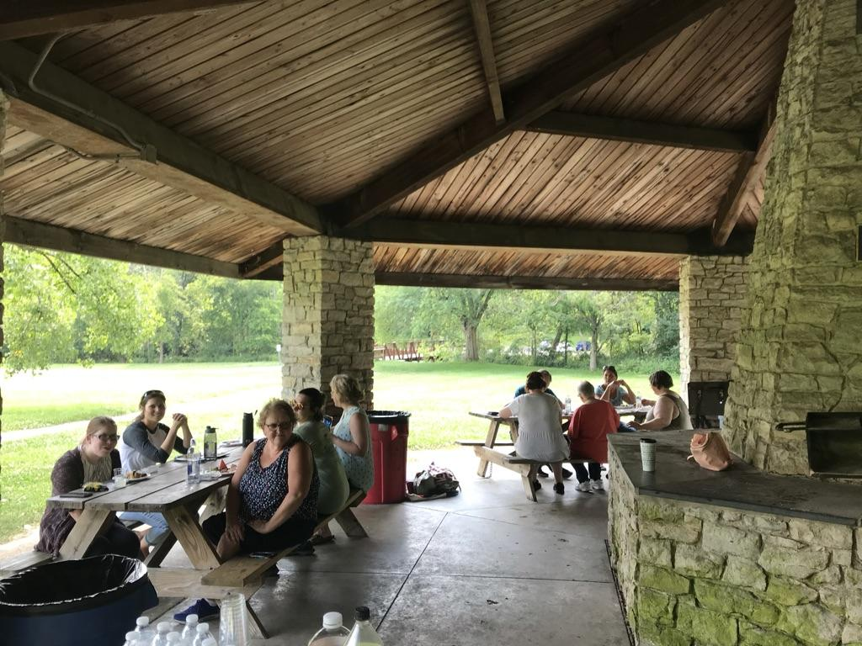
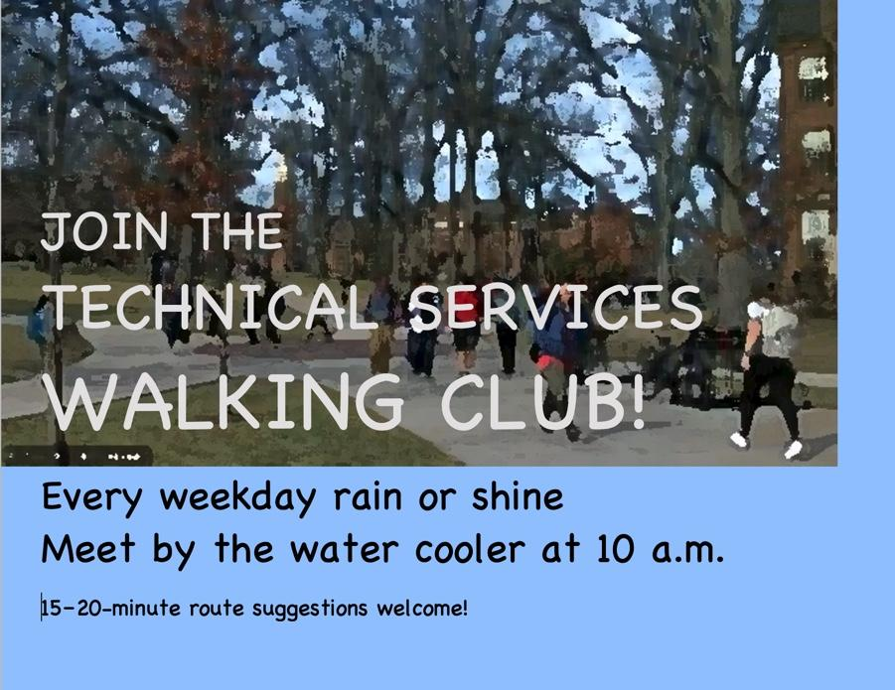
Celebrate staff & encourage fun

Slide 19
Thanks!
Questions?
Cara Calabrese | Calabrcm@miamioh.edu
Sarah Nagle | Pricesb@miamioh.edu

