Slide 1
Assessment of a broad-based CCC “Get It Now” program Implementation
Kevin Messner, Susan Hurst,
Jennifer Bazeley & Rob Withers
ALAO - Nov. 20, 2015

Slide 2
Acknowledgements
Thanks to Jennifer Bazeley, Interim Head of Technical Services, for getting us started with this project, and providing data and expertise throughout the planning and implementation of the process.
Thanks to Jerome Conley, Dean of Miami University Libraries, and Aaron Shrimplin, Associate Dean, for providing funding and support for this pilot project.

Slide 3
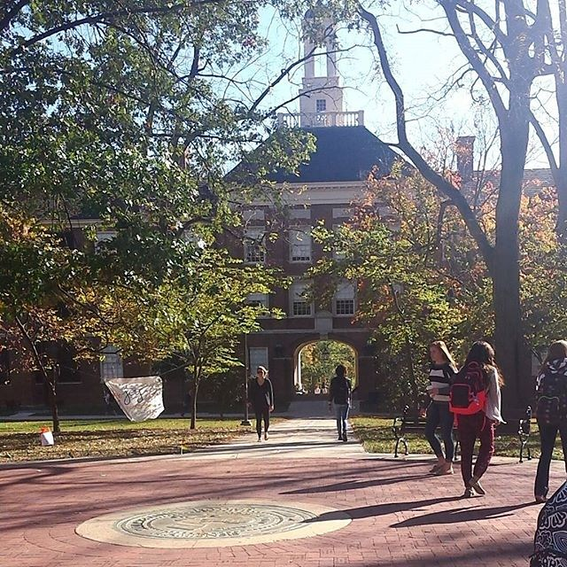
Miami University
Oxford Campus
16,000 Undergraduates
2,700 Graduate Students
2 Regional Campuses
Hamilton - 3,400
Middletown - 2,100

Slide 4
Why Article Pay-Per-View??
Cost of new journal subscriptions is prohibitive.
Materials budget is flat.
Continuing to cancel journals.
Getting rid of print holdings – space issues.
Journals dropping out of aggregators or have long embargos.
Concerns about speed and reliability of ILL service.
See what titles are requested, possibly purchase backfiles?
Improve access and service for users.
Funding for Innovative pilots.

Slide 5
Timeline
Started discussing article Pay-Per-View in late 2013.
Looked at various vendors, including Read Cube.
Selected Copyright Clearance Center (CCC) based on ability to work with link resolver & ILLIAD, also a good number of publishers included.
Began as a pilot, ballparked $27,000 initial funding as a worst case scenario based on one year of ILL requests at $70 per article.
Considered starting as a mediated service, Summer 2014.
Decided we needed to go unmediated so patrons could access articles on nights and weekends (the whole point of “Get It Now”).
Went unmediated Fall 2014.

Slide 6
“Get it Now” – What Does That Mean for US??
“Get It Now” is a service of Copyright Clearance Center (CCC).
We currently have no limits on publishers or price per article.
Notifications of orders go to an entity email address so that we can monitor orders in a general way.
Can be mediated or unmediated.
We are invoiced monthly for all orders placed.
Originally set a total budget cut-off of $27,000.

Slide 7
“Get it Now” – What Does That Mean for the Patrons??
Available to ALL Miami students, faculty, & staff.
Works through the Link Resolver system.
Promises to deliver articles from participating publishers in less than 8 hours – may not always be the case?
Articles are delivered via email.
Our patrons are limited to 3 article orders within a 24 hour time period (default is 5).

Slide 8
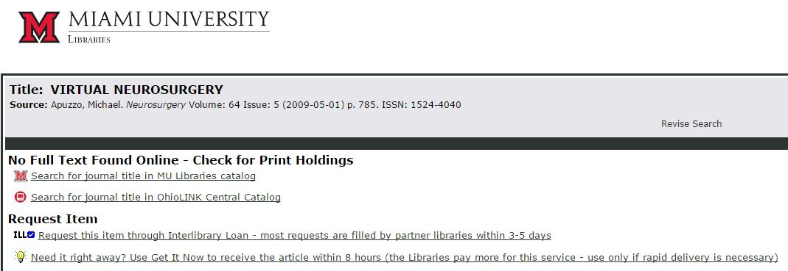

Slide 9
Publishers
A list of participating publishers is online at:
http://tinyurl.com/GINPublishers
Focus on medical/health services but includes all areas.
Taylor & Frances journals are included, (largest # of requests).
Articles requested from 31 publishers.
14 publishers had requests for more than 1 article.

Slide 11
So What Happened –
Did We Go Broke??
Looking at one year of data – 9/18/14 – 10/4/15.
167 requests
10 requests cancelled (6%), could not be fulfilled.
157 filled.
Article price range so far, $18 to $69
Total cost of $5,566
Average cost of $35.75 per article

Slide 12
Who is using the GIN service?
By academic status
Some concerns about opening to undergrads, would they “blow up” use?
Undergrads accounted for 62% of requests, are 68% of campus population
In proportion to population size, grad students are the heavy users:
  1 request per 159 undergrads
  1 request per 103 faculty
  1 request per 56 grad students
Notes:
Undergrads account for the largest portion of service use, but they are also by far the largest user group on campus. In proportion to the head counts, grad students are the heaviest users

Slide 13
Who is using the GIN service?
By department/major
3 departments account for nearly half of use
Mainly departments with relevance to the health sciences ‘sphere’ (both natural and social science aspects)

Slide 14
Journal titles used
Similar pattern if we look at the journals being used – health and life sciences predominate
Nature Genetics 4
Journal of Gerontological Nursing 3
Journal Of Lgbt Issues In Counseling 3
Nature Neuroscience 3
American Journal of Drug and Alcohol Abuse 2
American Journal of Geriatric Psychiatry 2
Annals of Leisure Research 2
Archives of Clinical Neuropsychology 2
Behavioral Pharmacology 2
CNS & Neurological Disorders - Drug Targets 2
Early Child Development and Care 2
Gerontologist 2
Hormone Research 2
International Journal of Human Resource Management 2
Journal of Hypertension 2
Journal of Positive Psychology 2
Journal of Psychoactive Drugs 2
Nature Geoscience 2
Perspectives in Psychiatric Care 2
Psychological Science 2
Quarterly Review of Film and Video 2

Slide 15
Analysis of article title words
effects 8
patients 8
older 8
children 8
effect 8
study 7
research 7
care 7
disorder 7
clinical 6
adults 6
cognitive 6
gender 6
analysis 6
evidence 5
review 5
growth 5
therapy 5
dementia 5
cannabis 5
disease 5
treatment 5
brain 5
nurse 5
trial 5
bipolar 5
alpha 5
…and if we look at frequently encountered words in the article titles
Notes:
Stop words omitted. Call out cannabis.

Slide 16
‘Discipline’ of article
clinical medicine 40
clinical psychology 28
education 22
physiology 13
nursing 12
neuroscience 10
gerontology 9
gender studies 9
political science 6
ethnic studies 6
management 5
biochemistry 5
sports studies 4
family studies 4
sociology 4
biology 4
…or an (informal) assessment of the discipline focus of each article
Notes:
Medicine a very large group…interest in clinical work. Pre-med students, nursing students, other?

Slide 17
Age of articles requested
111 of articles requested (67% total) were published 2010-2015.
Remaining 33% scattered from 1972-2012.
Notes:
Lots of recent material. Inherent to health sciences. Also, this is a channel to get stuff that is embargoed in EbscoHost, JSTOR, etc.
Not exclusively recent though…1/3 of requests “older, backissue” material.

Slide 18
“What Could Possibly Go Wrong?”
Auditing the service
Problems with overuse by certain patrons?
24 users have requested more than once
9 of those were 2-3 requests within a day of each other
Heaviest two users have six requests each (including cancellations)
Are the same articles requested (and being bought) multiple times?
3 cases of 2 requests for the same article, placed within a week of each other
A case of 4 requests for the same article, placed within a week of each other
Likely students working on the same assignment, or a journal club reading one paper

Slide 19
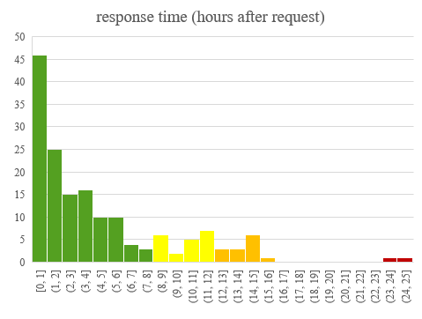
Get It Now. Real Soon…Usually.
Service most often has a very rapid delivery time, within a few hours.
Mean time between request and delivery = 4.5 hours
35 requests (21%) exceeded the indicated 8 hour delivery time*
  Most of these requested Sunday or Monday (and delivered Mon-Tues)
Notes:
Naming your service Get It Now may be asking for trouble. Are we inviting trouble by adopting that branding?
Explain graph, a bit confusing.

Slide 20
Timeline of service use – is use increasing?
Service could become very expensive to maintain if use accelerated uncontrolled
More use in peak of Spring ‘15 than in Fall ’14 semester, but no clear trend as yet.
Surprising how little use during summer, especially if grad students heavier users
  Summer use was mostly grads and faculty

Slide 21
But we already have that…
23 of the articles requested (and purchased), we already had access to
Most in either SWORD or on-campus closed stacks; scans available by request in both cases
Some in the OhioLink EJC!
GIN an easier process than navigating and interpreting our catalog and local request form
Path of least resistance for user
Upkeep of entries in link resolver has helped improve this; remain vigilant

Slide 22
Comparison to ILL Borrowing
ILL dwarfs GIN – well over 3,000 requests annually
Speed of ILL a concern expressed by grad students and faculty.
  Average delivery time for ILL in 2014 has improved considerably to 3.24 days. (GIN was 4.5 hours)
    10% arrived in under 8 hours, so there is currently some overlap between GIN and ILL delivery speed.
  Majority of GIN charges are comparable to ILL charges if we don’t find a reciprocal lender
  Decline of ~400 requests in FY 2015 v. 2014 (about 12%)

Slide 23
ILL Users
Requests by Dept (Top 10)
Spanish & Portuguese | 7%
History | 7%
Kinesiology & Health | 6%
English | 5%
Political Science | 5%
Educational Leadership | 4%
GRAMELAC | 4%
Psychology | 4%
Music | 4%
Sociology and Gerontology | 4%
Notes:
User base much more faculty driven, grad student use similar portion, less undergrad.
Much heavier use in the humanities and social sciences, relatively little use by natural sciences.

Slide 24
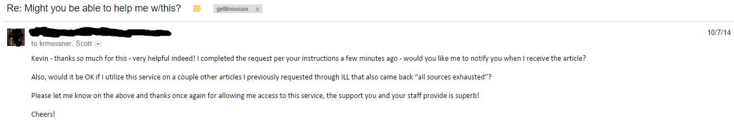
Conclusions
Have not surveyed users, have done little in the way of broadband promotions (“one toe in the water” approach)
Those who learn of it are appreciative, enthusiastic
Very useful capability for the true emergency needs

Slide 25
Conclusions
Why the domination by bio-health material?
  GIN participating publishers are themselves heavily in this sphere; document delivery a long-standing industry in medicine, pharmacy, etc. fields
  Heavy demand by some disciplines, e.g. psychology
  Some of Miami’s most research intensive fields (e.g. Ph.D. programs) are in biology, psychology, gerontology
Good match for our needs – we’re not a medical school, will not invest heavily in a rich medical collection (couldn’t do more than scrape the surface, at best)
Likewise, will never invest in every T&F journal
  GIN clearly meeting a need for access to these specialized literature segments, though

Slide 26
Conclusions
Sustainability?
$35 “per drink model”, vs increasingly unaffordable $3,500 per year subscriptions.
  Which approach is more realistic?
Remains the major question/concern. Continue to monitor. If necessary, rationing to 1/article per day could have some impact, at least sends a message.
Relationship to ILL – per item costs, personnel costs. Which is a better deal?
Philosophical concerns/reservations about collection ownership vs borrowing access models

Slide 27
Contact Information
Kevin Messner, Interim Head of B.E.S.T. Library and Chemistry/CPB Engineering Librarian, 219B Laws Hall (B.E.S.T Library), 513-529-7204, krmessner@miamioh.edu
Susan Hurst, Business Librarian, 219A Laws Hall (B.E.S.T. Library), 513-529-4144, hurstsj@miamioh.edu
Rob Withers, Head of Access Services, 111 King Library, 513-529-6148, witherre@miamioh.edu

Slide 28

QUESTIONS

