Slide 1


Talent Within:
Building Library
Leaders Through
Staff Development
Jennifer Natale
John Millard

Slide 2

Overview
Professional development initiatives at Miami:
New Team Member Training
Team Leader Training
Professional Development Committee
Notes:
Jenn

Slide 3
Informal Poll
How many of you believe that we need to keep learning in order to be effective in our roles?
Notes:
Jenn

Slide 4
Informal Poll
How many of you wish you had a more focused plan for library staff development at your institution?
Notes:
Jenn

Slide 5
Reasons we might not...
Not enough time
Other priorities take precedent
Lack of staffing
Lack of knowledge
Just don’t know where to start...
Notes:
Jenn/John

Slide 6
History of training/prof. dev.
Individualized on-boarding for new staff members
New Team Member Training
HR Process for classified staff
Professional development
funding
Notes:
NTMT - annual, 1-2 day event
HR Process - classified staff can follow guidelines to earn points for professional development that earn them increases in hourly wage
Library funds of a set amount for attending conferences and other professional development opportunities - primarily for librarian level

Slide 7
On Campus Learning
Attend workshops or events on campus
Attend library led activities
Basically no cohesive plan...

Slide 8
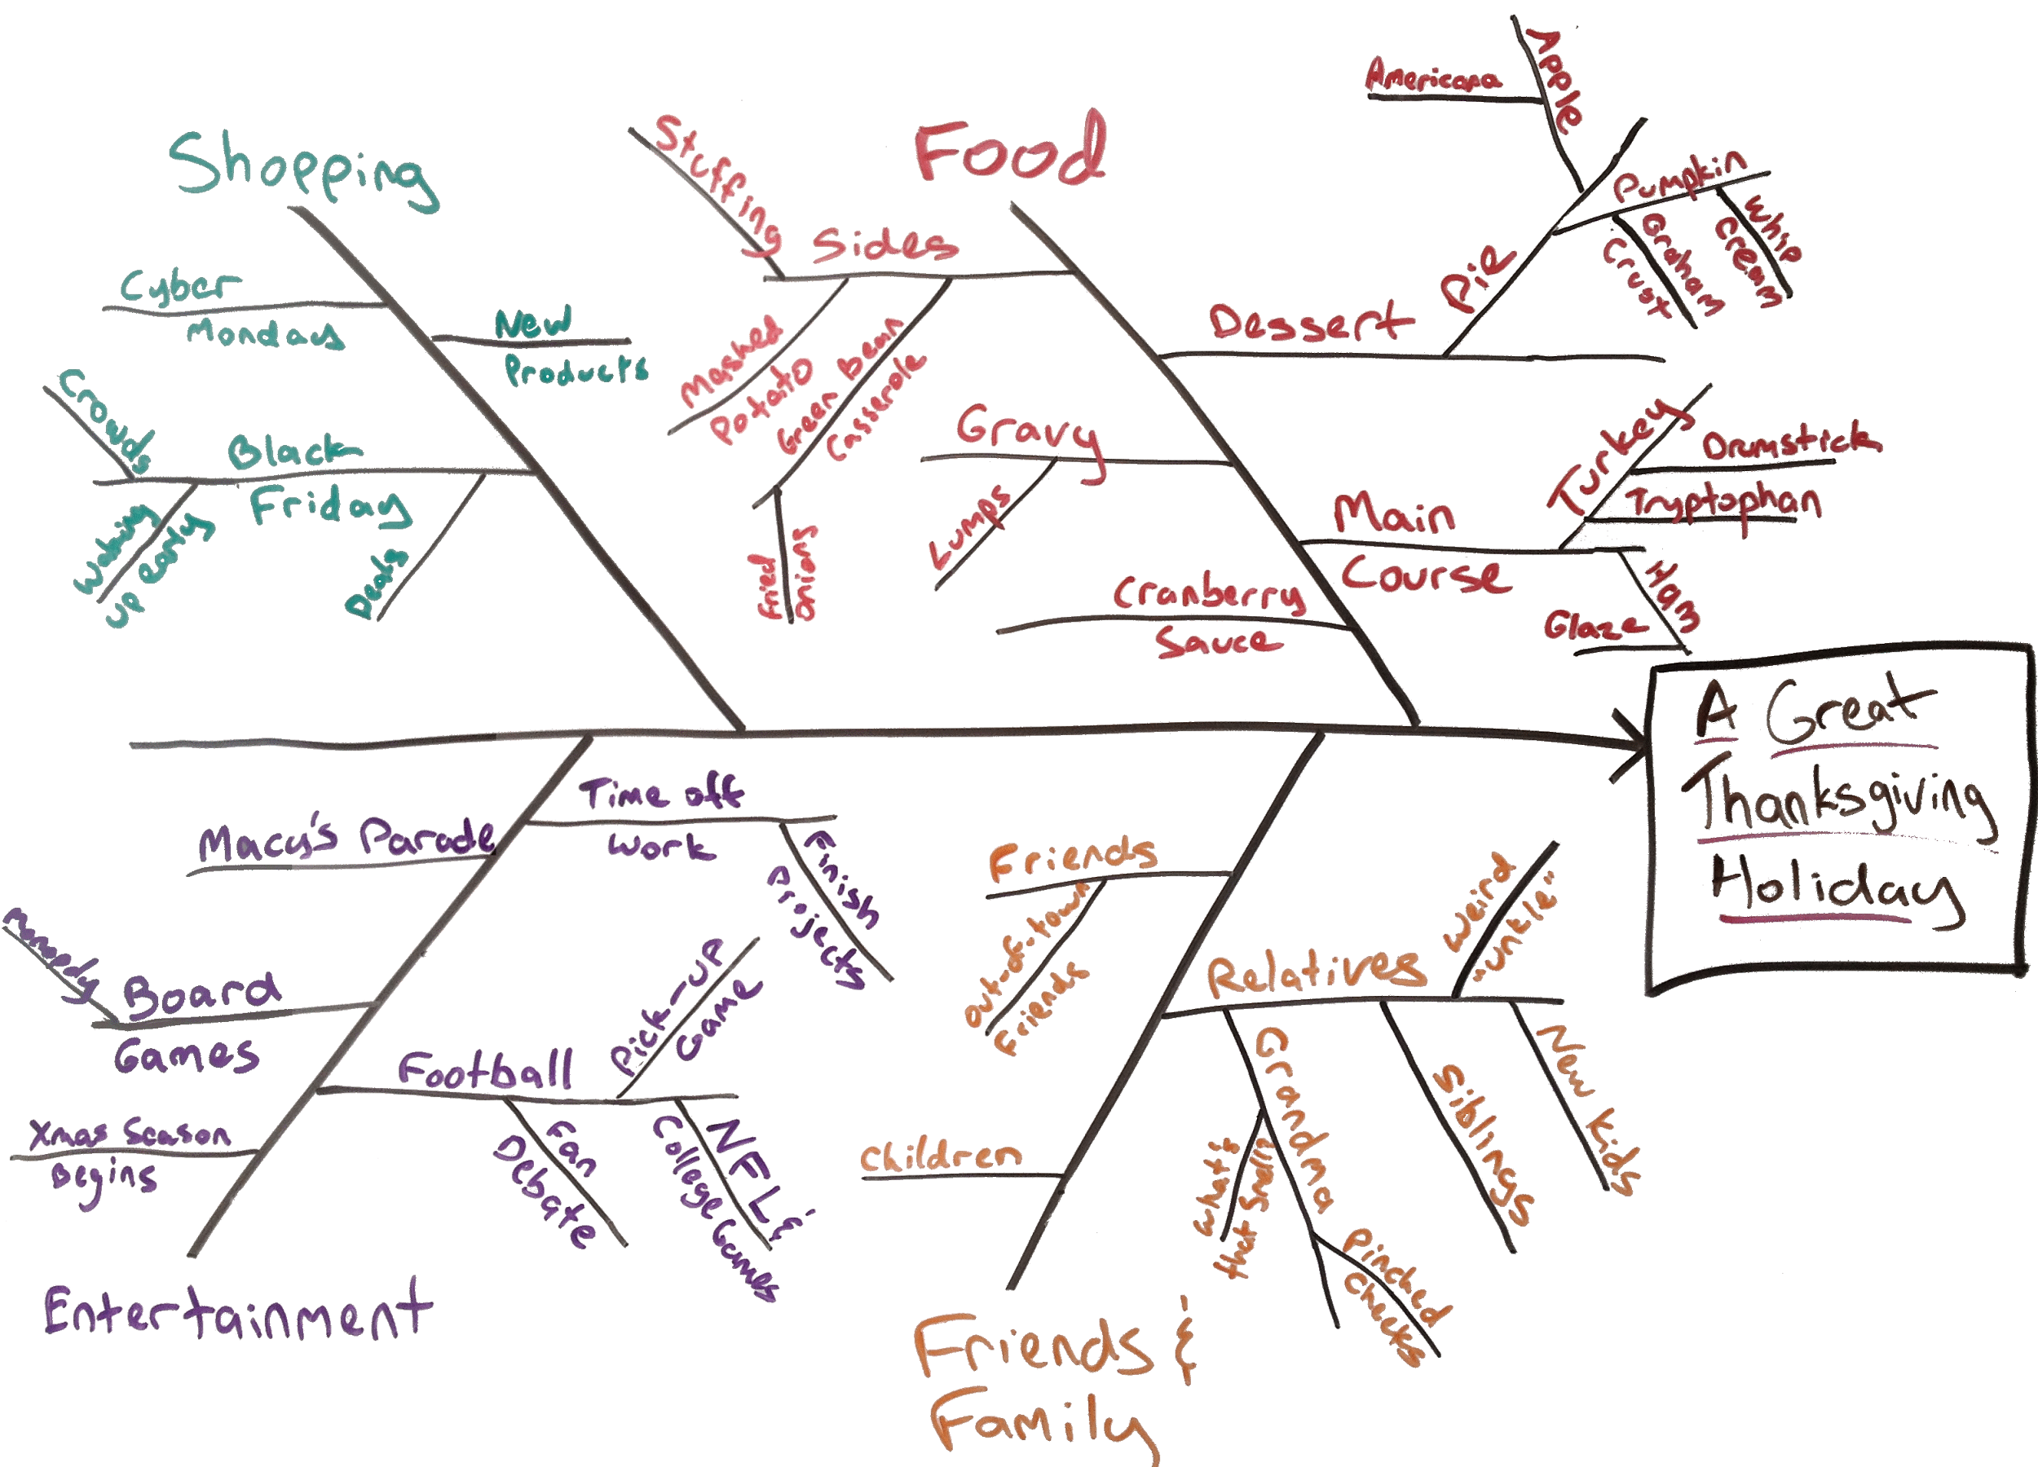
History of NTMT - CQI
Notes:
-Early 90’s campus wide effort to implement CQI - Heavily adopted by the Libraries and IT Services
-Consisted of multi-day immersive Team Leader and Team Member training sessions
- Focused heavily on process analytics and team/organization dynamics
- By 2010, Team Member training was offered as new staff were onboarded, reduced to 1.5 days.
- Focused on primarily on team dynamics, tools for effective meetings and avoiding dysfunctional decision making

Slide 9

Leadership Development
Notes:
- Recruited middle managers with the intent of developing managers into leaders
- Focused on issues facing the organization during significant leadership changes
- Hoped to build leadership capacity by example/experientially.
- Pilot for a year, revealed need for a more formal experience

Slide 10
New Plan - Learning Outcomes
Staff members connecting and building relationships across units
Build skills necessary to work well in teams
Establish expectations for staff involvement in our system
Notes:
John Example of a re-design of an existing program. Change from 1-2 day to 5 monthly sessions

Slide 11
Framework
Tuckman’s Model
Team building activities
Discussion/reflection
Diversity discussions
Certificate of completion
Notes:
John

Slide 12
Next Time / Tips
Project creation and other highly engaging activities
Provide learning opportunities in all areas of the libraries
Food...
Notes:
John Giving the group an actual project to complete together so they learn how to put the things we learned in action.

Slide 13
Leadership Training
Focus on emerging leaders / middle managers
Multiple sessions - “course”
The Leadership Challenge book
Team of three to organize
- student affairs experience
Notes:
Jenn

Slide 14
Learning Outcomes
Strengthen the team of middle managers
Build leadership capacity for our system or other opportunities
Advance supervisory skills
Notes:
Jenn

Slide 15
Next Time / Tips
Annual cohort - application process
Use of LMS instead of LibGuide
Seek partners / expertise if you don’t have it internally
Create a system and emphasize
the importance
Notes:
Jenn Application process might produce better buy-in; LMS could provide better interactivity like discussions online

Slide 16
New Highlight on PD
Success of initial trainings
Proposal to create a committee to oversee prof dev
Support from the administration
Part of the university strategic
plan
Notes:
John Funding, staff time

Slide 17
Role of committee
NTMT
Leadership course
General coordination of prof dev workshops / activities
Provide resources
Notes:
John

Slide 18
PD LibGuide
Professional organizations
Conferences
Internal and external learning opportunities
Online learning
Inspiration
Notes:
Jenn Link on handout

Slide 19
Goals
Create a more holistic view of our development (system vs. individual)
Start more conversations and generate new ideas
Improve job satisfaction and performance
Notes:
Jenn

Slide 20
Suggestions
Try something new
Seek expertise internally or externally
Continued assessment
Build a plan and assign people
to it
Notes:
Jenn

Slide 21
Questions?
And we’d love to hear about your successes and ideas!
Notes:
If you’d like us to share some aspect of our initiatives, you can give us your email and we will contact you

