Slide 1

EVANGELISTS AND PRAGMATISTS:
Finding Common Ground
Job van Exel – Erasmus University, Rotterdam, Netherlands
Jen Waller – Miami University, Oxford, Ohio

Slide 2
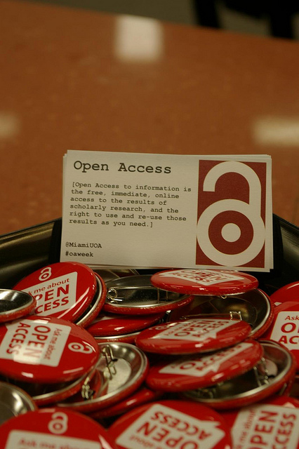
[ Open access to information is the free, immediate, online access to the results of scholarly research and the right to use and reuse those results as you need. ]
– Peter Suber
Notes:
People often start with definitions, and this is no different. I want to make sure we’re all on the same page with our understanding of Open Access.
[Read definition]
Peter Suber is now the Director for the Office for Scholarly Communication at Harvard, and he is a leading expert on Open Access,

Slide 3
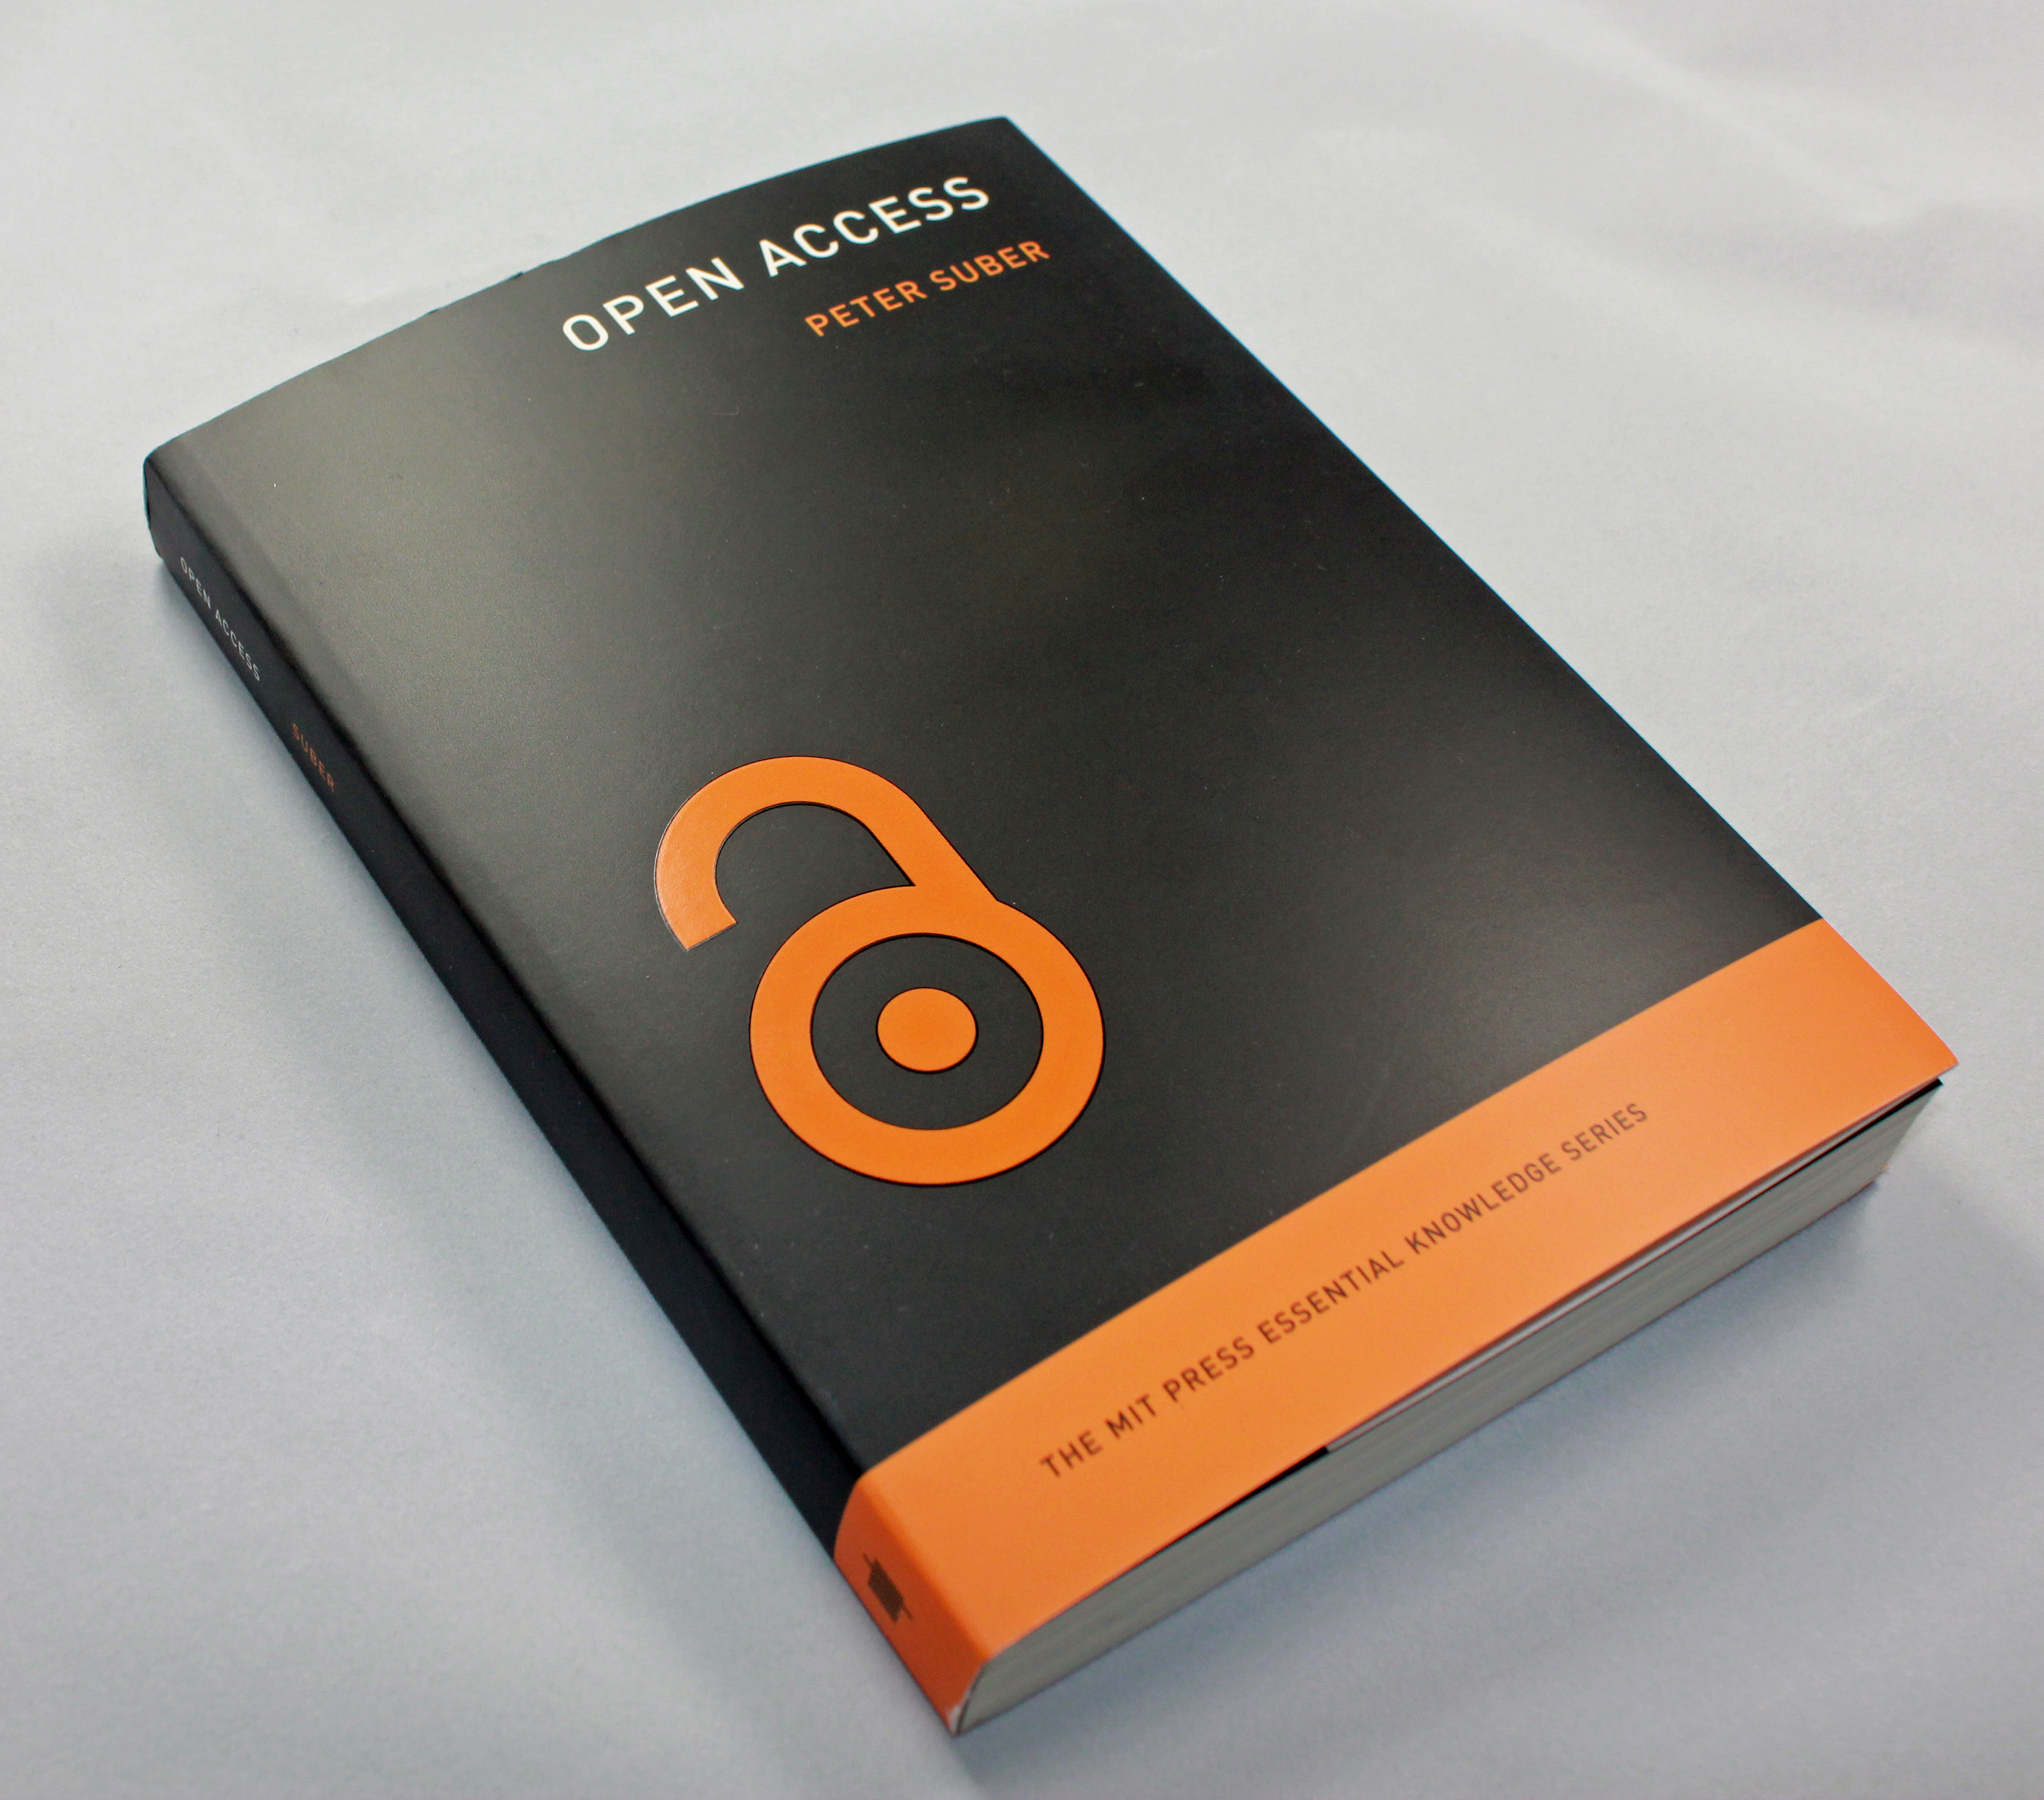
Suber, P. (2012) Open Access. Cambridge, Mass: MIT Press
http://mitpress.mit.edu/books/open-access
Notes:
And, in fact, he’s written the authoritative book on the topic. The book itself an experiment in open access. It was published and sold by MIT Press for about eight months after it was released. Since that time it has been available as a freely downloadable book in several different formats. So if you want to read the book online or print hardcopies, you’re able to do so for free. If you want to purchase the physical book, you can still do that too.

Slide 4
http://openaccess.mpg.de/Berlin-Declaration
Berlin Declaration
http://www.budapestopenaccessinitiative.org/read
Budapest Open Access
Statement
http://legacy.earlham.edu/~peters/fos/bethesda.htm
Bethesda Statement
Notes:
For our purposes, other definitions of Open Access are largely the same. The major ones that people turn to include the Berlin Declaration, the Budapest Open Access Statement, and the Bethesda Statement. Suber’s is most eloquent and succinct.

Slide 5


Gold Path
Green Path
Notes:
So now that we have our definition, there are two widely acknowledged “paths” to open access. The first path is called the gold path, and it means that a publisher has found a sustainable economic model to make the journal’s content freely available.

Slide 6
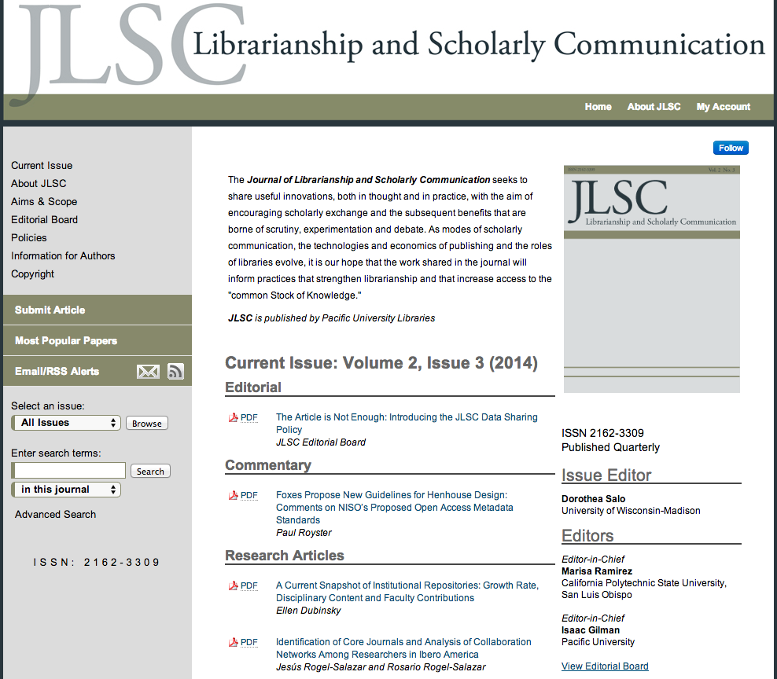
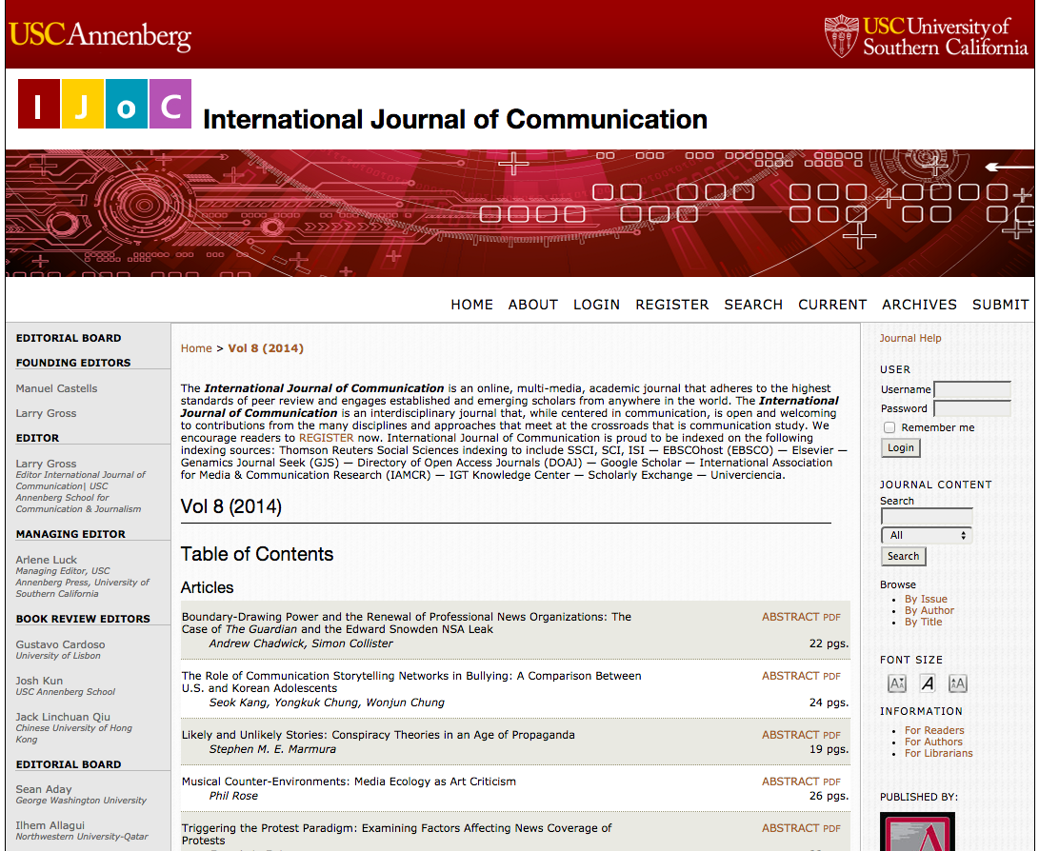
Gold
http://jlsc-pub.org/jlsc/
http://ijoc.org
Notes:
There are many examples of “gold” open access journals, but the Journal for Librarianship and Scholarly Communication is one example, as is the International Journal of Communication published by USC Annenberg Press. PLOS, or the Public Library of Science, is a huge one for STEM fields. I think this kind of open access is reasonably well understood by people, and it seems to be the first thing people think of when you say open access – that is, open access journals

Slide 7
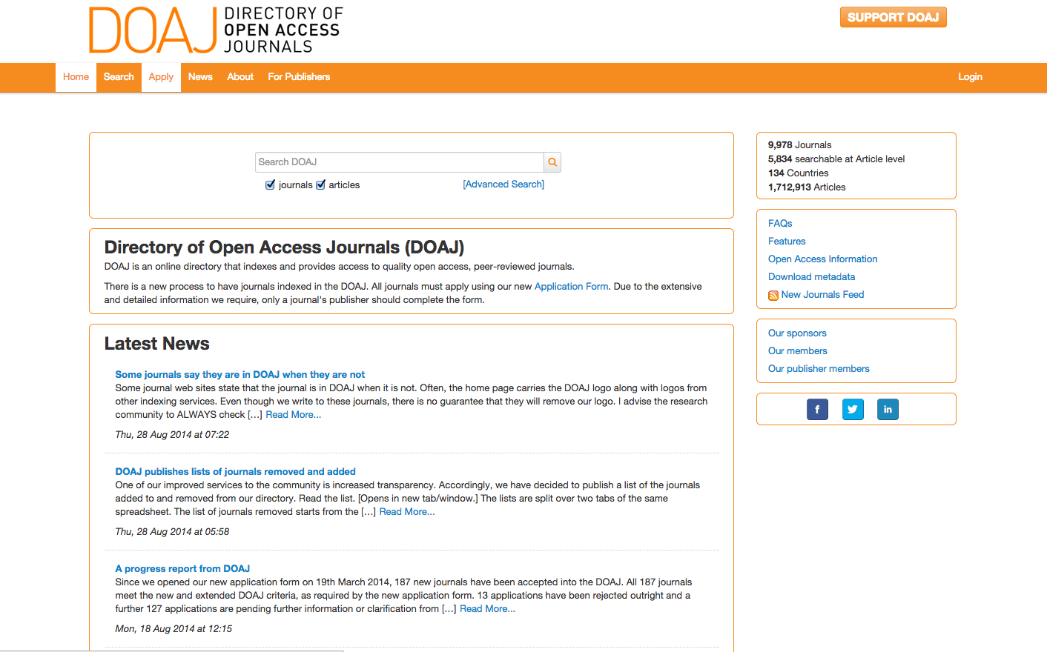
http://doaj.org
Notes:
The Directory of Open Access Journals lists nearly 10,000 open access journals, and it’s a good resource if you’re looking for an open access publishing outlet.

Slide 8
Gold Path
Green Path
Notes:
But there’s a second route to open access, which is commonly called the green path, and it means that an author self-archives their work in an open access repository.

Slide 9
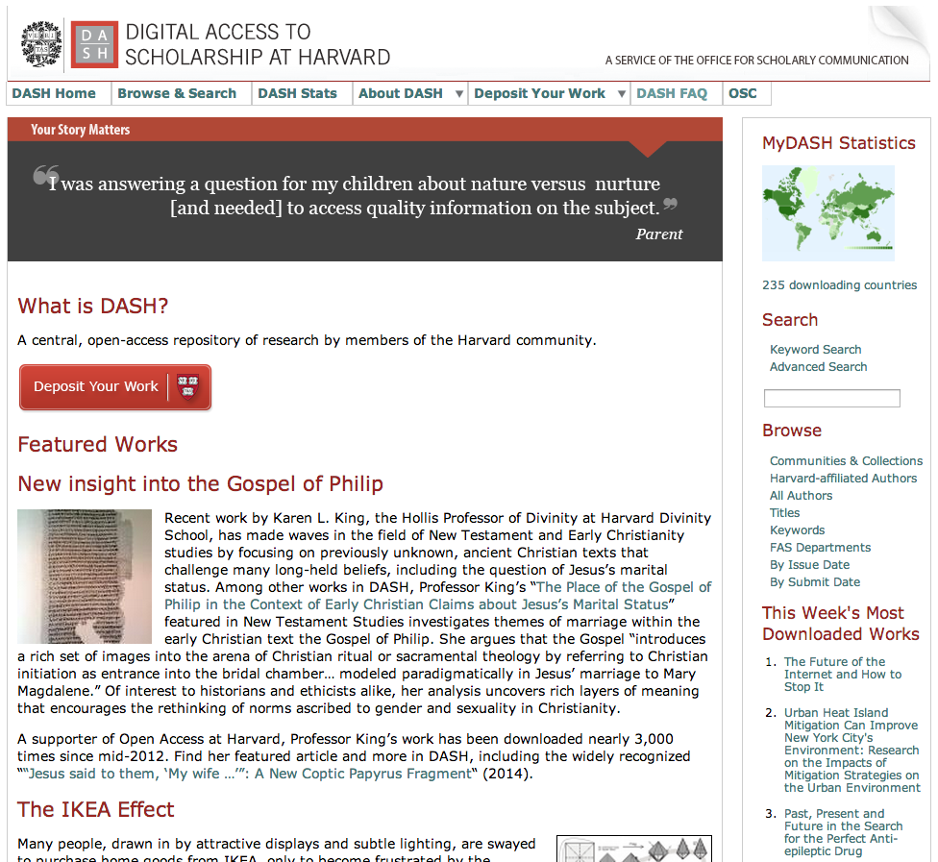
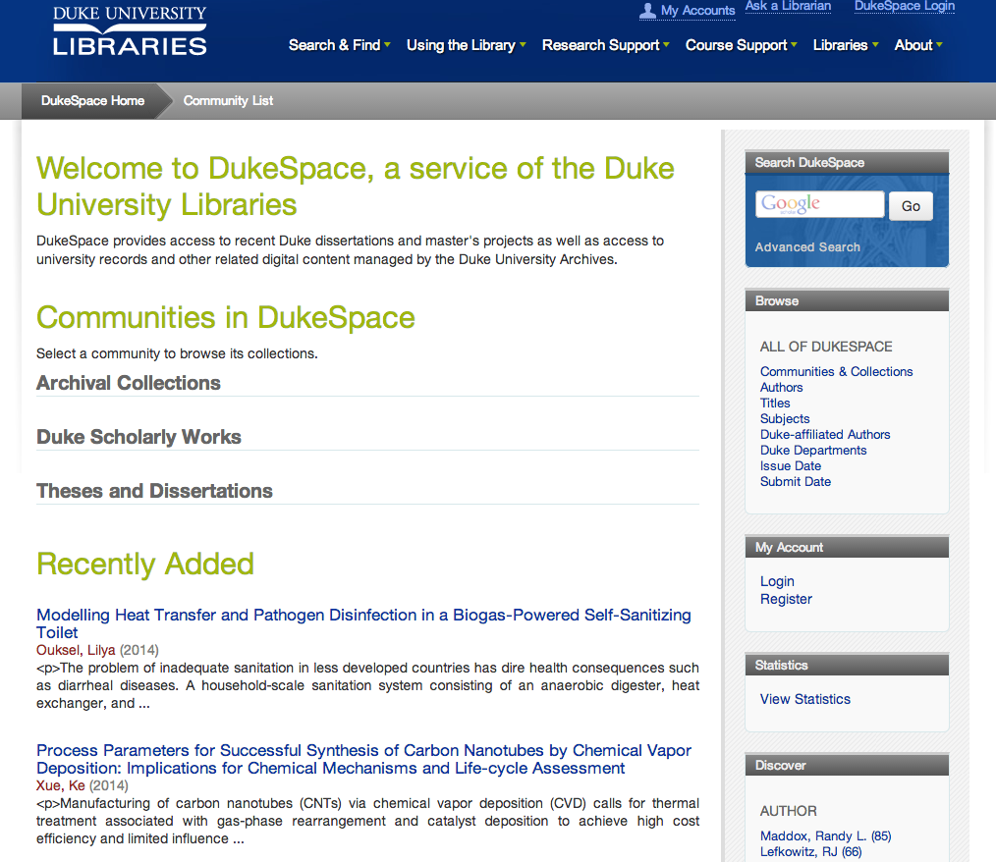
Green
http://dash.harvard.edu/
http://dukespace.lib.duke.edu/
Notes:
Open access repositories are often based at an academic institution, such as the ones at Harvard or Duke University. And they are often run by “The Library Guys” that Job referred to yesterday.

Slide 10
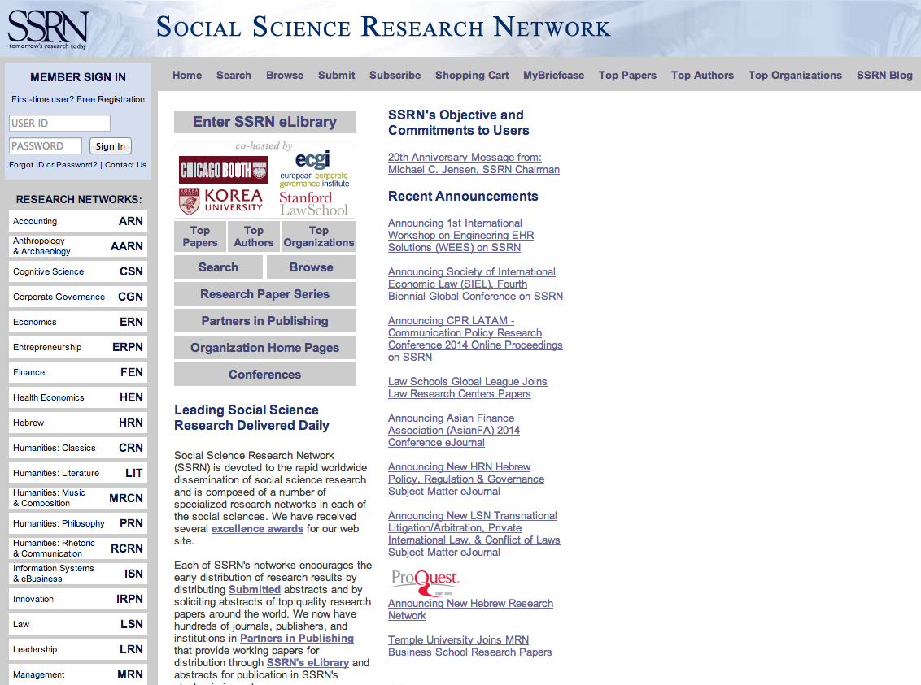
Green
“SSRN’s objective is to provide rapid worldwide distribution of research to authors and their readers and to facilitate communication among them at the lowest possible cost. “
http://ssrn.com/en/
Notes:
Or repositories can be disciplinary based, such as SSRN, the Social Science Research Network.
SSRN’s objective is to provide rapid worldwide distribution of research to authors and their readers and to facilitate communication among them at the lowest possible cost.

Slide 11
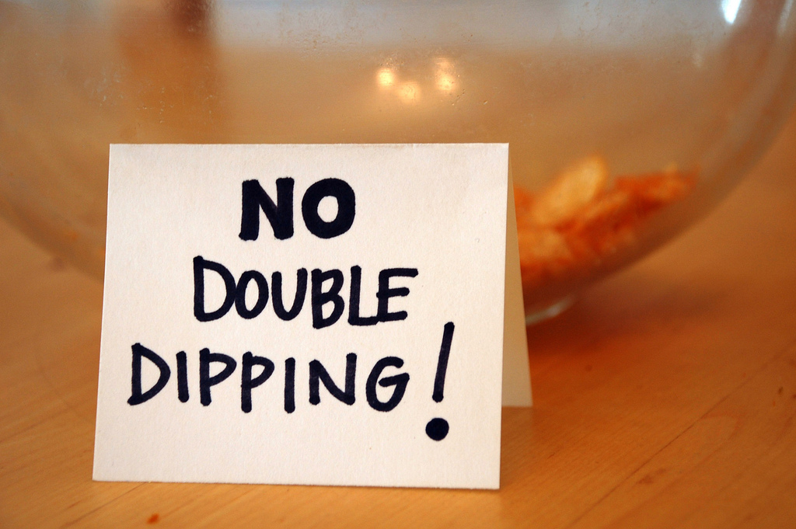
Notes:
There’s also a third model, which is neither green nor gold. It’s called hybrid, and it’s when a traditional, subscription publisher offers authors the option of making their article open access for a fee. Many find this model very problematic, because of what we call double dipping. Publishers are receiving article processing fees from the author, yet they’re still charging full subscription prices.

Slide 12


Notes:
I think there aren’t many people who want their scholarship closed up and inaccessible, so in principle most everyone seems to agree that open access is a good thing. But there are certainly opinions about how exactly to implement it. I think a lot of these opinions are formed when principles of open access intersect with how things have typically been done in the academy.
Additionally, there are points of confusion about the ways in which copyright and publisher agreements haven’t always worked in the best interest of authors.

Slide 13

Notes:
Sometimes the promotion and tenure process seems to clash with principles of open access. Publishing in a prestigious journal becomes more important than anything else.

Slide 14
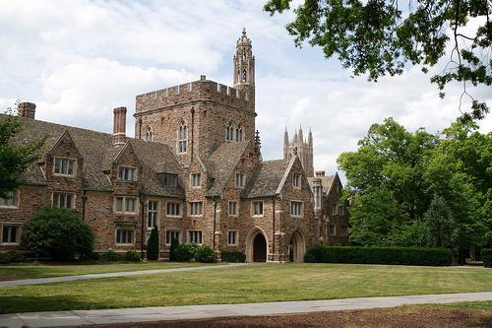
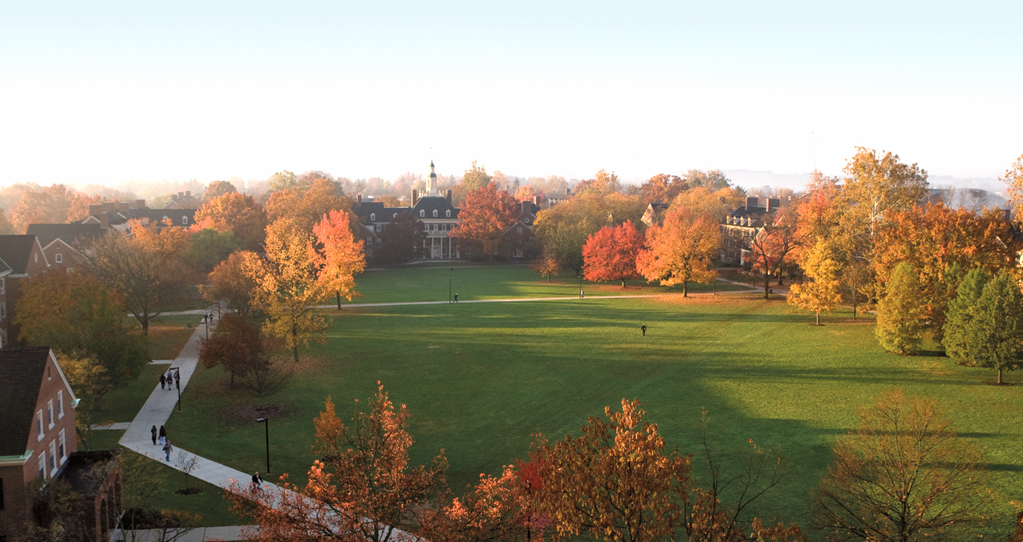
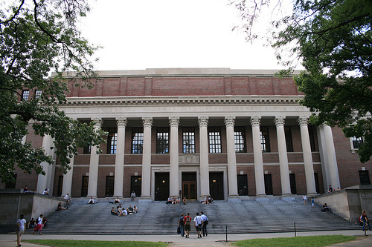
Duke University
≠
Harvard University
Notes:
So some of these issues are what motivated us to conduct our research. We had been participants in the greater discussions about open access, and we knew that faculty at Duke, Harvard, University of Kansas, Oberlin, MIT, Amherst, and a score of others – including the entire California system – had adopted open access policies.
But we also knew that faculty at these schools weren’t necessarily representative of faculty at Miami University.

Slide 15
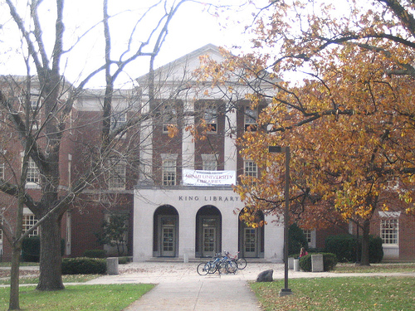
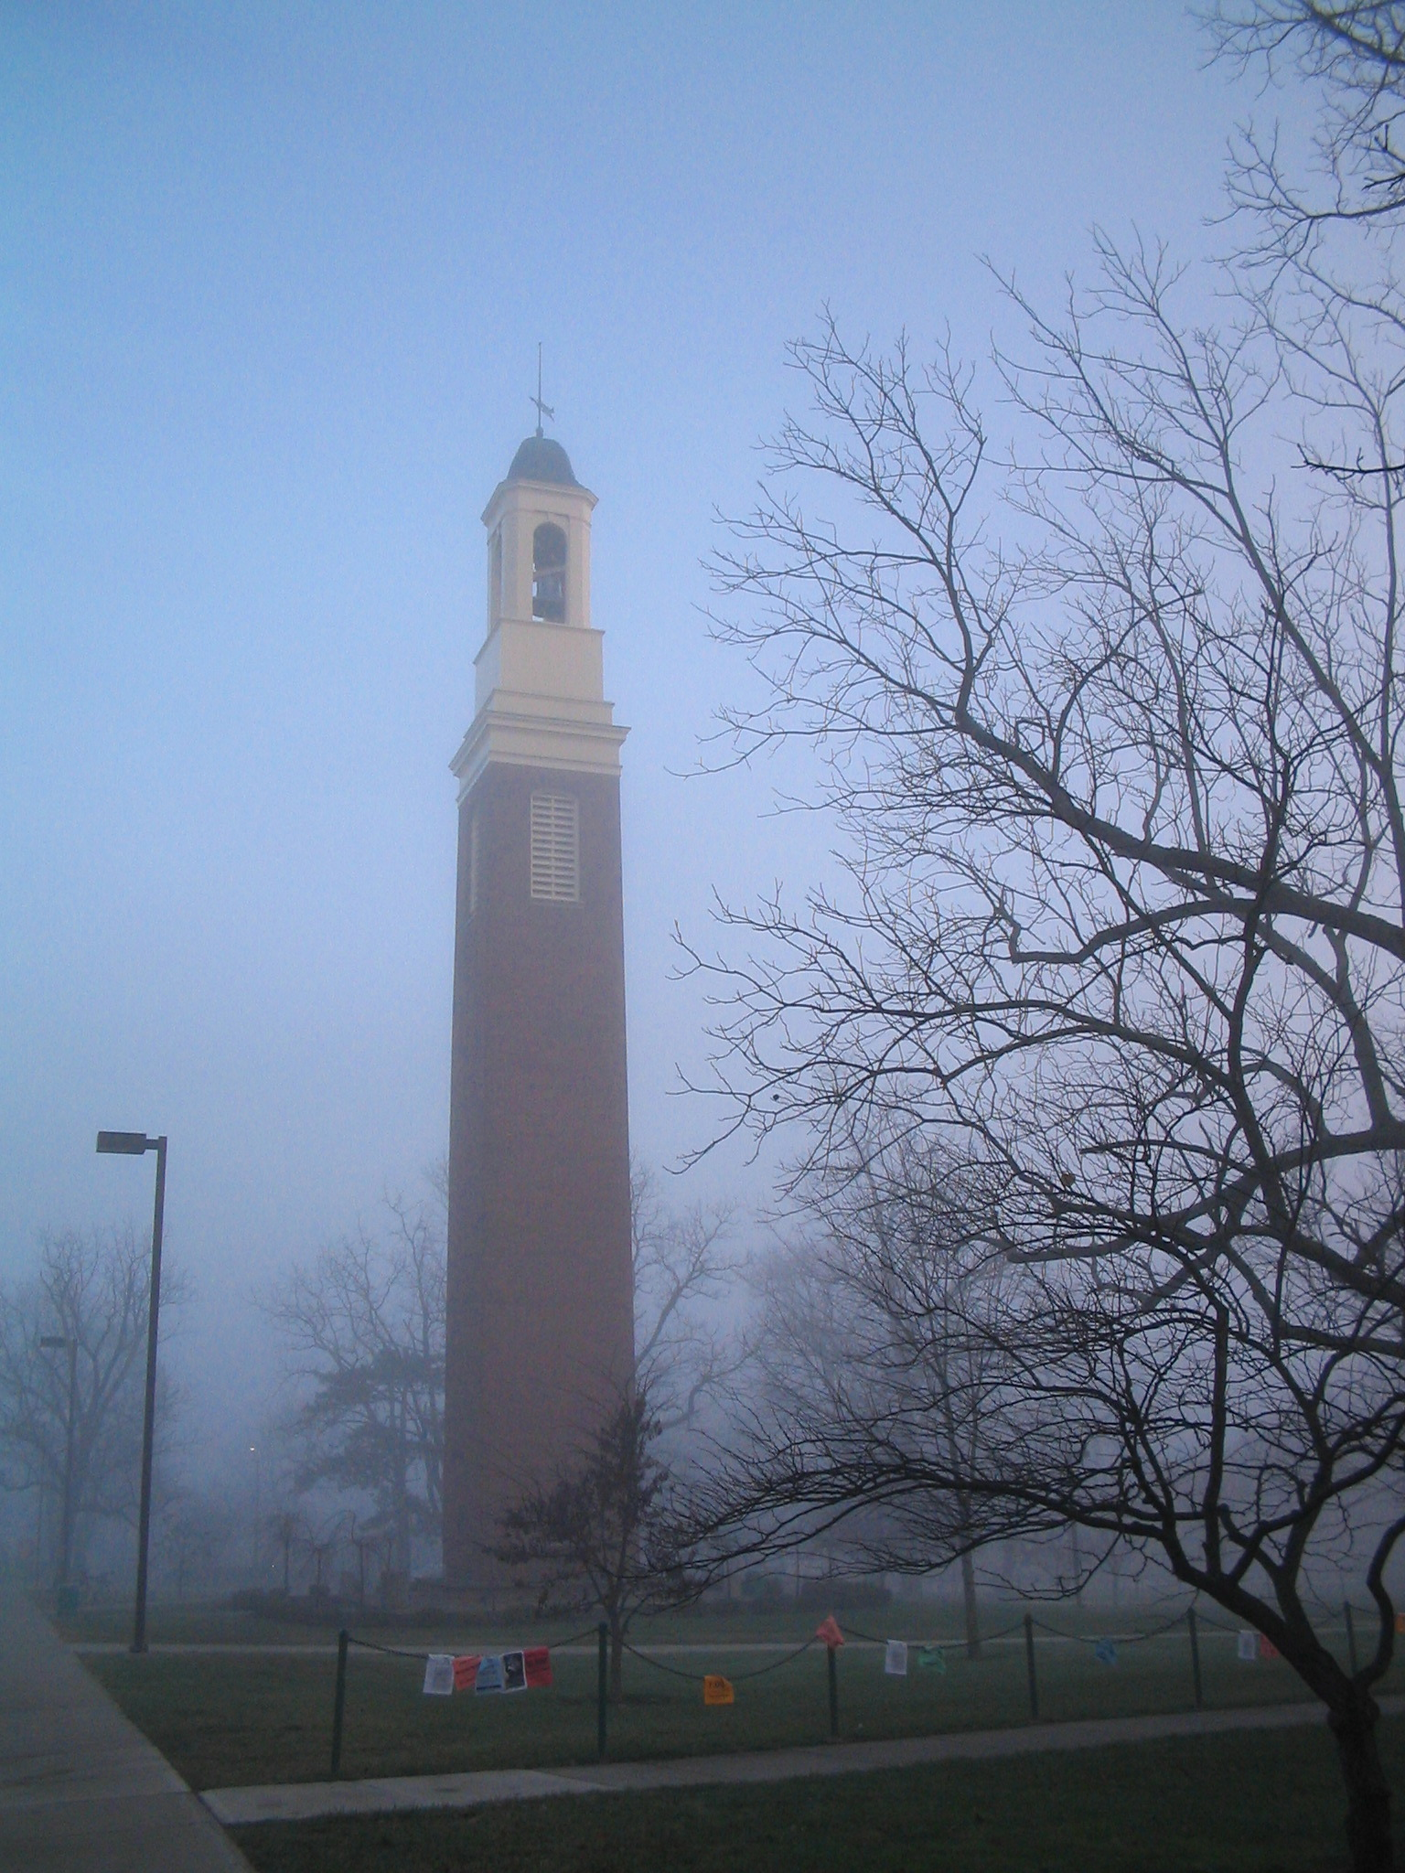
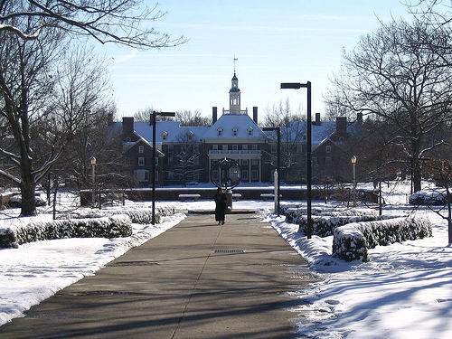
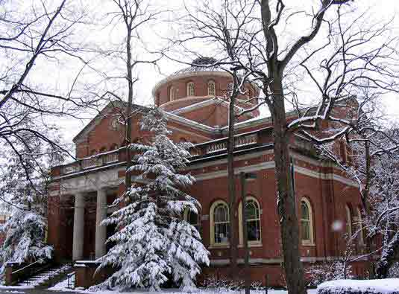
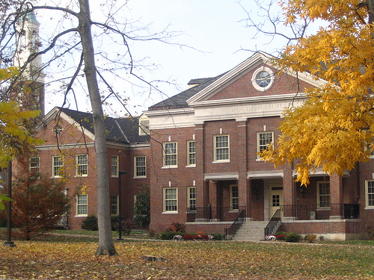
The Context:
Notes:
So just to give some context…
Miami University was established in 1809, which is before Florida became a state
It is a public university with main campus in Oxford, OH, which is about 45-minutes northwest of Cincinnati and about 3-miles from the Indiana border. Miami has three smaller regional campuses in Hamilton, Middletown, and West Chester, which are all in the greater Cincinnati area.
In 2013 the university had a total undergraduate FTE of 21,300 students and total grad enrollment of 2,439 students.
Focuses primarily on undergrad liberal education offering bachelor’s degrees in over 100 areas, master’s degrees in more than 50 areas, and several doctoral degrees.
Faculty positions are primarily tenure-track but adjunct and clinical/lecturer positions have been rising in number in recent years.

Slide 16
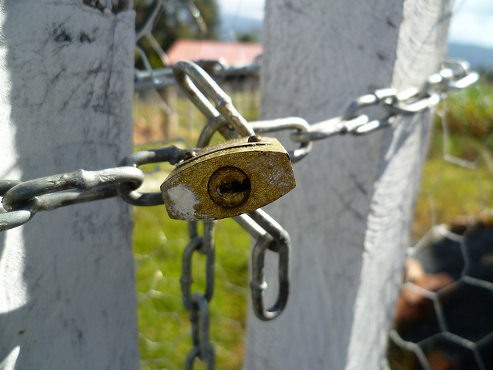

Notes:
So while we have a large and active body of faculty performing research and publishing, the university community is conservative and has been slow to recognize changes in scholarly communication.
We believed that a better understanding of our faculty members’ opinions about open access could inform our initiatives in implementing open access programming, services, and policies on our campus. Additionally, we thought components of faculty confusion about open access could guide other library services related to open access, like enhancements we make to our institutional repository or the inclusion of open access topics in library instruction and outreach.

Slide 17
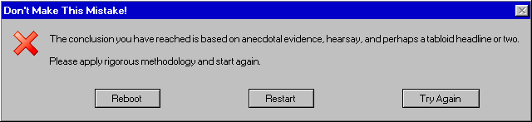
Notes:
In other words, we had heard anecdotal evidence and hearsay. We had heard about faculty supporters, faculty confusion, and faculty who were misinformed. Too often we design programs and services without the input of our communities, so we wanted to avoid this.

Slide 18
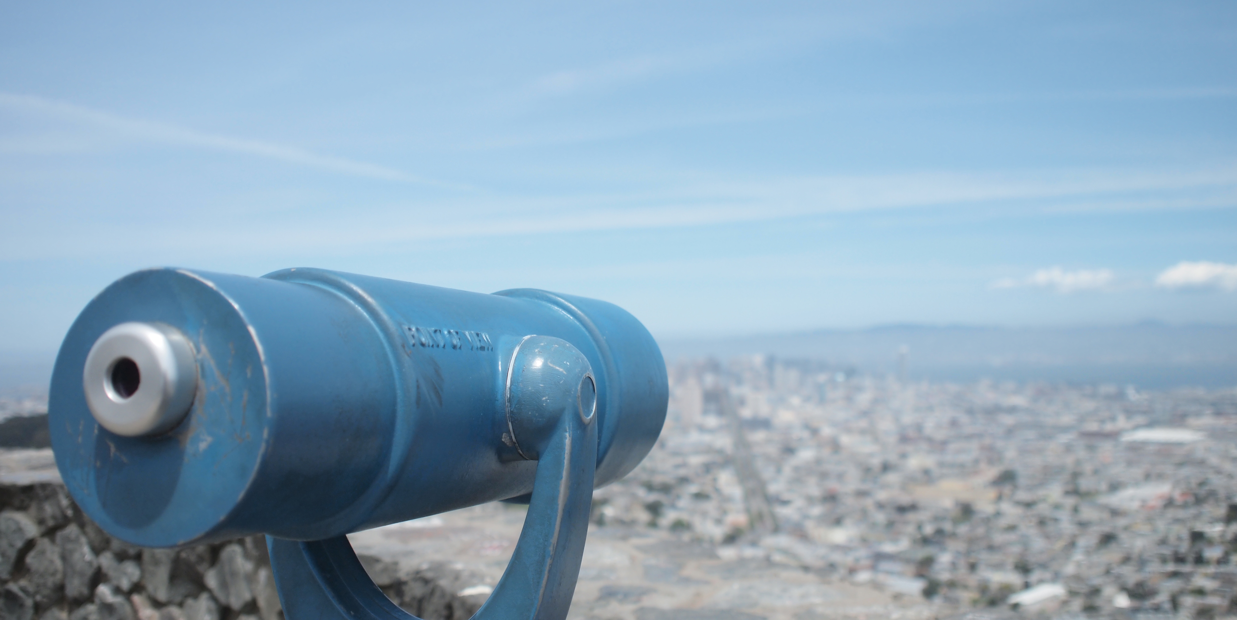
Points of View…
Keep the Change: Clusters of Faculty Opinion on Open Access
http://www.ala.org/acrl/sites/ala.org.acrl/files/content/conferences/confsandpreconfs/2013/papers/WallerRevelleShrimplin_Keep.pdf
Notes:
My boss, who is now the Libraries’ Associate Dean, had worked with Steven Brown prior to coming to Miami. So he was familiar with Q Methodology, and he and other colleagues at Miami had done a number of studies using it. This was my introduction to Q, and I’m still far from the expert all of you are. But because you all are experts, I’m going to skip the methodology, and jump straight to the three main opinion types we found on our campus.

Slide 19
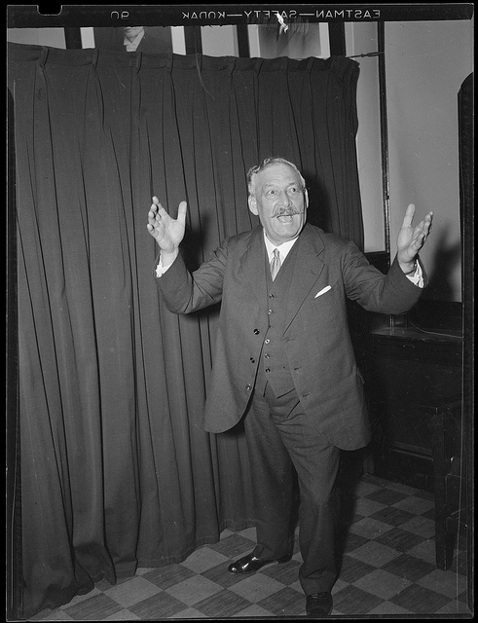
Evangelists
Notes:
We called the Factor One the Evangelists.
Evangelists’ opinions mirror many of the standard arguments made in favor of open access, namely that “information should be as widely and freely available as possible” They also believed in open data, increased access, and access to global audiences. The also greatly appreciate the speed at which articles become available.

Slide 20
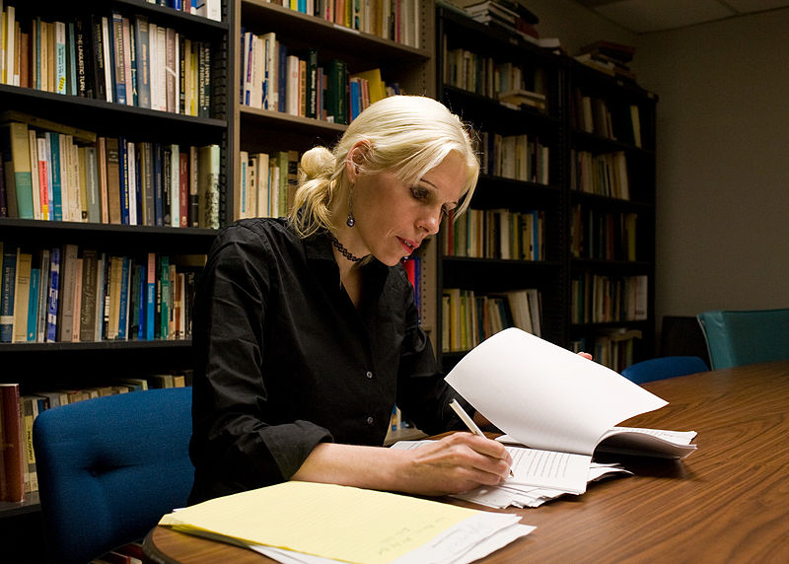
Pragmatists
Notes:
We called the second factor the Pragmatists. This group generally supports open access, but they are not willing to pay any cost to achieve it. They refuse to pass up prestigious publishing opportunities in favor of open access. However, if there are no differences between two publishing opportunities, they would choose the open access option. Pragmatists are also concerned about the perceived costs of open access publishing and find front-loading – or article processing charges – really problematic.

Slide 21
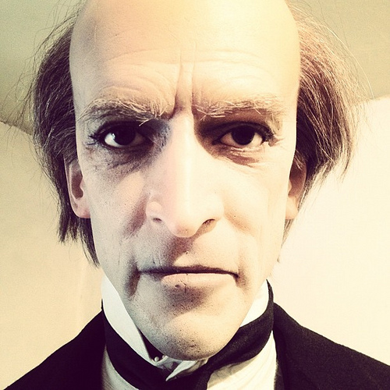
Traditionalists
Notes:
We called our third factor the Traditionalists. Traditionalists believe all who need access to scholarly research already have access to it and that all interested parties lie within the academic community. They don’t see a problem with publishing models as they currently stand. The traditionalists are also the only group that had concerns about open access leading to plagiarism, both of their own work and by their students.

Slide 22

Implications
Notes:
The results of this research continue to give us ideas for reaching different populations on campus. We knew we would find groups that were for and against, but the discovery of pragmatists gives us a target for outreach and advocacy efforts. Also funds by which we could help with some of the charges. Pragmatists are the people with whom we want to spend time. Our evangelists are also very important. Because they are already allies, we don’t want to alienate them. Additionally, they are often eager partners for testing new tools
For us, with a small group working on scholarly communication and open access, we have chosen to not spend time on traditionalists.

Slide 23
Views on open access publishing among members of ISSSS
Notes:
So now that I’ve talked about the original study, Job is going to discuss how he used our data.

Slide 24
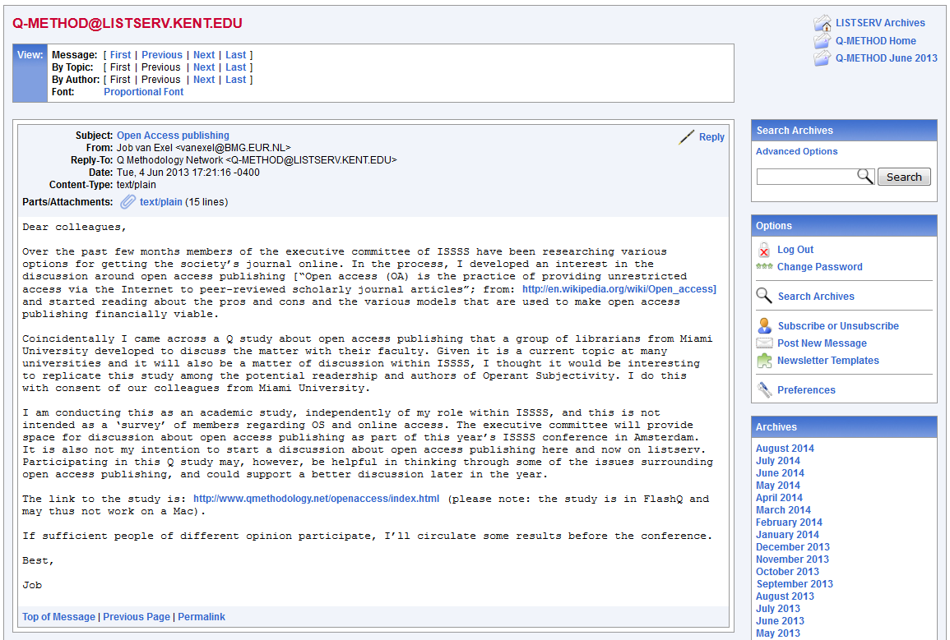

Slide 25
Some details about the study
Study was conducted online using FlashQ
Respondents ranked the 48 statements from Waller et. (2013) according to agreement.
Introduction to the subject:
    “This study is about open access, the practice of providing unrestricted access via the Internet to peer-reviewed scholarly journal articles (from: http://en.wikipedia.org/wiki/Open_access). This is a current topic at many universities. We are interested in your view about open access publishing. “
Condition of instruction:
    “To what extent do you agree with these statements about open access publishing?”

Slide 26
Results
Data supported three factors, defined by 4, 4 and 12 Q sorts, respectively.
Seven remaining Q sorts were all confounded.
Correlation between factor scores was moderate to high:
  factor 1 vs. factor 2 .55
  factor 1 vs. factor 3 .49
  factor 2 vs. factor 3 .73

Slide 27
Reserved pragmatists
information should be widely and freely available
more people read and cite your papers
  “although I see no evidence for this”
open access journals are considered of lower reputation, they’d rather publish in other, more prestigious journals
costs to authors and lack of appreciation by superiors and grant issuers are seen as barriers for pursuing open access publishing.

Slide 28
Reserved pragmatists
“Access to academic information is limited to an elite educational class. The world needs to be able to access information freely in order to promote equity.”
“Authors publish to provide knowledge to all others not just select others.”
“An author works hard on his or her manuscript. It seems insulting to have him or her pay to have it published. It's akin to a band writing an album, paying to record the album, and then giving it away for free. It's nice because the band wants to be heard, but it is not viewed as worthwhile as a band that is paid to record their album.”

Slide 29
Enthusiastic pragmatists
Making information as widely and freely available as possible is considered very important
  Give more people access to scholarly literature
  Stimulates innovation
  Get more people to read and cite your papers
    “As studies tend to show”
Open access journals are not less prestigious, but incentives in the system make you choose journals that are considered prestigious by their peers or by their university
Front loading publication costs is considered problematic and equated with 'vanity’ publishing
All in all, open access more beneficial to readers than to authors

Slide 30
Enthusiastic pragmatists
“Information dissemination is critical to generating new research ideas.”
“Citations from work are important in determining the impact of my work for others... so access is extremely important to promote this aspect of academic work.”
“I don’t' have much grant money to pay for publishing fees and will likely choose to publish in journals with small fees or no fees at all.”

Slide 31
Evangelists
Open access is a wonderful development
Information should be widely and freely available
  Faster access to cutting edge research increases the potential for innovation
  More people read and cite your papers
  A benefit for teaching (incl. data)
No significant difference in reputation between subscription and open access journals
Open access beneficial to authors as well as readers
Feel frustrated by commercial publishers' inability to adopt an open access model

Slide 32
Evangelists
“The current system limits a large portion of research to only those that can either afford it or have affiliations to get it.”
“[…] most of the world has been left out. Why, when there are opportunities to set this aright, can we justify restricting access to our work?”
“The more heads working with more ideas has been a worthy goal of science for hundreds of years. Openness is part of the bedrock of science.”
“The environment I work in teaches virtually. We limit the amount of paid for resources and strive to use all OER for the specific purpose of being able to share our courses and the content we have created. Open access is vital to this function.”

Slide 33
Evangelists
Open comment:
  “As all groups, we (Q methodologists) need to share our research with other scholars. Once they see what we are doing and how Q methodology is the most powerful research tool available to them, our intellectual community will grow. Our body of knowledge will expand. Don't hide your research away for a few bucks. Give it away, give it away, give it away now.”

Slide 34
Comparing to Waller et al (2013)
 | Reserved pragmatists | Enthusiastic pragmatists | Evangelists
Evangelists | .56 | .75 | .95
Pragmatists | .73 | .40 | .46
Traditionalists | .33 | .11 | .09

Slide 35
Comparing to Waller et al (2013)
 |  | F1 | F2
ISSSS | Evangelists | .91 | .22
 | Enthusiastic pragmatists | .72 | .19
 | Reserved pragmatists | .38 | .80
Waller et al. | Evangelists | .97 | .23
 | Pragmatists | .34 | .73
 | Traditionalists | .01 | .40

Slide 36
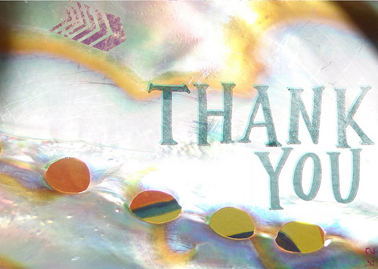

Questions?
Thank you!
Notes:
ALL

Slide 37
Photo Credits
Handshake man – woman
© Flazingo Photos
Used under a CC BY-SA 2.0 license
https://www.flickr.com/photos/124247024@N07/14090438714/
Open Access Definition Cards and Buttons
© Jen Waller
CC BY-NC-SA 2.0 license
https://www.flickr.com/photos/jenwaller/6291928307
Open Access….for sale
© Jeffrey Beall
Used under a CC BY-SA 2.0 license
https://www.flickr.com/photos/denverjeffrey/7736921426/
Golden Path
© Mathias Liebing
Used under a CC BY-NC-ND 2.0 license
https://www.flickr.com/photos/mathias764/6294661566
Along the Canal Path
© Kenneth Spencer
Used under a CC BY-NC-SA 2.0 license
https://www.flickr.com/photos/kendo26/14564107607/
Journal of Librarianship and Scholarly Communication
Home page screen shot
http://jlsc-pub.org/jlsc
International Journal of Communication
Home page screen shot
http://ijoc.org
Digital Access to Scholarship at Harvard
Home page screen shot
http://dash.harvard.edu
Duke University Libraries
DukeSpace screen shot
http://dukespace.lib.duke.edu
Social Science Research Network
Home page screen shot
http://ssrn.com/en/
Large copyright graffiti sigh on cream colored wall
© Horia Varlan
Used under a CC BY 2.0 license
https://www.flickr.com/photos/horiavarlan/4273272605/
Author Rights Brochure Cover
© SPARC
Used under a CC BY 3.0 license
http://www.sparc.arl.org/sites/default/files/SPARC_AuthorRights_Poster2006_0.pdf
Day 207: I’ve Contracted An Agreement
© Juli
Used under a CC BY NC-ND 2.0 license
https://www.flickr.com/photos/julishannon/2434691031/
Untitled
© David Silver
Used under a CC BY NC-SA 2.0 license
https://www.flickr.com/photos/davidsilver/2861078232/

Slide 38
Photo Credits
Miamiu / Alumni Hall in Winter
Licensed under Public Domain via Wikimedia Commons
http://commons.wikimedia.org/wiki/
File:Miamiu.jpg#mediaviewer/File:Miamiu.jpg
Muohiobelltower
Licensed under Public domain via Wikimedia Commons
http://commons.wikimedia.org/wiki/
File:Muohiobelltower.jpg#mediaviewer/File:Muohiobelltower.jpg
Sundial and MacCracken Hall
© Brandon C / ColorblindRain
Used under a CC BY-NC 2.0 license
https://www.flickr.com/photos/bmcirillo/3658748/
Roudebush Hall
© Brandon C / ColorblindRain
Used under a CC BY-NC 2.0 license
https://www.flickr.com/photos/bmcirillo/86556265/
King Library
© Brandon C / ColorblindRain
Used under a CC BY-NC 2.0 license
https://www.flickr.com/photos/bmcirillo/86556538/
Open Access
© Mauricio Fino / maolibrarian
Used under a CC BY-NC-SA 2.0 license
https://www.flickr.com/photos/maolibrarian/5618343640/
Open Access Logo
Used under a CC 1.0 Public Domain Dedication
http://commons.wikimedia.org/wiki/File:Open_Access_logo_PLoS_white.svg
Duke University
© Nan-Cheng Tsai/Kobetsai
Used under CC BY-ND 2.0
https://www.flickr.com/photos/kobetsai/4385384680
Harvard University Campus
© Nekonomist
Used under CC BY-NC-ND 2.0
https://www.flickr.com/photos/nekonomist/2744275609/
Tappan Hall
© Miami University
Windows Error Message
© atomsmacher.org
Create Your Own Error Message: http://atom.smasher.org/error/
Point of View II
© James…….
Used under a CC BY-ND 2.0 license
https://www.flickr.com/photos/james_p/4612467296/
Gipsy Smith, evangelist, in action in the Boston Arena
© Boston Public Library, Leslie Jones Collection
Used under CC BY-NC-ND 2.0
https://www.flickr.com/photos/boston_public_library/8094123894/
/

Slide 39
Photo Credits
Professor Moriarty said to remind you to eat your vegetables
© Steven Gray/Steve Gray
Used under CC BY-NC 2.0 license
https://www.flickr.com/photos/stevengrayphotography/8025722664/
Berit Brogaard
© August Jennewein
Used under CC-BY 3.0 license
http://commons.wikimedia.org/wiki/File:Berit_Brogaard.jpg
On Target
© viZZZual.com
Used under a CC BY 2.0 license
https://www.flickr.com/photos/vizzzual-dot-com/2655969483/
Q is for Question Mark
© Ben R./b4b2
Used under CC BY-NC-ND 2.0 license
https://www.flickr.com/photos/b4b2/3954106061/
Thank You
© Katharina Friederike
Used under CC BY-2.0
https://www.flickr.com/photos/k2scrapper/8577741616/
Just take one dip and end it
© Peyri Herrera
Used under a CC BY-ND 2.0 license
https://www.flickr.com/photos/peyri/2483791713

Slide 40
Et Cetera
This work was created by Jen Waller and Job Van Exel for the International Society for the Scientific Study of Subjectivity (ISSSS) 30th Annual Q Conference and presented on September 5, 2014, in Salt Lake City, UT.
This work is licensed under a Creative Commons Attribution-Share Alike 3.0 Unported (CC BY-SA 3.0) license. For more information about this license, please see:
http://creativecommons.org/licenses/by-sa/3.0/deed.en_US
If you are interested contacting the authors, you may do so at the following:
Job Van Exel: Twitter: @jobvanexel; Email: vanexel@bmg.eur.nl
Jen Waller: Twitter: @jenniferwaller; Email: wallerjl@miamioh.edu

