Slide 1
Are E-book Big Deal Bundles Still Valuable?
Charleston 2014

Slide 2
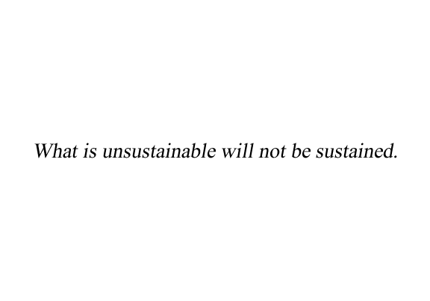
Milton Friedman

Slide 3
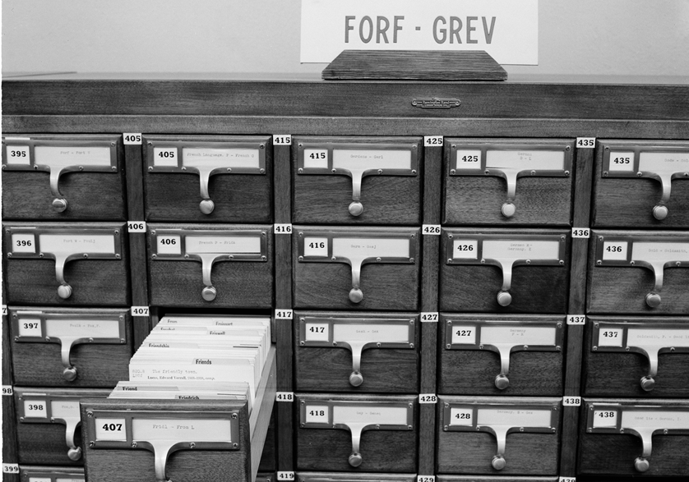
Transitions into the Digital

Slide 4

Library as Laboratory

Slide 5

Workbench to Workforce

Slide 6
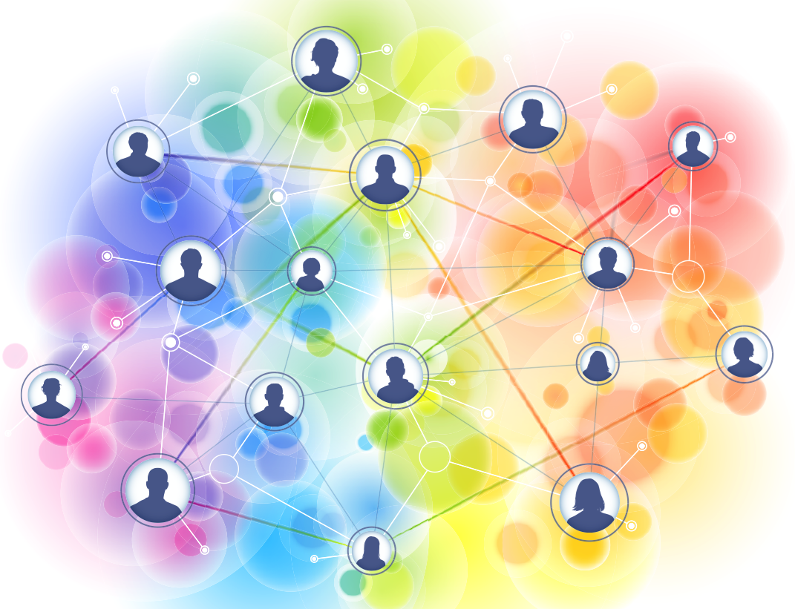
A Space Between the Spaces

Slide 7
Campus Life & E-books
Book Lovers (34%) have an inherent affinity for the print form
Technophiles (23%) are strongly interested in the possibilities of new technology as regards the book
Pragmatists (17%) are the most neutral of the four, as they are most interested in content and see pros and cons of both formats
Printers (26%) prefer print books but are distinguished from Book Lovers in that they have specific difficulties with the usability of e-books

Slide 8
Q Methodology & Large N-Survey
Aaron Shrimplin, Andy Revelle, Susan Hurst, and Kevin Messner, “Contradictions and Consensus – Clusters of Opinions on E-books,” College & Research Libraries 72, no.2 (2011): 181-190.
Andy Revelle, Kevin Messner, Susan Hurst, and Aaron Shrimplin, “Book Lovers, Technophiles, Pragmatists, and Printers: The Social and Demographic Structure of User Attitudes Toward E-books,” College and Research Libraries 73, no. 5 (2012): 420-429.

Slide 9
Acquisition Models
E-book Collections
E-Approval
PDA/DDA
Title-level
Consortia

Slide 10
Print vs. Electronic Book Expenditures

Slide 11
Total Book Expenditure By Order Type

Slide 12



The Big Deal Approach

Slide 13
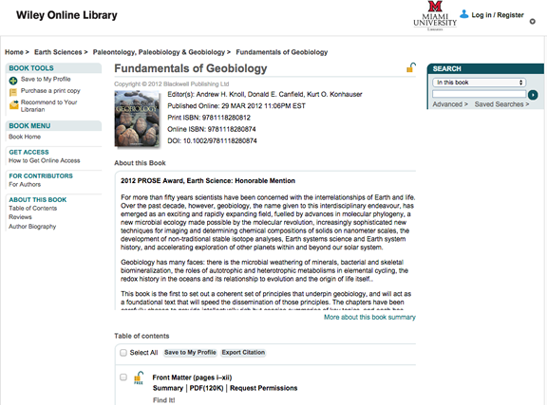
Wiley Platform
Notes:
Challenges -- Consortial package not clear-cut
Many imprints
Uncertain pub availability / dates
Catalog records released after publication
Usage data includes free content

Slide 14
Methodology
Wiley Online Books
2012 titles
n=927
Compiled usage from 2012 through 2014 (January – July) using standard COUNTER BR2 reports
SPSS/Excel/R/Photoshop

Slide 15
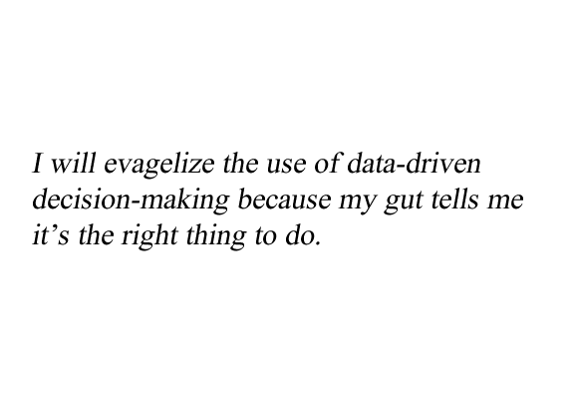
The Middle Manager’s Oath

Slide 16
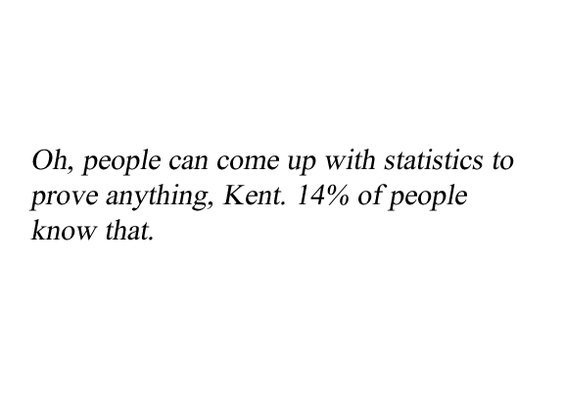
Homer Simpson

Slide 17
Title Use 2012-2014 n=927

Slide 18
Title Use Comparison

Slide 19
E-book DLs

Slide 20
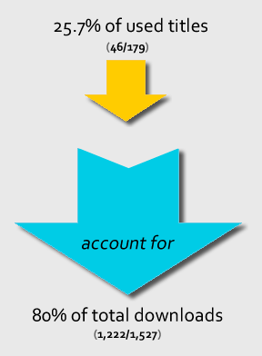
Pareto Principle

Slide 21
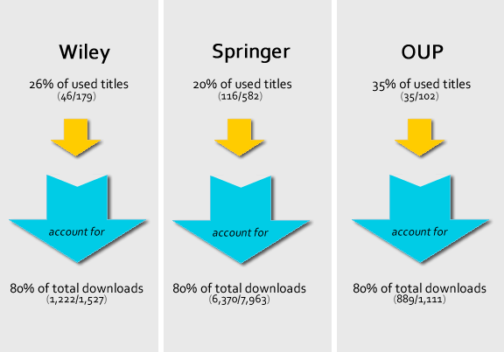
Pareto Comparison

Slide 22
Long Tail

Slide 23
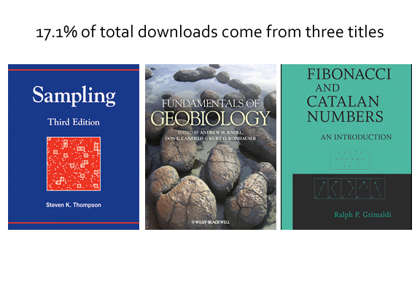
A Few High Use Titles Dominate

Slide 24
DLs by Book Type - Springer

Slide 25
Titles with Usage by Subject

Slide 26
Percentage of Total DLs by Subject

Slide 27
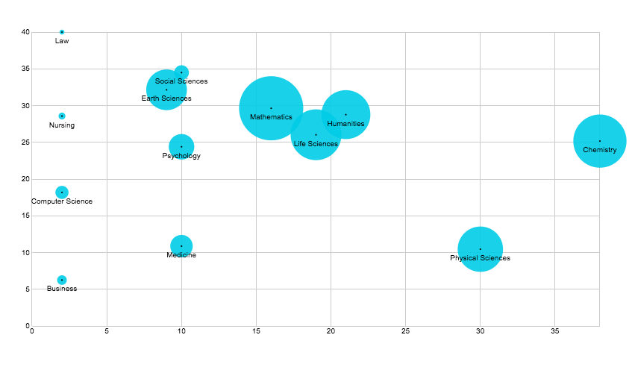

Slide 28
Value
Our price tag to OhioLINK is not commensurate with use; however, the bundle of titles becomes a better value overtime with additional usage & we own the content
179 titles @ list price = $29,588.88 (average cost per title is $165.30) – we would need to grow the number of titles used by over 50%
High use titles (textbooks)
Cost per download is high (~$30.00)
Notes:
We own the content
We would have to grow the number of titles used by over 50%

Slide 29
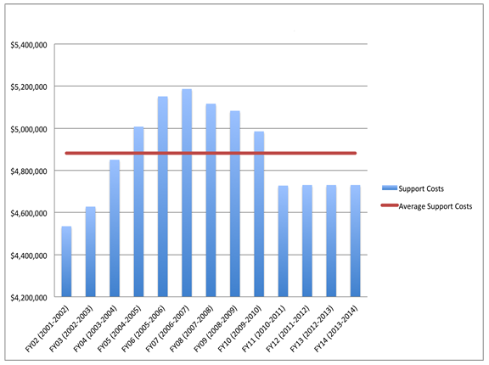
The New Normal

Slide 30
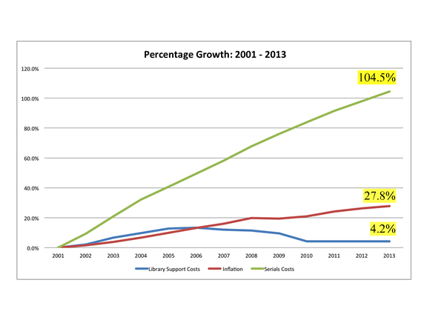
Erosion of Purchasing Power

Slide 31
Conclusions
81% percent of the titles in this study were not used from 2012 – July 2014
Underperforming asset
A relatively few high use titles dominate and the long tail accounts or a very small percentage of the total downloads
Textbooks are heavily used
Demand varies across subject areas
Fiscal challenges

Slide 32
Next Steps
More analysis
Shrink print / grow e
Compare local e-book package value to consortial e-book package value
Does the value of the collection increase with time with additional usage

Slide 33
Questions? Comments?
    Jennifer Bazeley
    Interim Head of Technical Services
    bazelejw@MiamiOH.edu
    Aaron K. Shrimplin
    Associate Dean
    aaron.shrimplin@MiamiOH.edu

