Slide 1
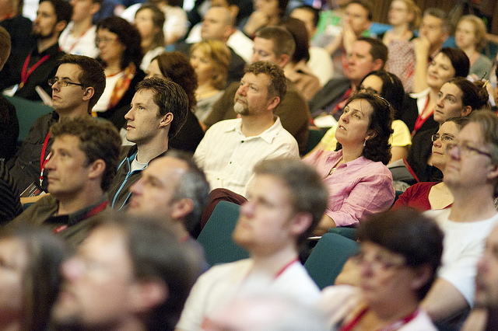

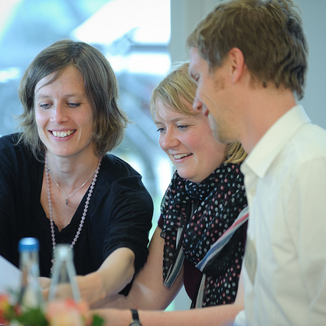

Engrossed, Enraged, Engaged:
Empowering Faculty in Transforming Scholarly Communication
Jen Waller & Jennifer Bazeley, Miami University Libraries

Slide 2
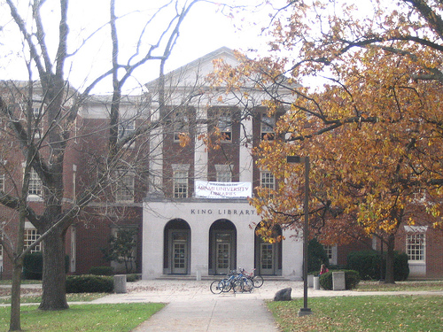
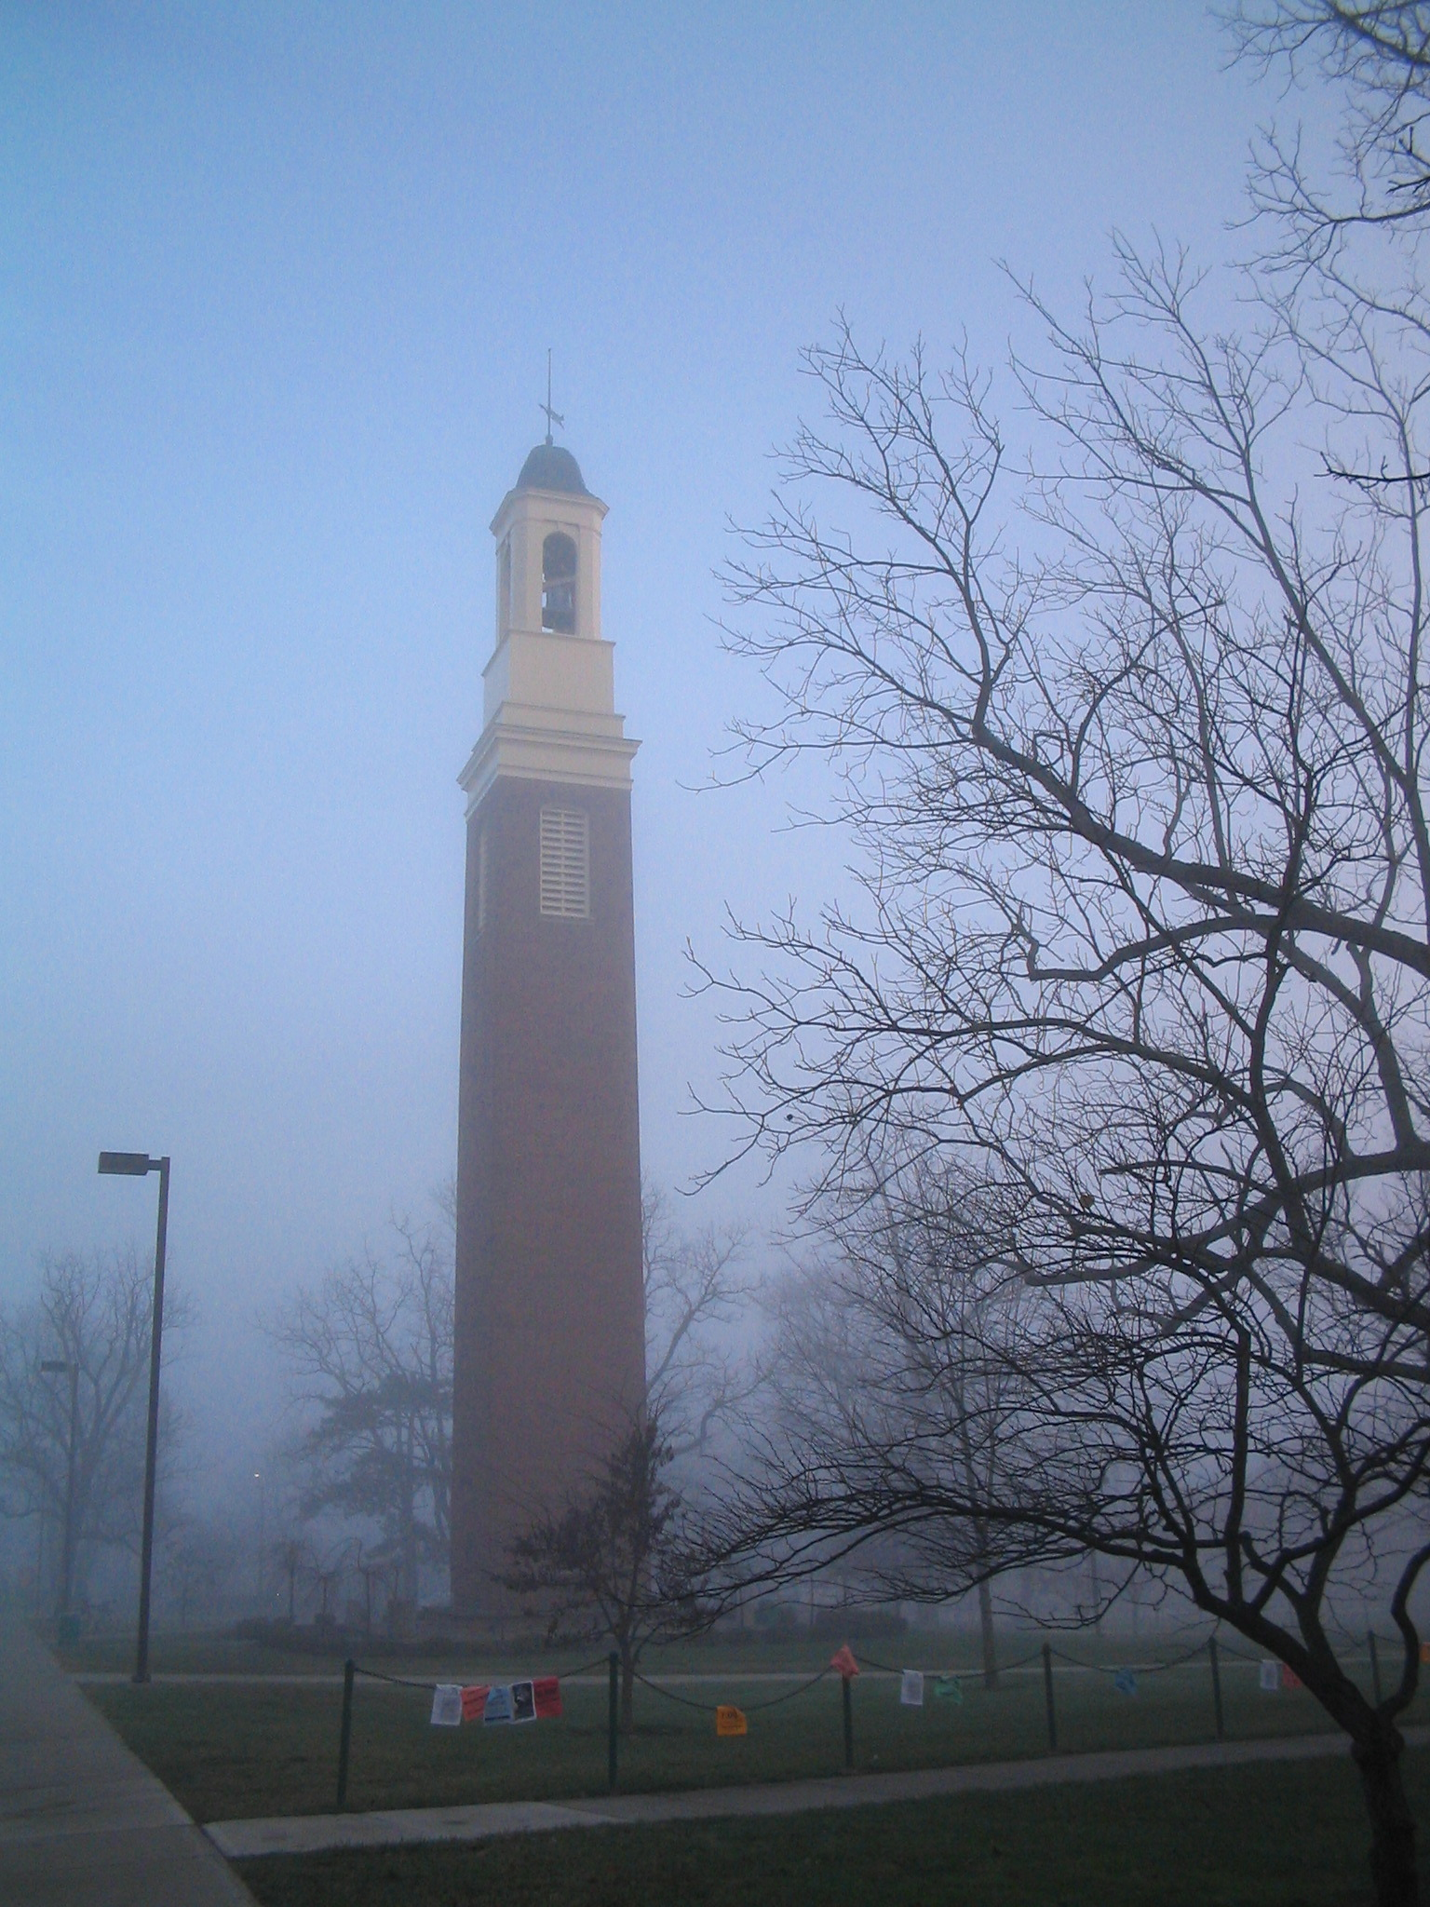
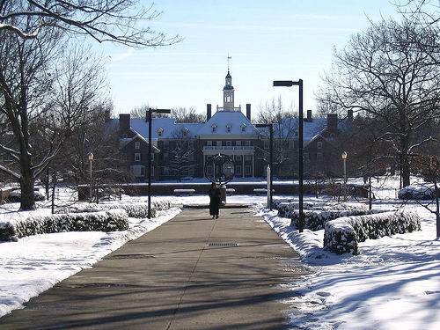
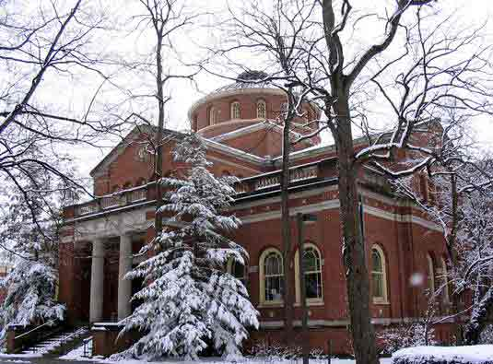
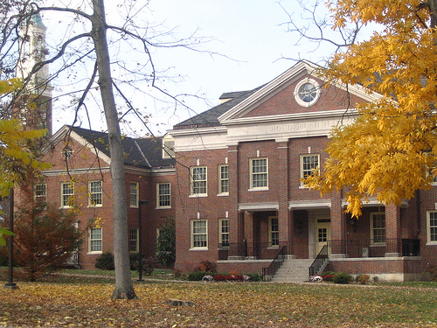
The Context:

Slide 3
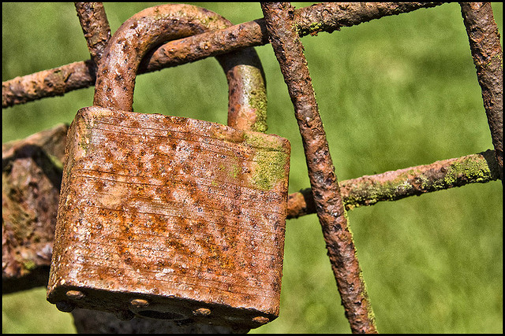

The Challenge:

Slide 4
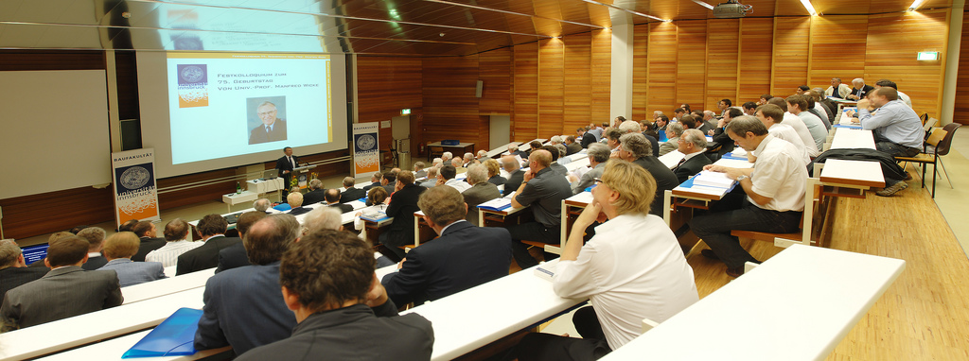
Previous Efforts:
Presentations to:
  History Department
  Psychology Department
  College of Arts & Sciences Department Chairs

Slide 5
What is an FLC?
“A faculty learning community is a group of trans-disciplinary faculty, graduate students and professional staff group of size 6-15 or more (8 to 12 is the recommended size) engaging in an active, collaborative, yearlong program with a curriculum about enhancing teaching and learning and with frequent seminars and activities that provide learning, development, transdisciplinarity, the scholarship of teaching and learning, and community building.”
http://www.units.miamioh.edu/flc/whatis.php

Slide 6
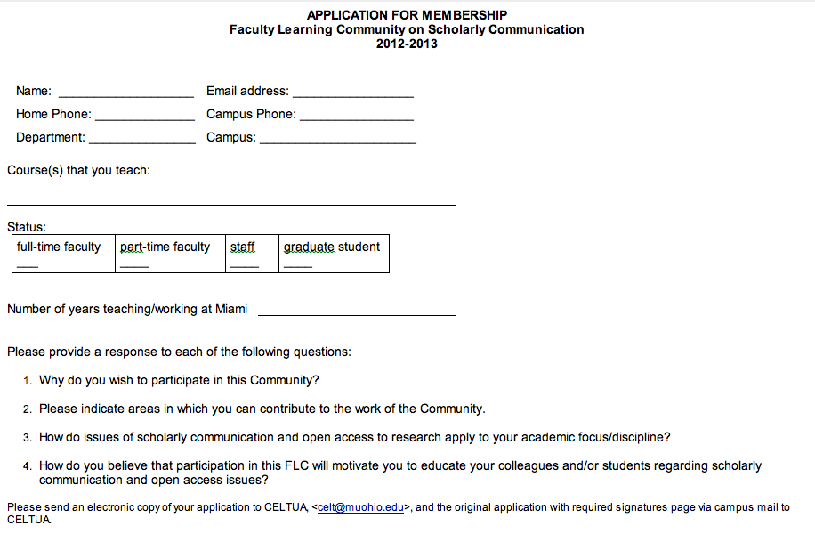
The Process: applications

Slide 7

The Process: member selection

Slide 8
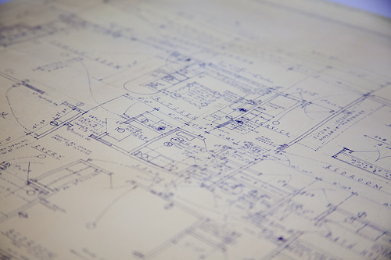
Original Objectives

Slide 9
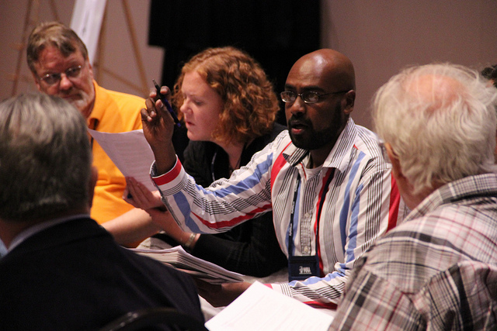
Our FLC: programming & meetings

Slide 10
Meeting Topics
Open Access
Open Data, Data Sharing (panel discussion)
Open Peer Review
Predatory Publishers, Vanity Presses
Economics of Publishing & Funding Models
Institutional Repositories
Altmetrics
Author Rights
Creative Commons
Copyright
OER
Misconceptions about Open Access
Open Access Week special programming

Slide 11
Engrossed

Slide 12
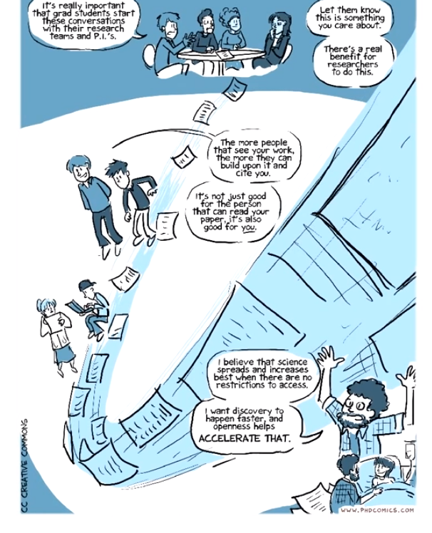
Engrossed: “Open Access Explained”
http://youtu.be/L5rVH1KGBCY

Slide 13
Publisher Revenue & Profit
Engrossed: journal costs
Year | Total Revenue | Total Profit
2002 | $2,097,511,500.00 | $694,851,300.00
2003 | $2,236,805,700.00 | $756,399,900.00
2004 | $2,207,651,100.00 | $745,062,000.00
2005 | $2,325,889,200.00 | $727,245,300.00
2006 | $2,463,563,700.00 | $753,160,500.00
2007 | $2,440,887,900.00 | $772,596,900.00
2008 | $2,753,490,000.00 | $919,989,600.00
2009 | $3,215,104,500.00 | $1,122,452,100.00
2010 | $3,281,512,200.00 | $1,172,662,800.00
2011 | $3,333,342,600.00 | $1,243,929,600.00

Slide 14
Engrossed: author rights
ACRL copyright transfer exercise:
http://www.scholcomm.acrl.ala.org/node/32

Slide 15

Engrossed: open peer review

Slide 16
Enraged

Slide 17
Engaged

Slide 18
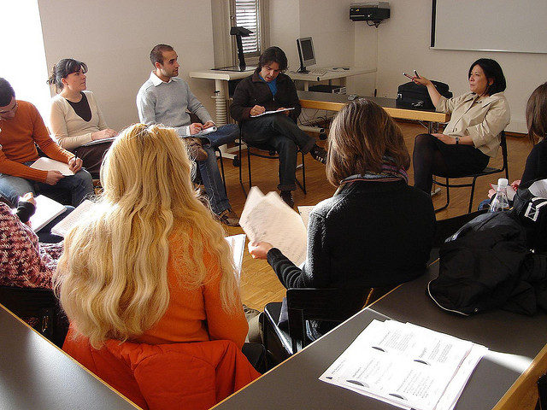
Engaged: member-facilitated discussions

Slide 19
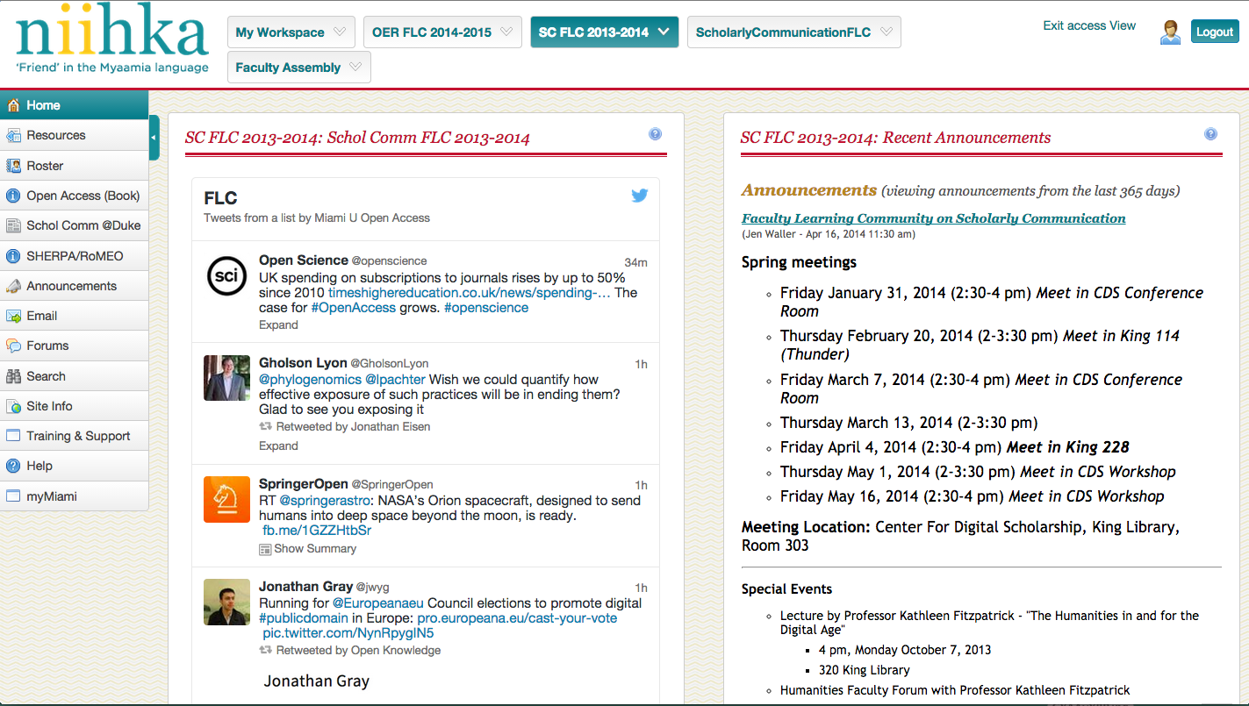
Engaged: LMS – niihka (Sakai)

Slide 20
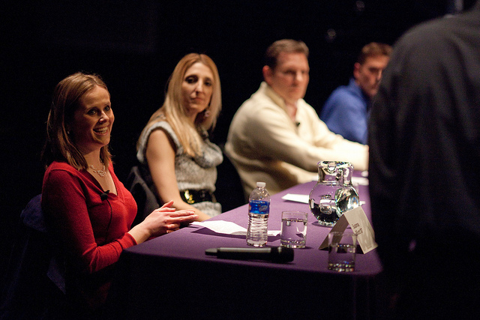
Engaged: panel on open data/data sharing

Slide 21




Engaged: getting your work “out there”

Slide 22
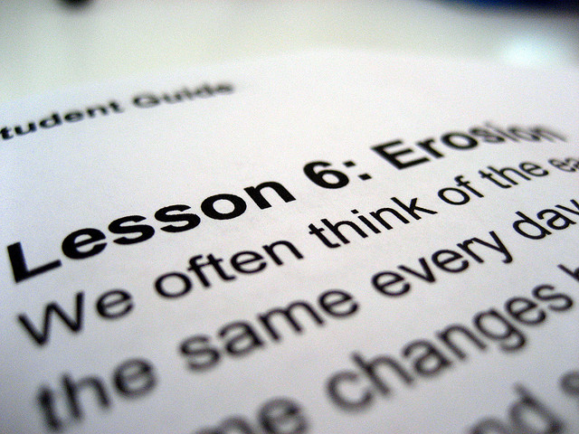
Outcomes

Slide 23

Successes

Slide 24
Open Access Week panel discussion

Slide 25
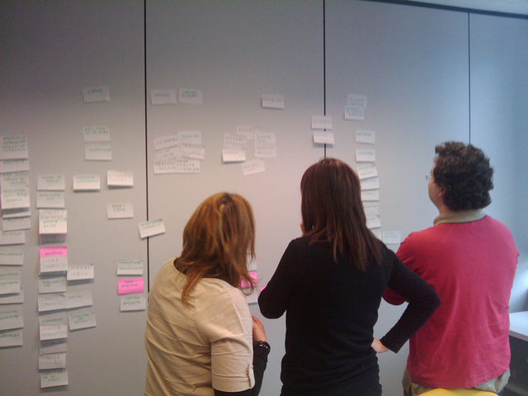
Scholarly Communication website

Slide 26
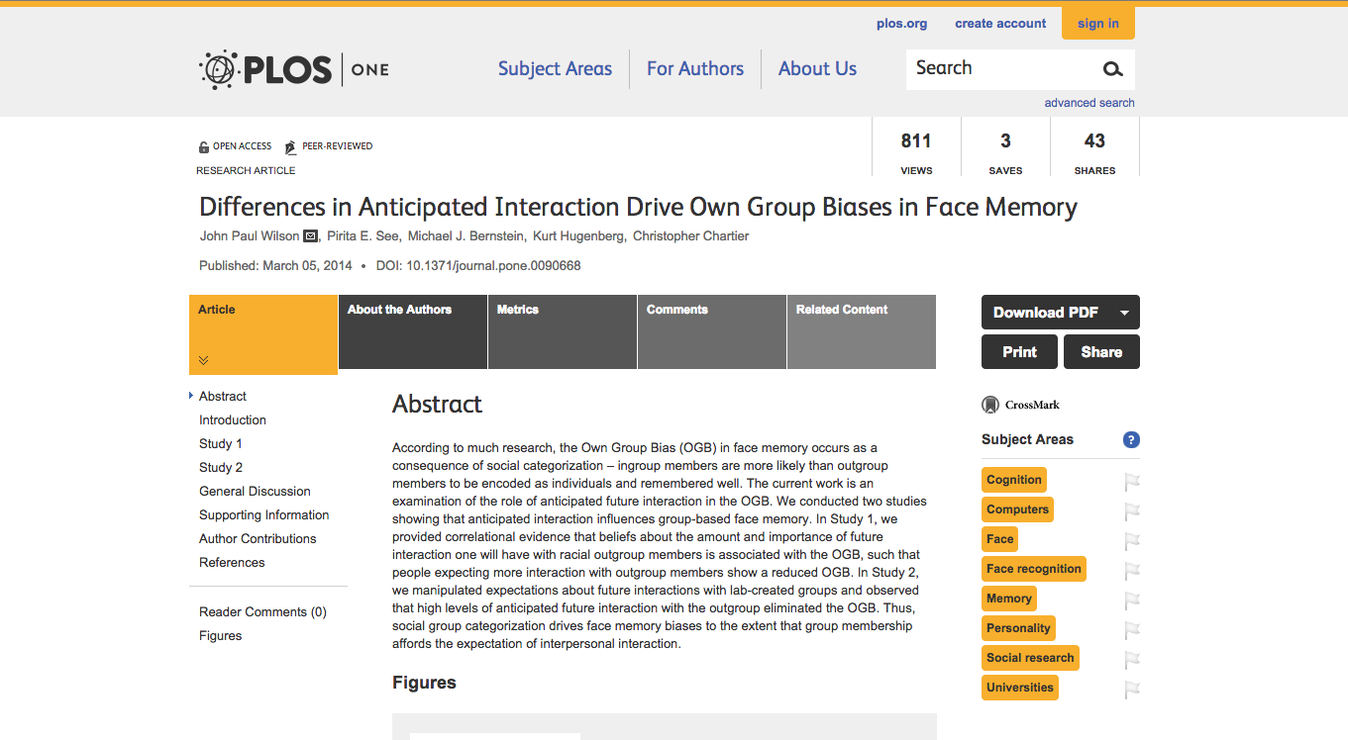
Faculty behaviors changed

Slide 27

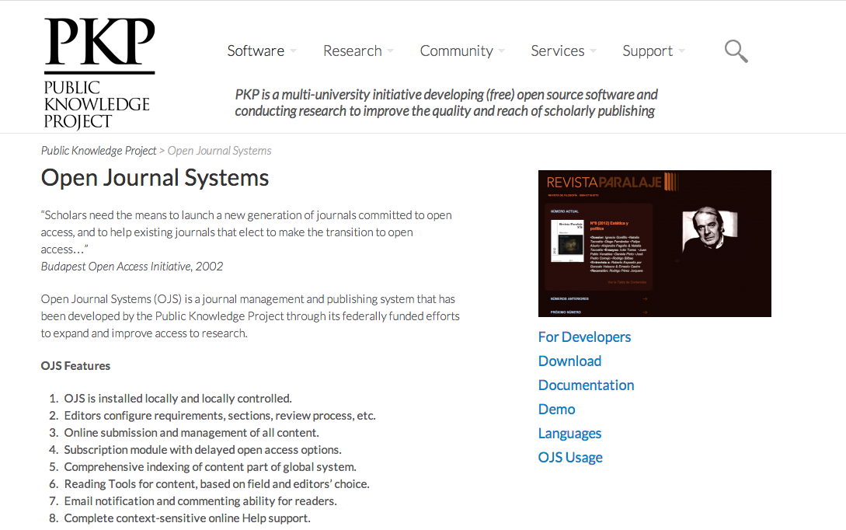
Faculty behaviors changed

Slide 28
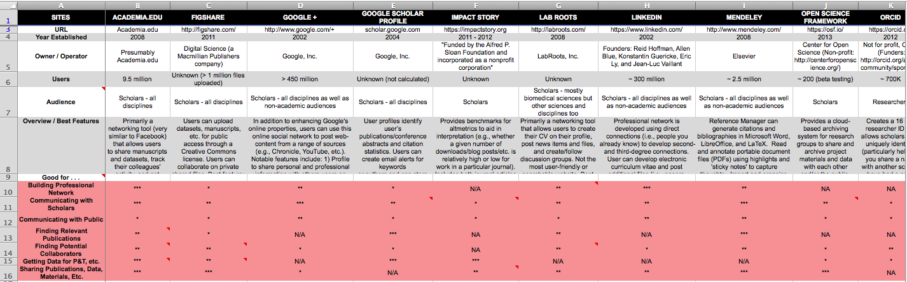
Faculty created tools

Slide 29
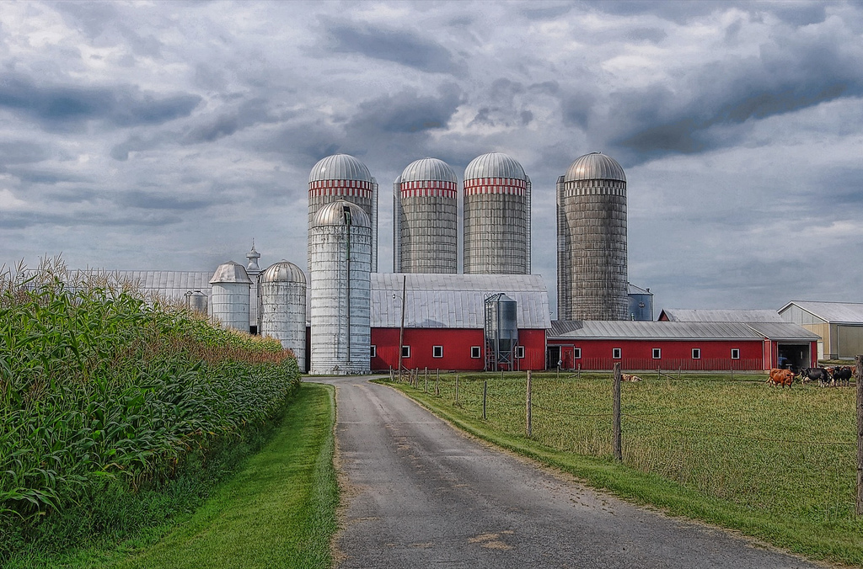
Breaking Down Silos

Slide 30

Your FLC: diy

Slide 31
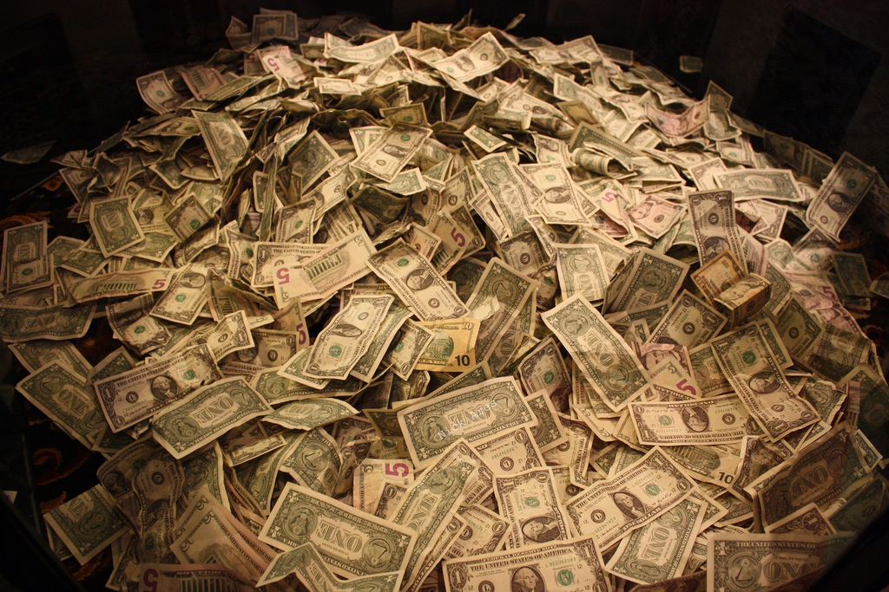
DIY: funding

Slide 32
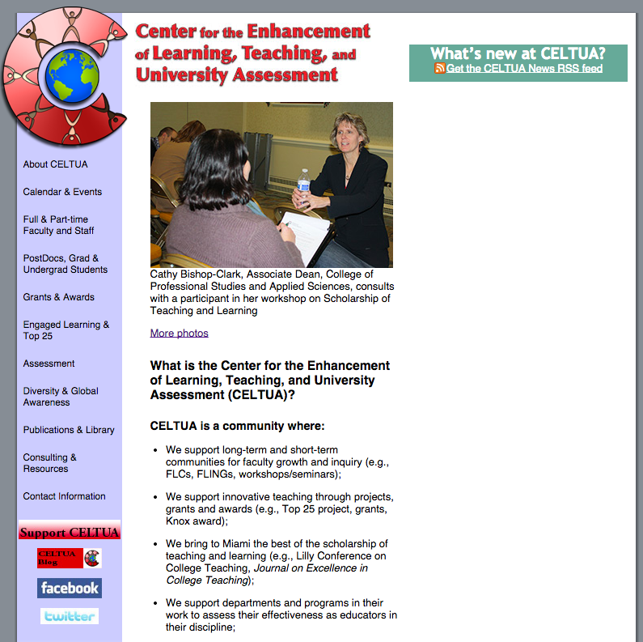
DIY: funding partners
Center for Teaching & Learning
Center for Advancement of Teaching
Center for Teaching Innovation and Excellence
Faculty Professional Development Center

Slide 33

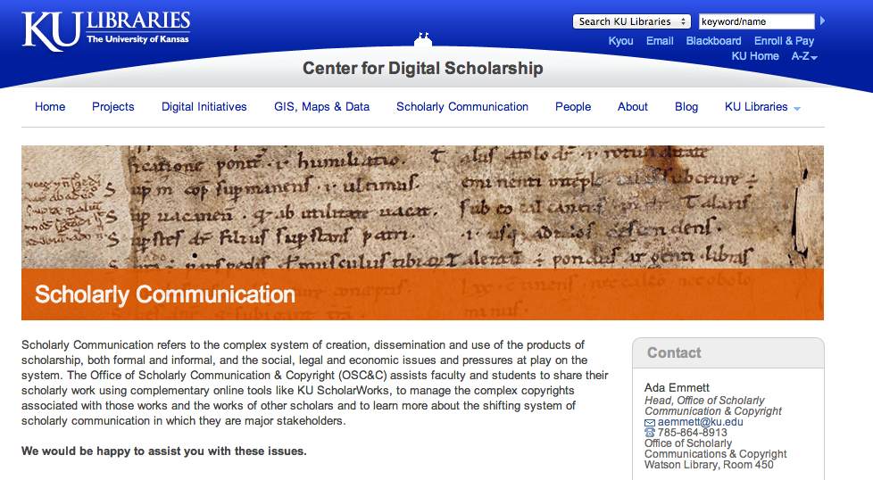
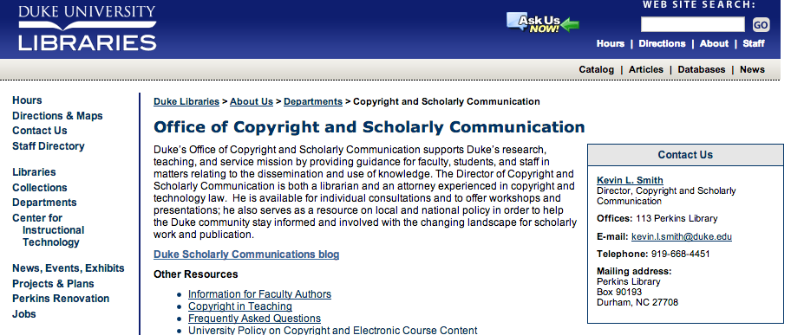

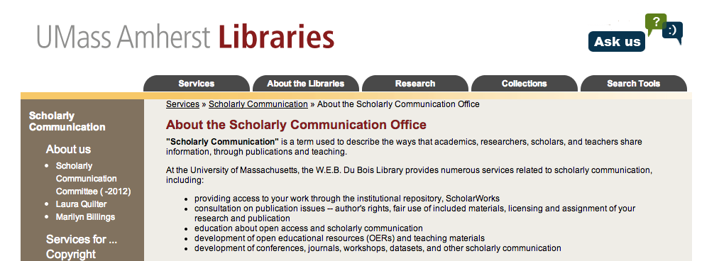
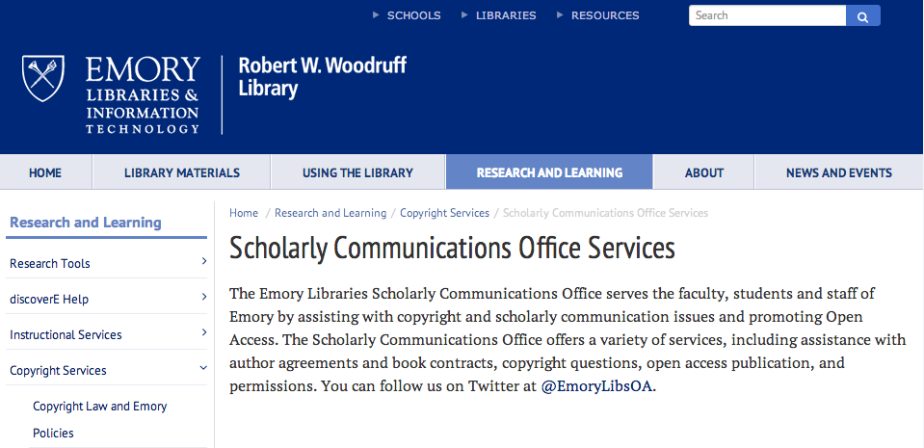

DIY: funding partners

Slide 34
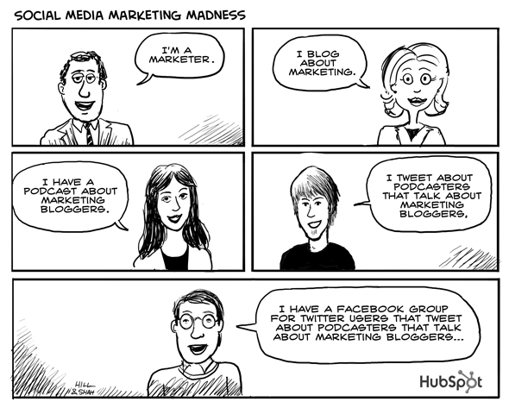
DIY: marketing, promotion, communication

Slide 35

DIY: scheduling & meetings

Slide 36


Slide 37

Thank you! questions?

Slide 38
Photo Credits
Engrossed 3
Engrossed © TEDxCanberra.
Used under a CC BY-NC-ND 2.0 license.
https://www.flickr.com/photos/tedxcanberra/5119237201/
Enraged
Thoth God of Knowledge © Rage Wallpaper.
Used under a CC BY 2.0 license.
https://www.flickr.com/photos/thoth-god/3680655443/
Engaged
Workshop © Heinrich-Böll-Stiftung.
Used under a CC BY-SA 2.0 license.
https://www.flickr.com/photos/boellstiftung/5803926253
Miamiu/Alumni Hall in Winter
In the public domain via Wikimedia Commons
http://commons.wikimedia.org/wiki/
File:Miamiu.jpg#mediaviewer/File:Miamiu.jpg
Muohiobelltower
In the public domain via Wikimedia Commons
http://commons.wikimedia.org/wiki/
File: Muohiobelltower.jpb#mediaviewer/File:Muohiobelltower.jpg
Sundial and MacCracken Hall © Brandon C/ColorblindRain.
Used under a CC BY-NC 2.0 license.
https://www.flickr.com/photos/bmcirillo/3658748
Roudebush Hall © Brandon C/ColorblindRain
Used under a CC BY-NC 2.0 license.
https://www.flickr.com/photos/bmcirillo/86556265
King Library © Brandon C/ColorblindRain
Used under a CC BY-NC 2.0 license.
https://www.flickr.com/photos/bmcirillo/86556538
Rusty Padlock © Katie Dalton
Used under a CC BY-NC-ND 2.0 license
https://www.flickr.com/photos/katiedee/3863955491/
Open Access Logo
Used under a CC 1.0 public domain dedication
http://commons.wikimedia.org/wiki
File:Open_Access_logo_PLoS_white.svg
Le Select © jpeligen
Used under a CC BY-NC-ND 2.0 license
https://www.flickr.com/photos/jpellgen/14984073129/
Blueprint © Will Scullin
Used under a CC BY 2.0 licence
https://www.flickr.com/photos/wscullin/3770015991/
Town Meeting on Minority Participation in Mathematics © Mathematical Association of America
Used under a CC BY-ND 2.0 license.
https://www.flickr.com/photos/maaorg/9522144785/

Slide 39
Photo Credits
Screenshot from “Open Access Explained” video © Piled Higher and Deeper (PHD Comics)
Used under a CC BY 2.0 license
http://youtu.be/L5rVH1KGBCY
Peer Review Monster © Gideon Burton
Used under a CC BY-SA 2.0 license
https://www.flickr.com/photos/wakingtiger/3157622458/
Susan leads group discussion (2) © smannion
Used under a CC BY-NC 2.0 license
https://www.flickr.com/photos/smannion/3385143768
Panel Discussion © tylerhoff
Used under a CC BY 2.0 license
https://www.flickr.com/photos/tylerhoff/5500743398
Scatter © Gioia De Antoniis
Used under a CC BY-NC-ND 2.0 license
https://www.flickr.com/photos/jox1989/5327951306/
Altmetric Badges © altmetric.com
http://www.altmetric.com/whatwedo.php
Plum Analytics logo © Plum Analytics
http://www.plumanalytics.com/
Impactstory logo © Impactstory
https://impactstory.org/static/img/impactstory-logo-sideways.png
lesson © califmom
Used under a CC BY-NC-ND 2.0 license
https://www.flickr.com/photos/califmom/3925603644/
Success © Jeff Hester
Used under a CC BY-NC-SA 2.0 license.
https://www.flickr.com/photos/jeffhester/2434283985/
Card Sorting © Francisco Tosete
Used under a CC BY-NC-SA 2.0 license
https://www.flickr.com/photos/ftosete/6168967242/
Overview of Scholarly Communication Sites
© David Perez, Ann Showalter, & Amy Summerville
Used by permission of the authors
Silos © Bob Jagendorf
Used under a CC BY-NC 2.0 license
https://www.flickr.com/photos/bobjagendorf/2219031438
DIY © James Provost
Used under a CC BY-NC-ND 2.0 license
https://www.flickr.com/photos/jprovost/3614581656/
Money © Nick Ares
Used under a CC BY-SA 2.0 license
https://www.flickr.com/photos/aresauburnphotos/2678453389/

Slide 40
Photo Credits
CELTUA screenshot
© Center for the Enhancement of Learning, Teaching, and University Assessment
at Miami University
Social Media Marketing Madness Cartoon by HubSpot
Used under a CC BY-NC-SA 2.0 license
https://www.flickr.com/photos/hubspot/3196650975/
Calendar © Mike Hyde
Used under a CC BY-NC-SA 2.0 license
https://www.flickr.com/photos/54339182@N06/7052923747
focusin’ mind © miuenski miuenski
Used under a CC BY-NC-SA 2.0 license
https://www.flickr.com/photos/miuenski/5887393036/
Questions © Tim O’Brien
Used under a CC BY-NC-SA 2.0 license
https://www.flickr.com/photos/oberazzi/318947873/

Slide 41
Et Cetera
This work was created by Jen Waller and Jennifer Bazeley for a concurrent session held from 2:15pm – 3:00pm in the Rutledge Room of the Francis Marion Hotel at the 34th Annual Charleston Conference in Charleston, South Carolina on November 6, 2014.
This work is licensed under a Creative Commons Attribution – Share Alike 3.0 Unported (CC BY-SA 3.0) license. For more information about this license, please see:
http://creativecommons.org/licenses/by-sa/3.0/deed.en_US
You can reach Jen Waller at jenwaller@miamioh.edu or @jenniferwaller on Twitter.
You can reach Jennifer Bazeley at bazelejw@miamioh.edu or @jwbazeley on Twitter.

