Slide 1
Patron Space-Use Analysis of a New Library Facility
Methods for Dispassionate Assessment of
What’s Working, What Isn’t
Kevin Messner, B.E.S.T. Library
Miami University

Slide 2
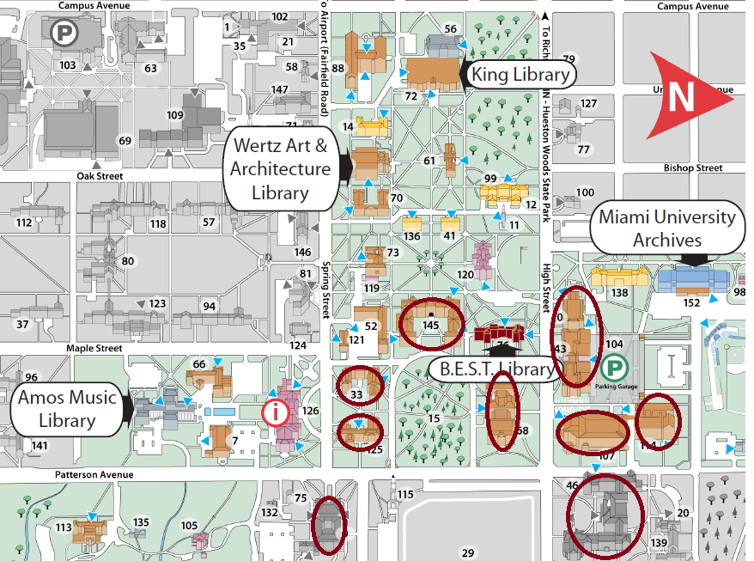
B.E.S.T. Library
Business, Engineering, Science and Technology -- necessarily (ahem) in that order
Opened in August 2011, replacing Brill Science Library and adding Psychology Dept and School of Business as clientele

Slide 3
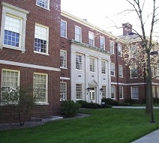
“Oh, a New Library…Woe is Us”
Project planning commenced in 2008, project re-scaled/re-budgeted in 2009
Overall space allotment about 2/3 space of Brill, while adding 2 major print collection areas/user groups
  Building systems footprint increased
  Stack space limitations
Basement and 1st Floor gutted and renovated
  library also occupies part of 2nd floor
  promise of a Phase 2 renovation and restoration of original sq ft allotment in 5-7 yrs
Opened August 2011

Slide 4
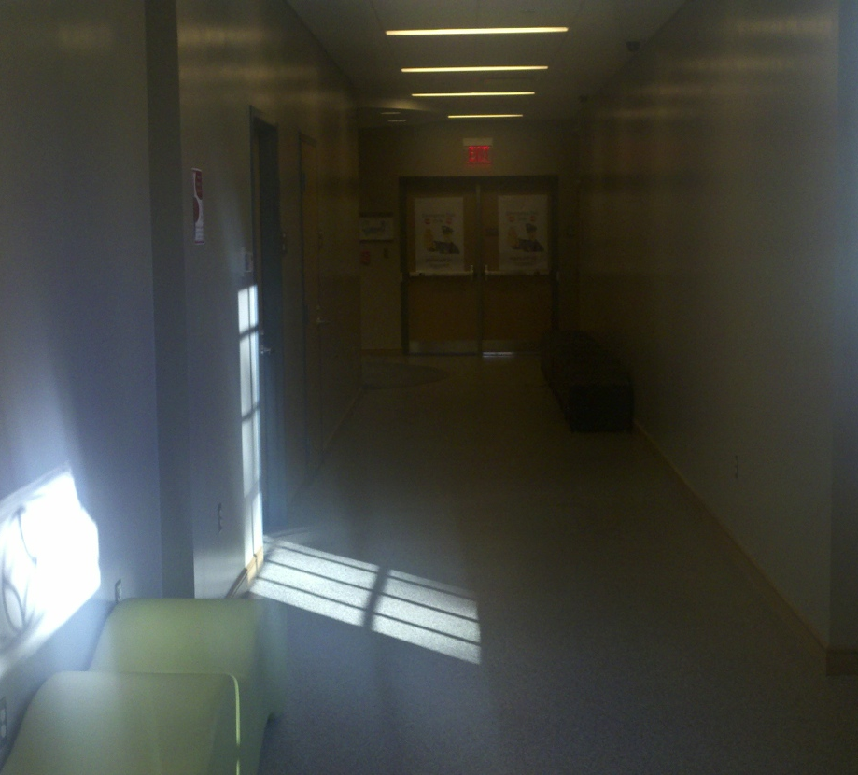
Making the Space Work
Concerns with space include:
“Swing space” on 2nd floor
Snake-like building shape, long corridors not conducive to stacks, “open space” design; fire egress limits usable space
Building access issues --Good neighbors, but poor fences

Slide 5
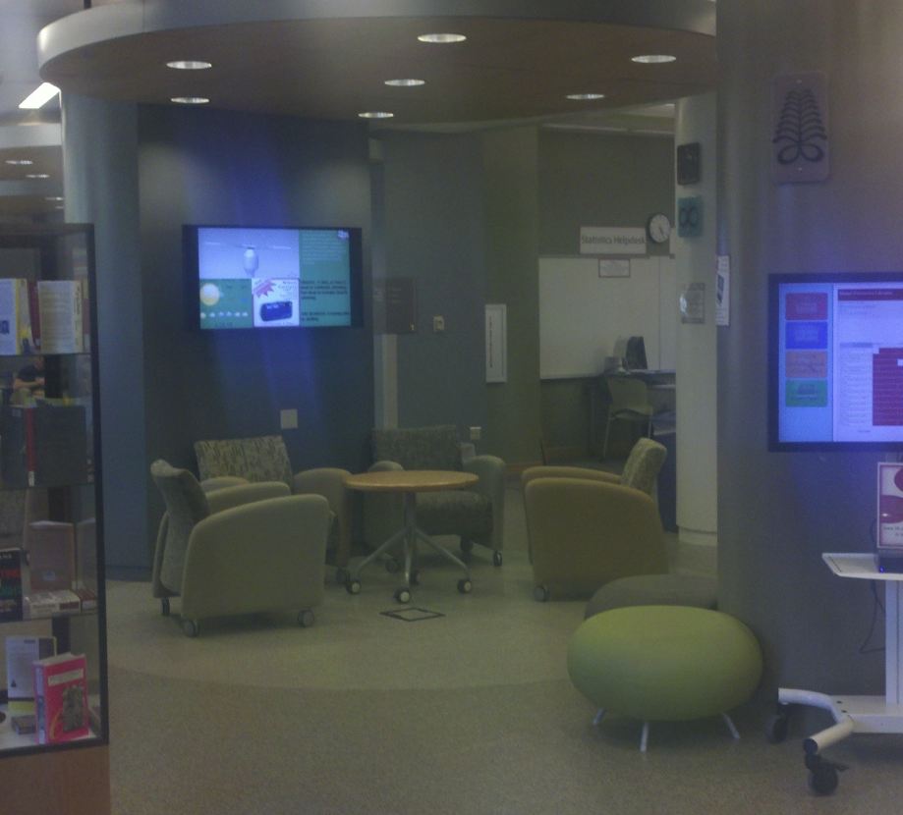
Motivation for Study
Prepare argument for retention of swing space, “Phase 2”, upkeep and enhancement of current space and furnishings
  Student Center construction
Evidence Basis: Demonstration of use patterns and needs, vs. opinion/perception/assertion

Slide 6
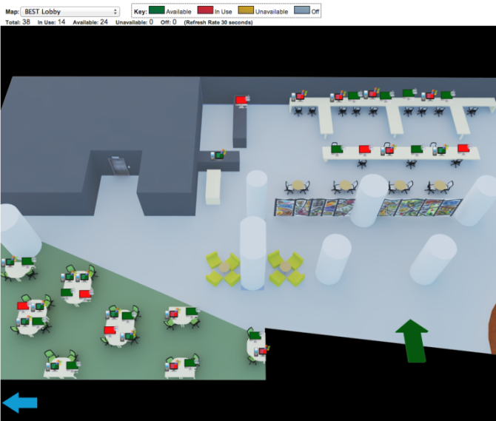
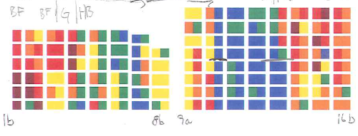
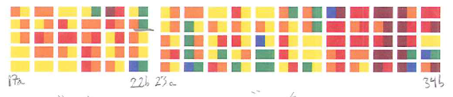
Space Data Visualization in Libraries
Real-time public computer availability
B.E.S.T. Stacks Management

Slide 7
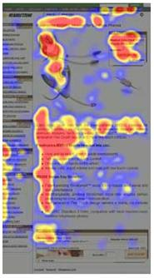
The Precedent: Space Use Study in Brill Library
Conducted 2007-08
Functionalized methodology, learned from mistakes
  no personal/identifiable data involved
  use “counts” using map of space
    2x day sampling → overkill
  “grid” data, transcribe onto spreadsheet for analysis
    1/8” grid → overkill
  “heat maps” as primary analysis tool
  futility of assessment during first year at B.E.S.T.
    (too much flux in furnishings)

Slide 8
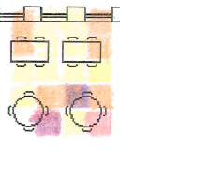
Round vs Square Tables

Slide 9
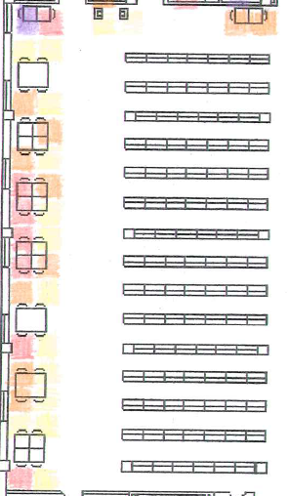
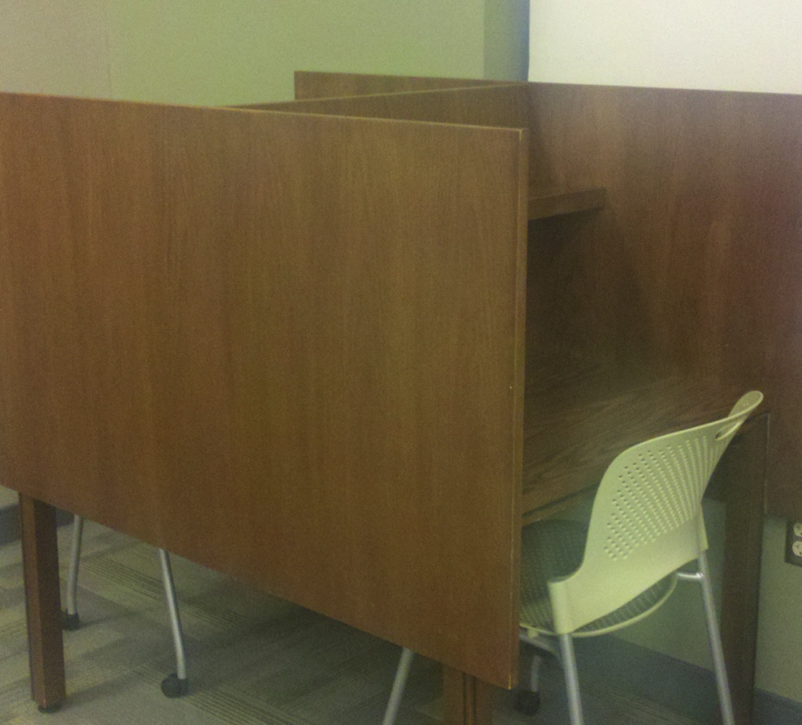
“Walled” Study Carrels

Slide 10
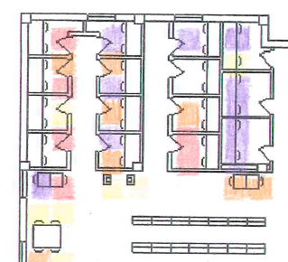
“Monk Cell” 1-2 Person Study Rooms

Slide 11
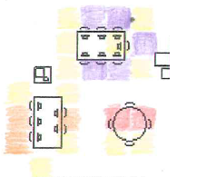
PCs vs Macs

Slide 12
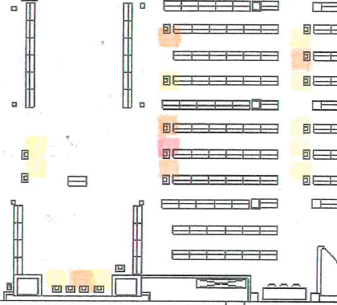
“Edge Effect” near Stacks
yellow – 0.2-0.5% of total use
orange – 0.5-1.0%
red – 1.0-1.5%
Purple – 1.5+%

Slide 13
Diurnal Cycle of 2nd v 3rd v 4th Floor Use
Floor Afternoon Evening
2nd (main) 66% (464) 35% (227)
3rd 26% (186) 38% (247)
4th 8% (55) 27% (179)*
Total 705 653
Over a one-month period, M-F

Slide 14
Specific goals and questions for the study
Estimate of overall use level (weakness of gate count data)
Temporal use patterns: matching operations hours to demand, is closing some sections/floors at slow times advisable?
Identify underutilized spaces and furnishings, repurpose as feasible
Identify crowded spaces – what do we need to replicate?
Mac/PC balance; computer lab use and “flexibility”
Are “group” study room seats used more heavily than regular seating? Are they used by groups or individuals? (optimizing study room size)

Slide 15
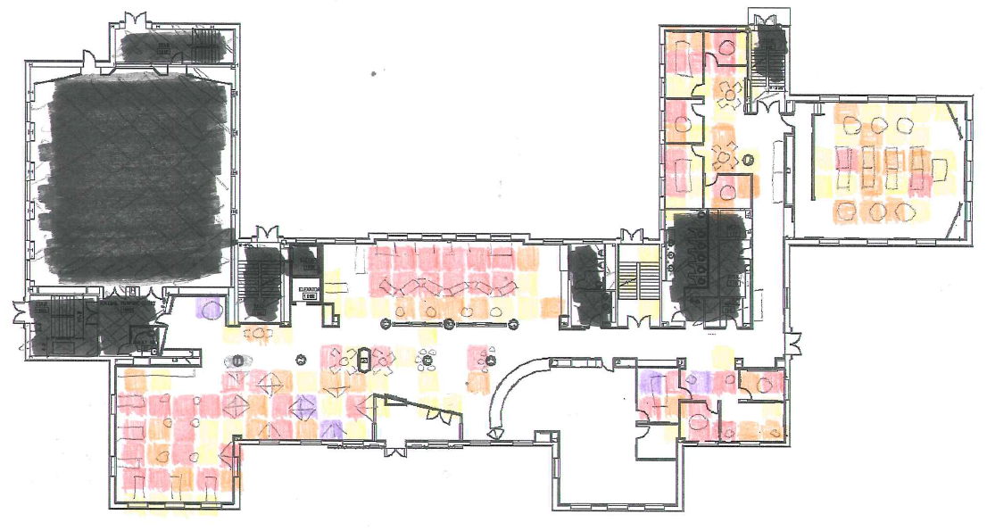
Preliminary Results

Slide 16
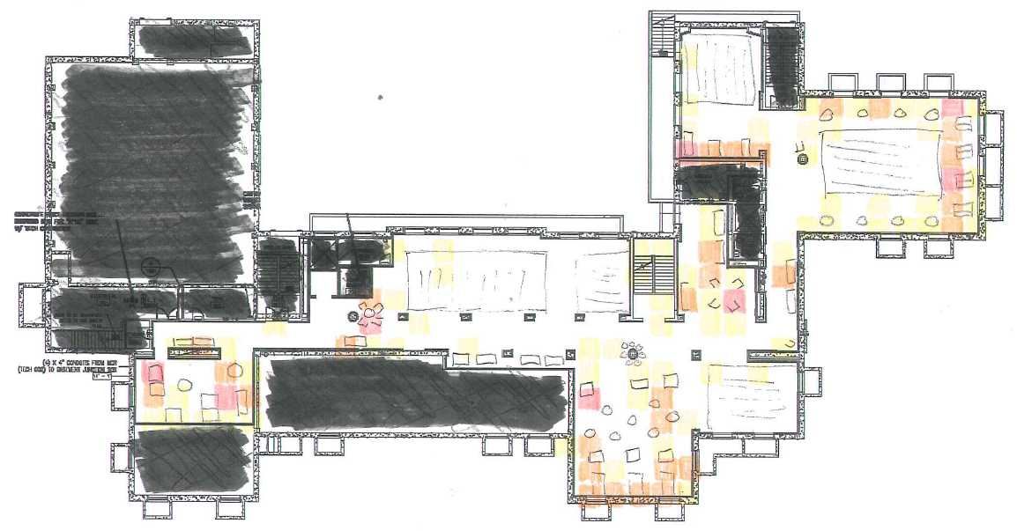
Preliminary Results

Slide 17
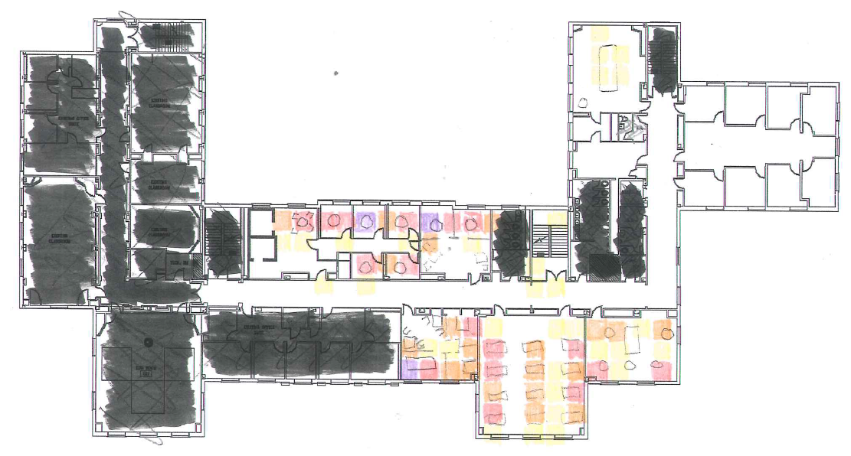
Preliminary Results

Slide 18
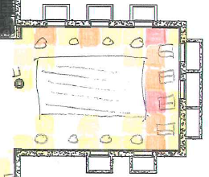
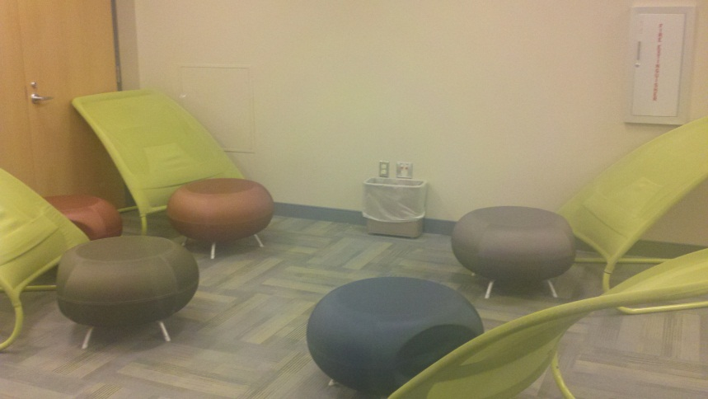
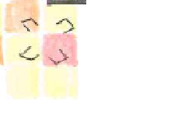
Preliminary Results
Popularity of walled study carrels, “swing chairs”

Slide 19
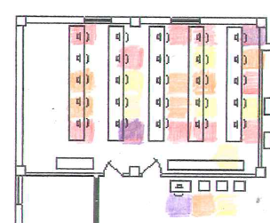
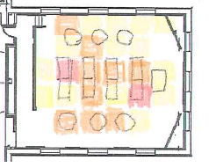
Preliminary Results
Underuse of computer lab and corridors

Slide 20
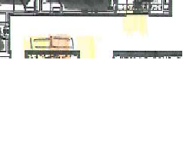
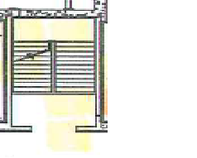
Preliminary Results
Well, some corridors…

Slide 21
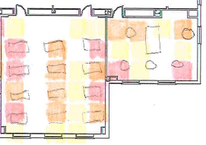
Preliminary Results
Traditional Table Seating vs. Lounge Chair Seating

Slide 22
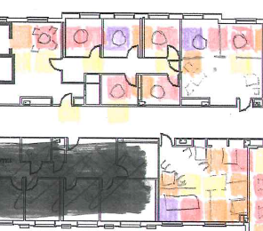
Preliminary Results
Reserved Study Rooms vs Uncontrolled Study Rooms

Slide 23
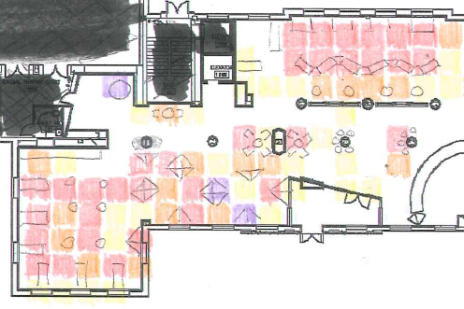
Preliminary Results
PCs vs. Macs…oh

Slide 24
Why these patterns?
Enter the qualitative portion of the study, in planning: spring semester survey of patrons “in situ”, in areas of interest identified through use maps
Target highly used areas (maybe, certain rarely used areas too?) with brief paper survey
Code survey sheets to location!
No demographic info to be recorded, except possibly major area of study

Slide 25

Draft Qualitative Survey
What were your reasons for choosing this particular seat or area today? Choose as many as apply:
I like this kind of chair
I like this kind of table
I like this kind of computer
There was an electric outlet available
I can study with another person or group
Not crowded; elbow room
Quiet/no one else around
There are other people around/I don’t like being alone
This was the first (or only) free spot I saw
I just picked this space randomly
Other __________________________________________________________

Slide 26
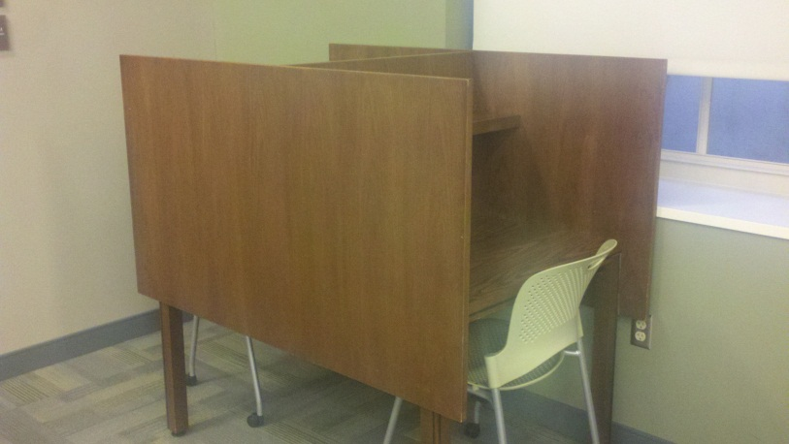
Draft Qualitative Survey
Was this the space you intended/hoped to use when you came here today? If not, what/where did you intend?
How is this space working for you today?
Any other comments about the space
in B.E.S.T. Library?

Slide 27
Speculating Future Directions
PC vs Mac use
Comparison/validation against study room reservation records
  are study rooms “booked up” as heavily as reservations suggest?
  Which are actually used as group and as single-person rooms?
  Are unregulated rooms used as heavily as reservable rooms?
Comparison to other buildings – other libraries, student center spaces (old and new)

Slide 28
Thanks
Mike LaTour
Nicole Berzins and Margaret Steward
Thomas Tully
Jerome Conley

